Slide 1
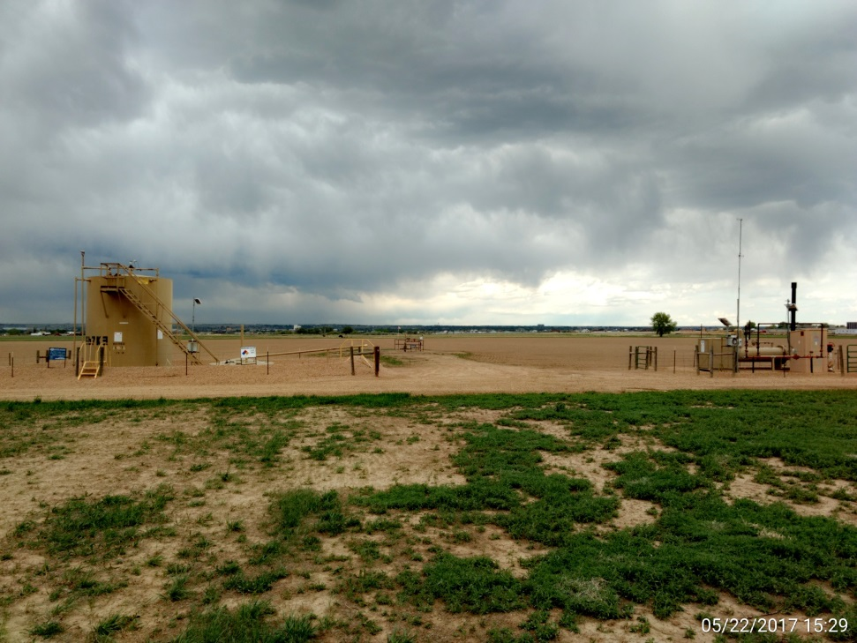
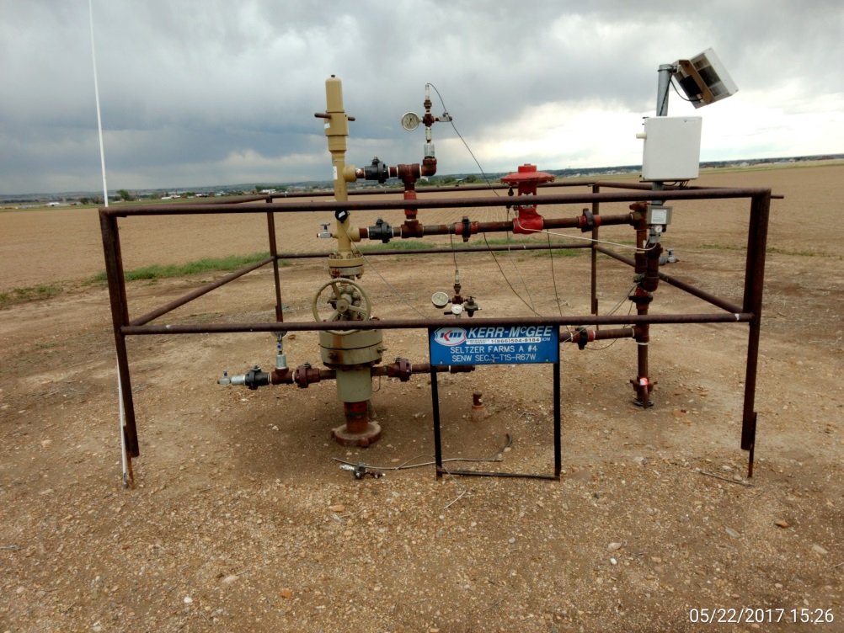
Inspection Photos
Location Name: Seltzer Farms A#4
API: 05-001-08725
Battery/wellhead View
Wellhead view, Note: Capped & marked supply line.

Slide 2

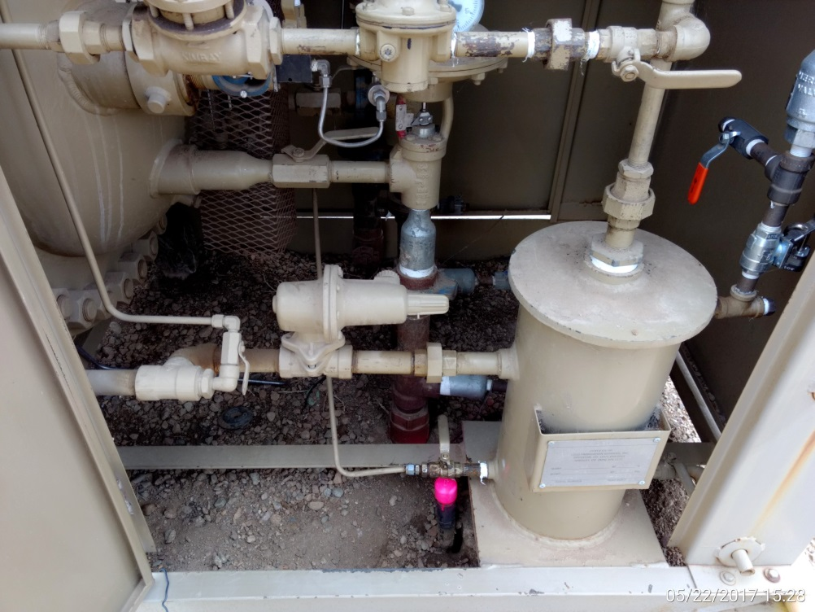
Inspection Photos
Location Name: Seltzer Farms A#4
API: 05-001-08725
Capped & marked supply line next to ground valve on flowline.
Separator cabinet, Note: supply line, capped & marked.

