Slide 1
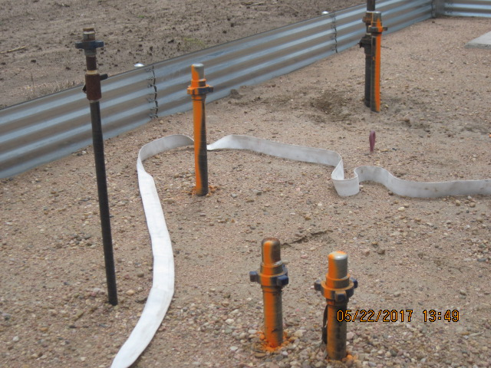
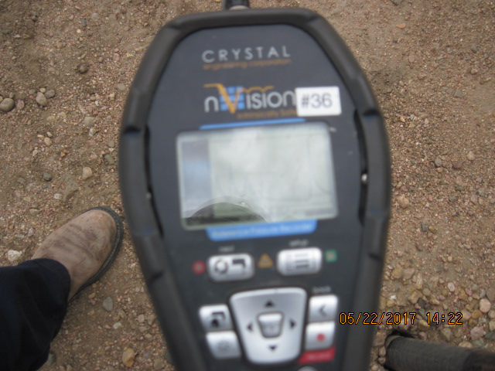
Inspection Photos
Location Name: [Kammerzell 4-12]
API: 02-123-12609
Kammarzell 4-12 OIL DUMP LINE
Kammerzel l4-12 battery 3 orange painted risers

