Slide 1
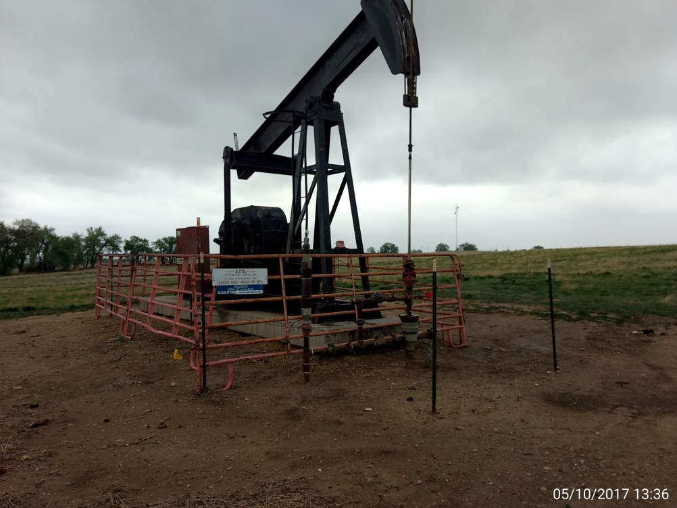
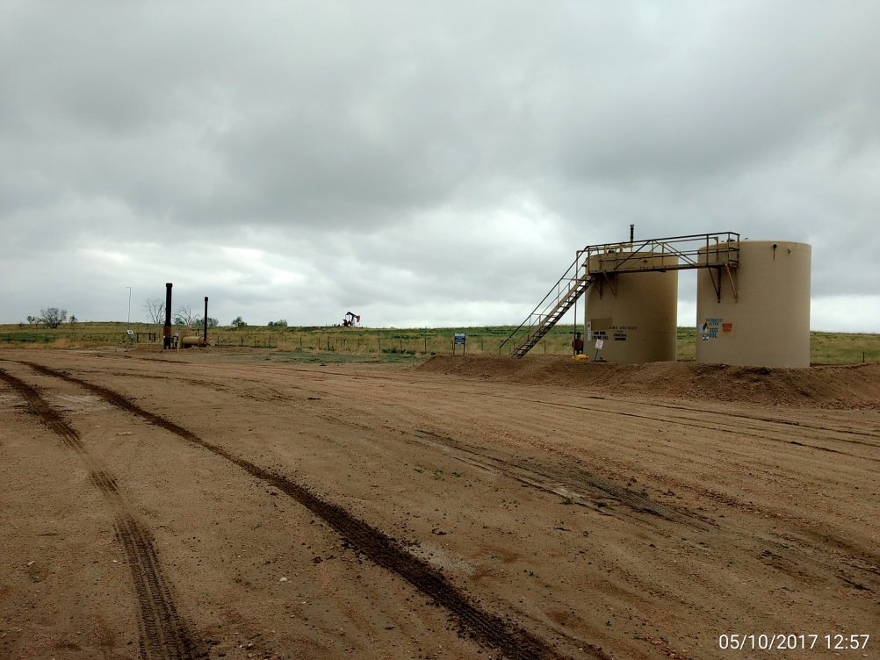
Inspection Photos
Location Name: Zarlengo #4
API: 05-001-08043
Pump jack, wellhead, & prime mover. Corrective actions have been addressed.
Battery View

