Slide 1
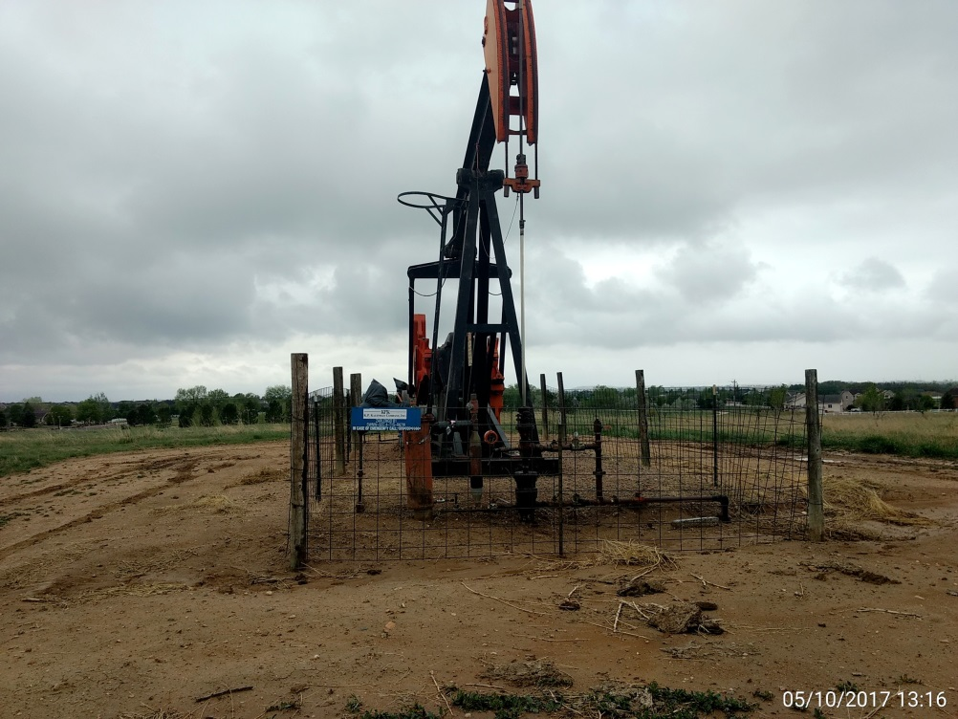
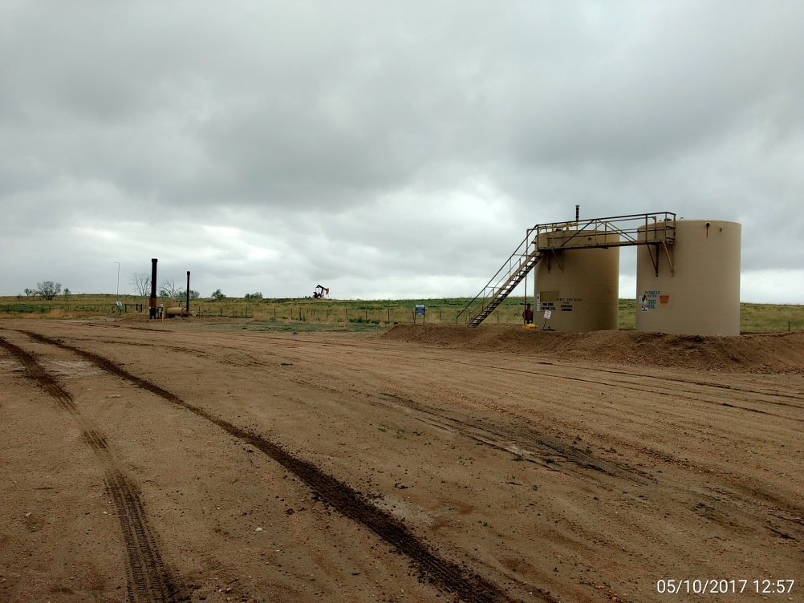
Inspection Photos
Location Name: Zarlengo B1
API: 05-001-09014
Wellhead, prime mover, & pump jack
Battery View

