Slide 1
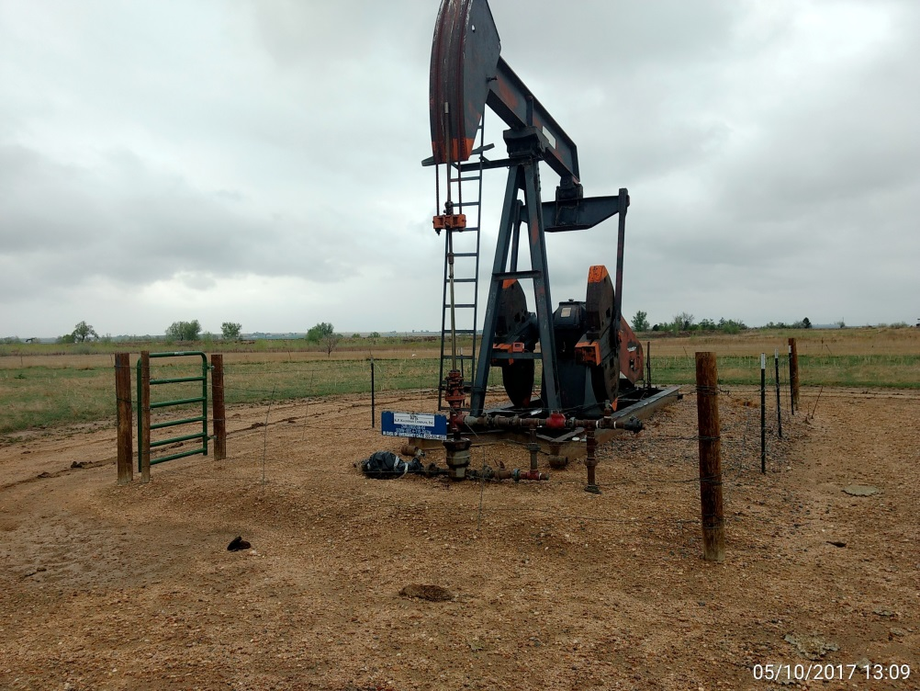
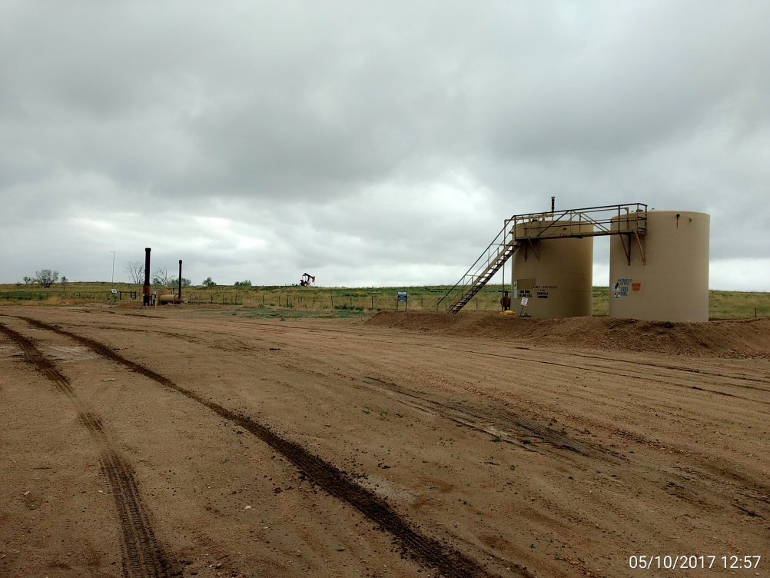
Inspection Photos
Location Name: Zarlengo 6-4
API: 05-001-09737
Wellhead, pump jack, & prime mover
Battery View

