Slide 1
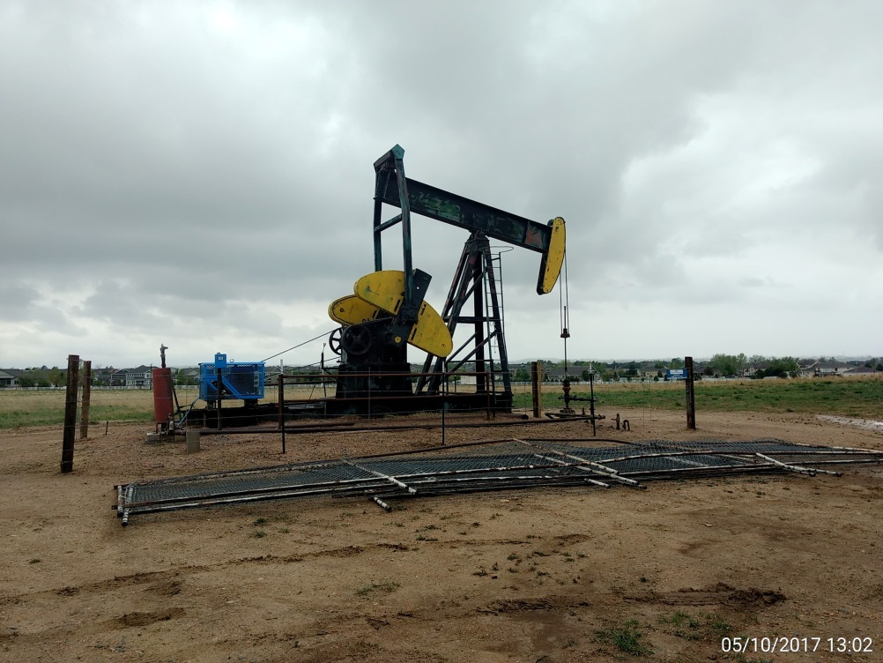
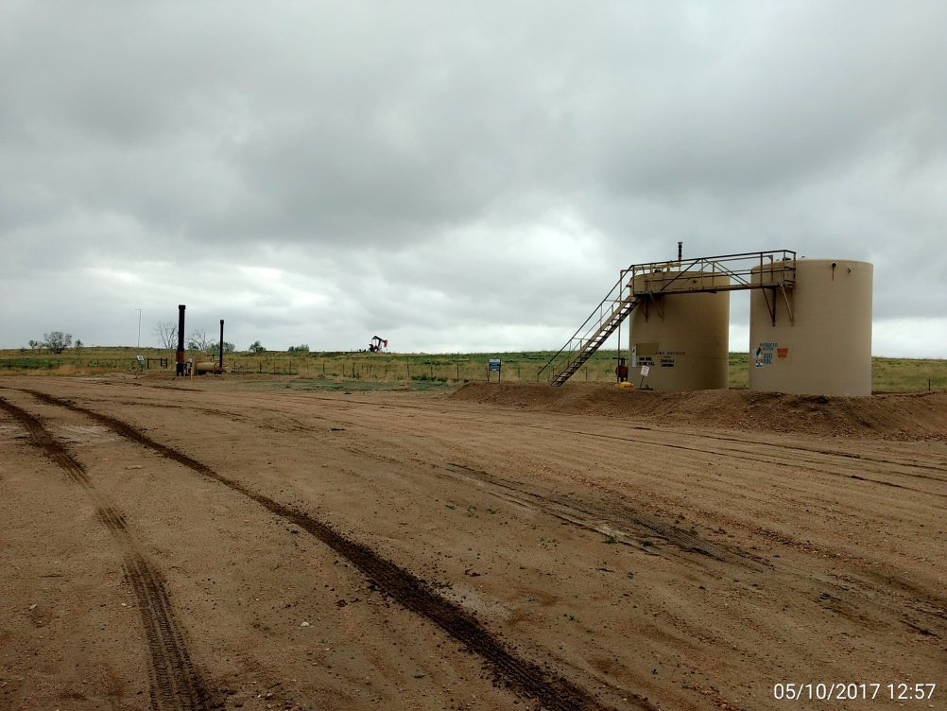
Inspection Photos
Location Name: Zarlengo #2
API: 05-001-07141
Well head, pumping unit, & prime mover
Battery View

