Slide 1
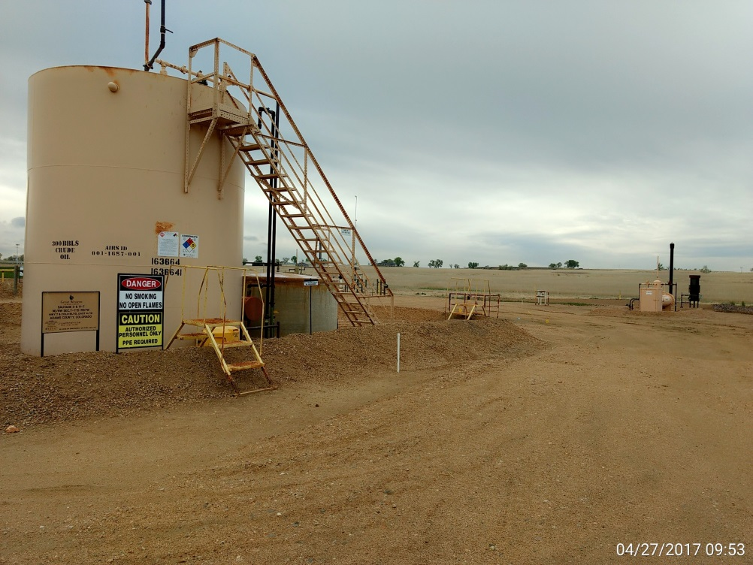
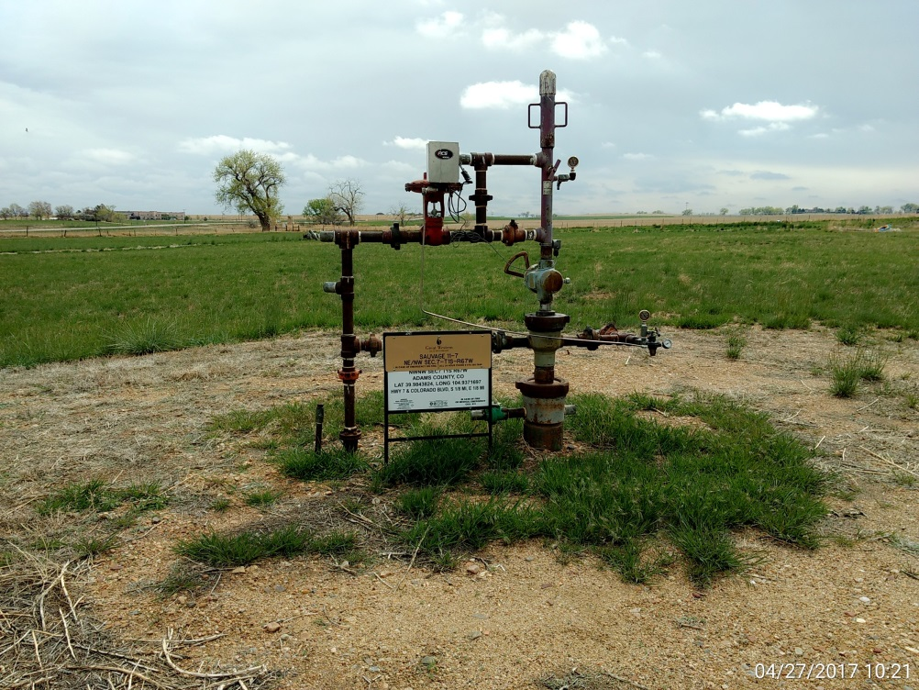
Inspection Photos
Location Name: Sauvage 11-7
API: 05-001-09426
Battery View
Wellhead View

