Slide 1
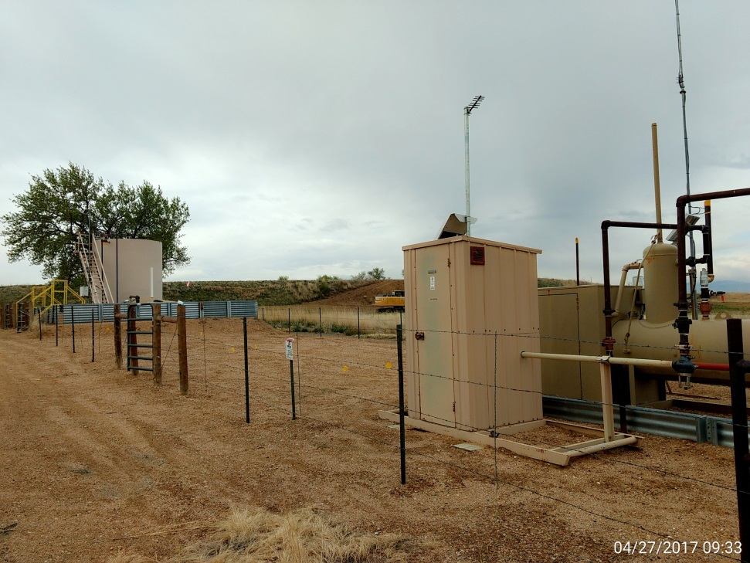
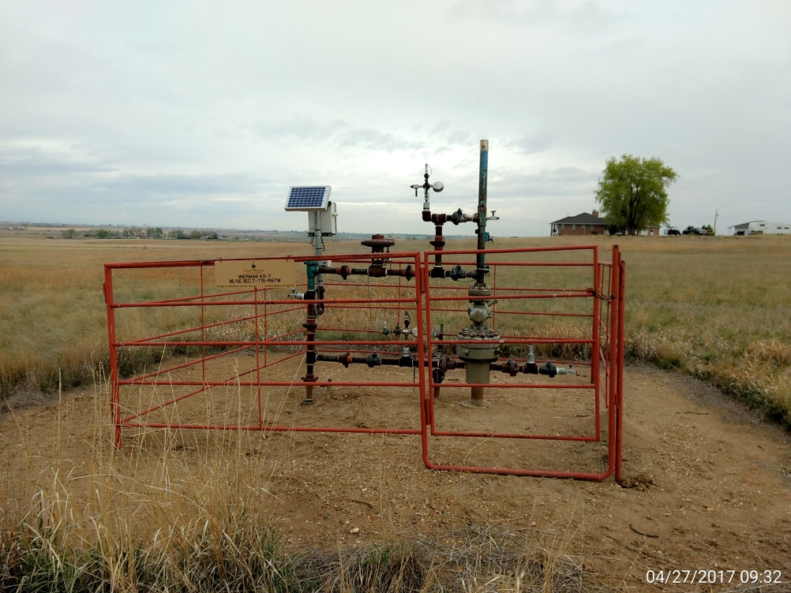
Inspection Photos
Location Name: Weirman 43-7
API: 05-001-09086
Battery View
Wellhead View

