Slide 1
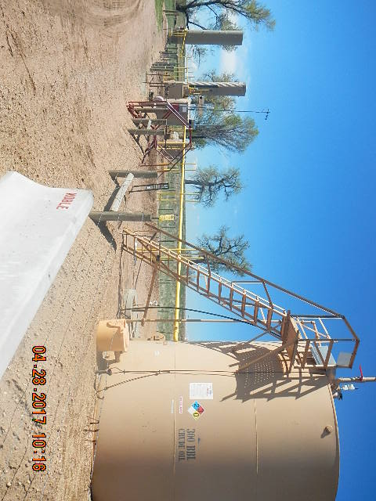
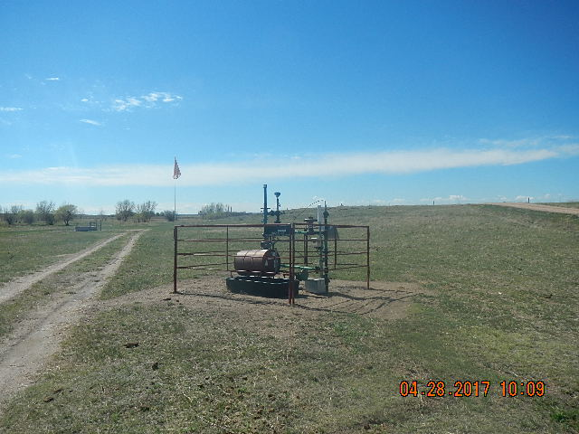
Inspection Photos
Location Name: TREBOR B 12-5
API: 05-123-13776
WELLHEAD TAKEN FROM THE NORTH
TANK BATTERY & EQUIPMENT TAKEN FROM NE

Slide 2
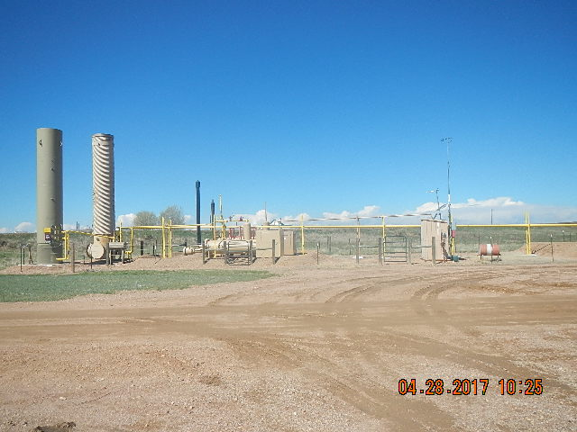
Inspection Photos
Location Name: TREBOR B 12-5
API: 05-123-13776
WELLHEAD TAKEN FROM THE NORTH
SEPERATOR & EQUIPMENT TAKEN FROM NE

