Slide 1
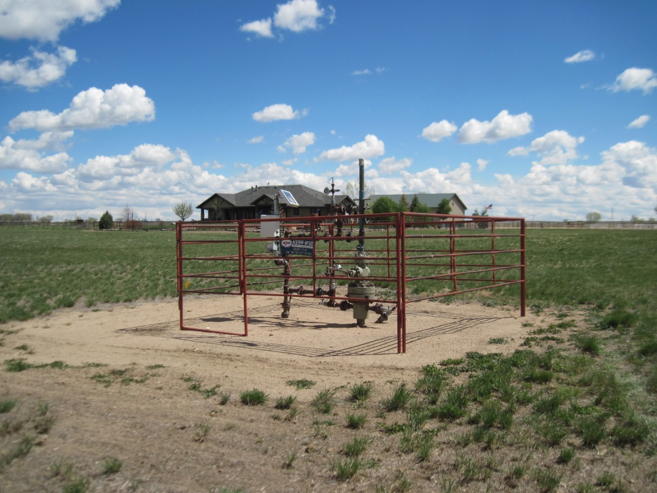
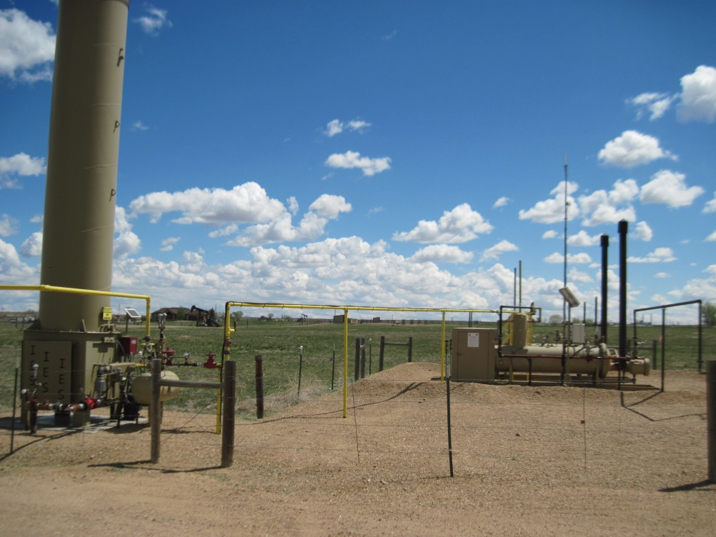
Inspection Photos
Location Name: GRANT 13-9
API: 05-123-21513
WELL HEAD
AT BATTERY

