Slide 1
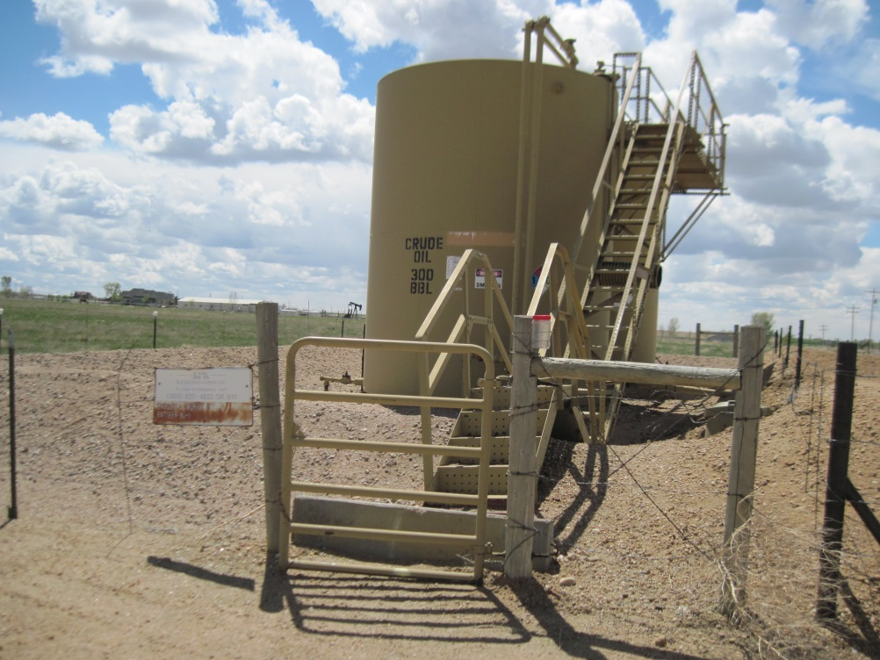
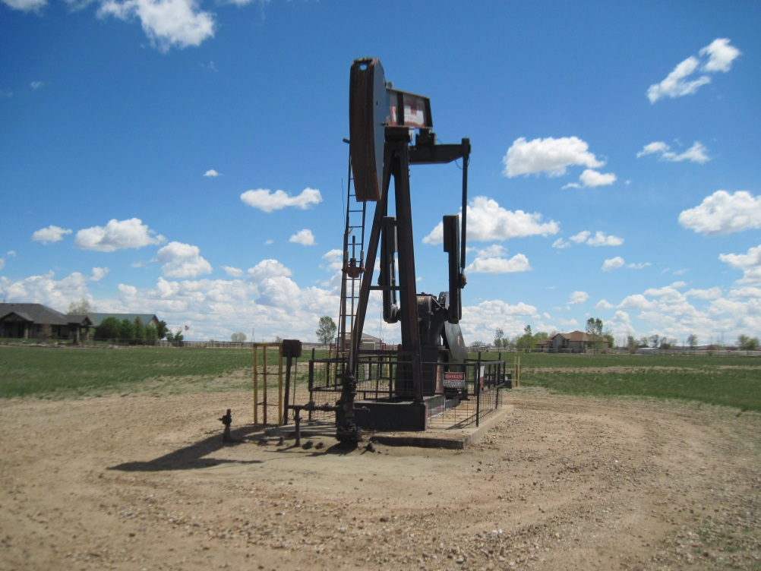
Inspection Photos
Location Name: [NAME]
API: 05-123-#####
TWOMBLY BATTERY
Margaret Twombly B-3 well

