Slide 1
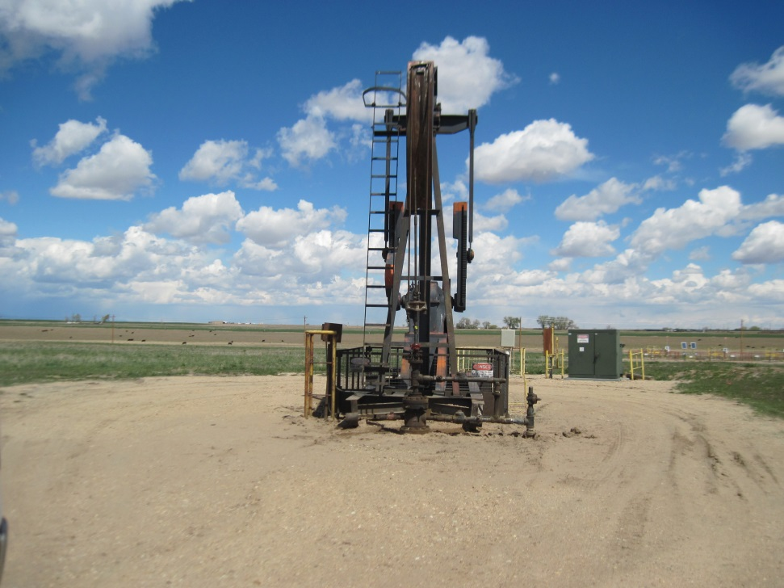
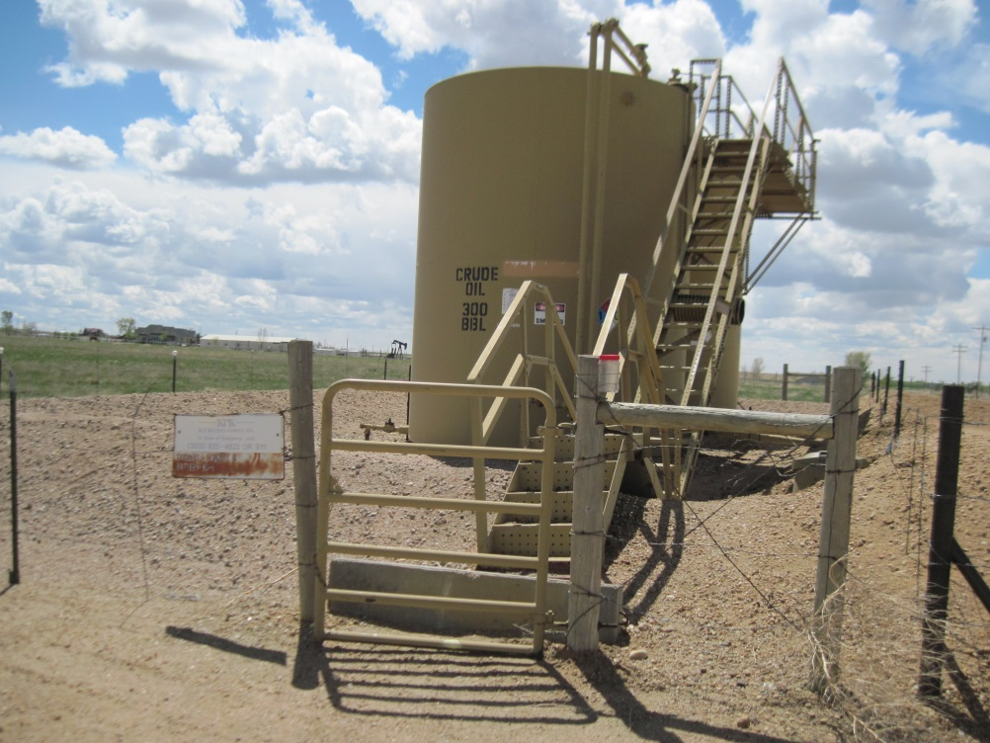
Inspection Photos
Location Name: MARGARET TWOMBLY B-5
API: 05-123-10280
TWOM BLY B-5 WELL
MARGARET TWOMBLY BATTERY

