Slide 1
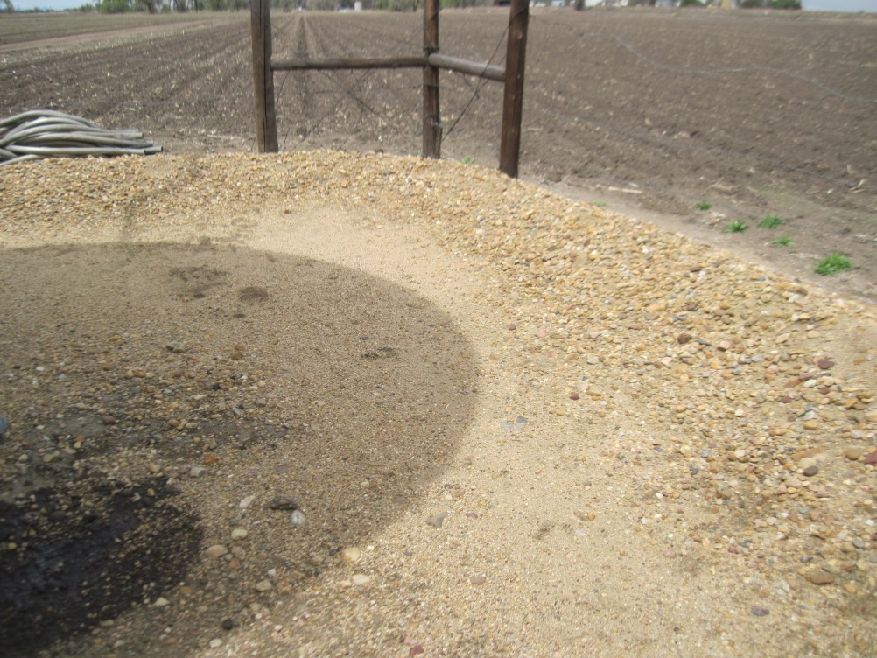
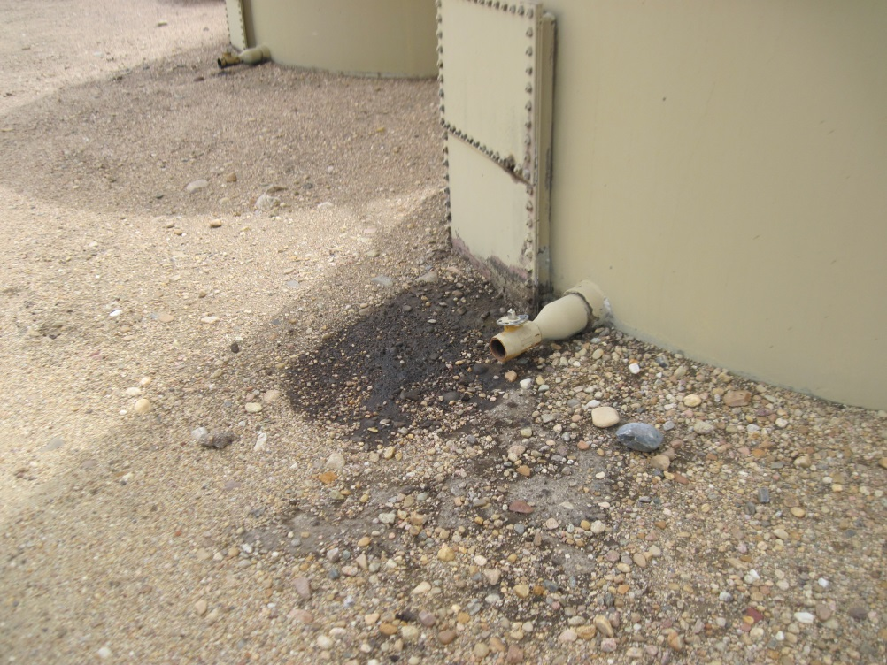
Inspection Photos
Location Name: MALLARD #1
API: 05-123-08644
STAINED SOIL AND BERM NEEDS REPAIRED
STAINED SOIL BY 2” VALVE

Slide 2
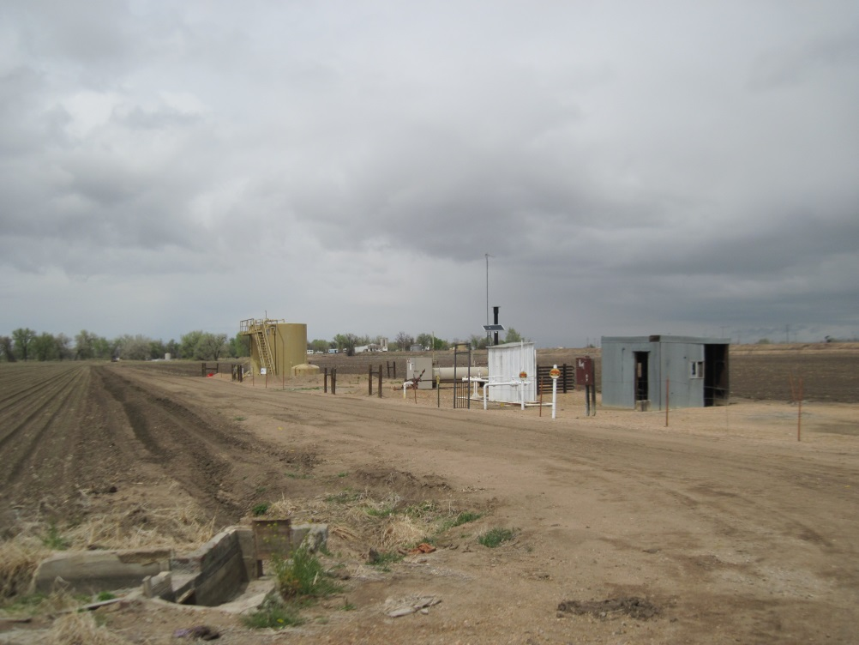
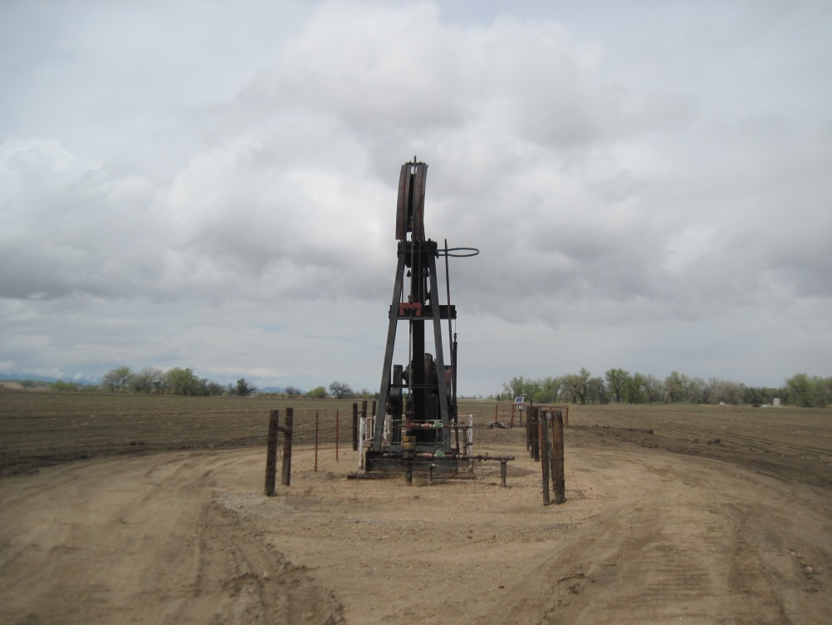
MALLARD #1
BATTERY AND EQUIPMENT
PUMP JACK

