Slide 1
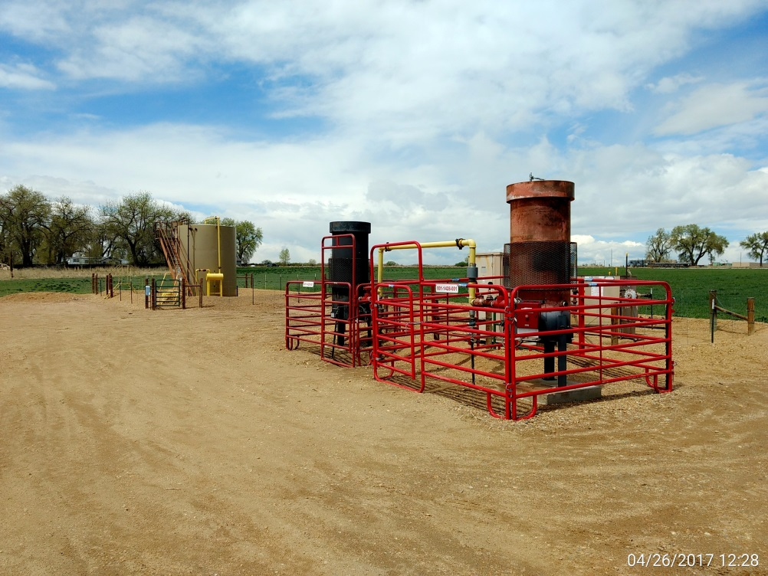
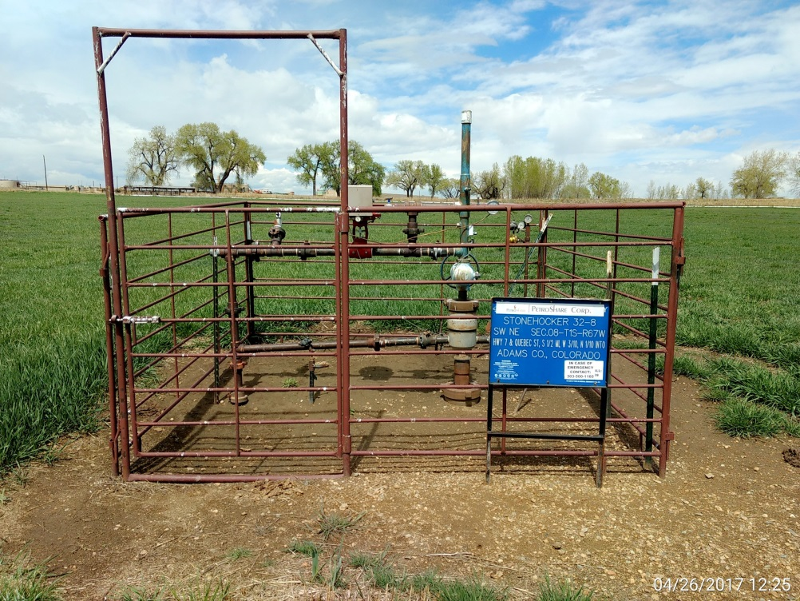
Inspection Photos
Location Name: Stonehocker 32-8
API: 05-001-09387
ECD’s, meter run, separator, & battery view
Wellhead view

