Slide 1
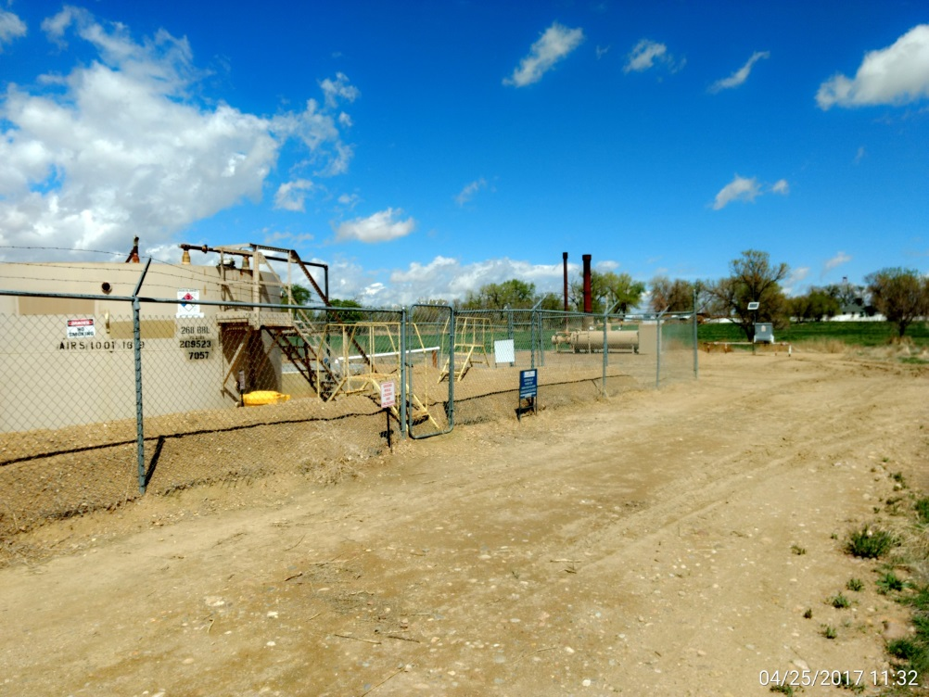
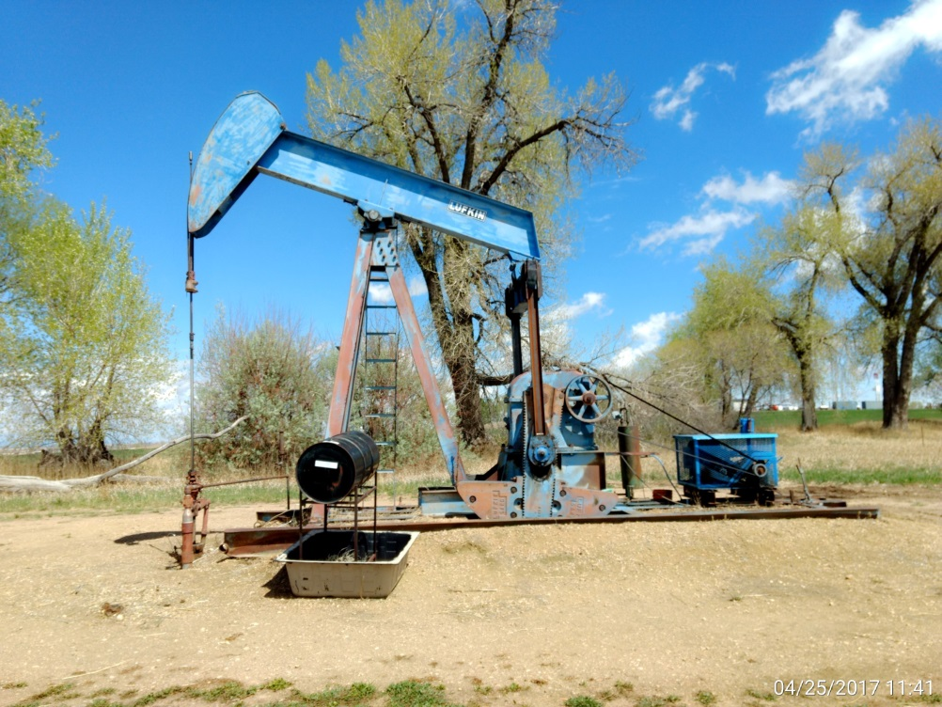
Inspection Photos
Location Name: Edstrom #1
API: 05-001-06889
Battery, separator, ECD, & meter run view
Wellhead, pumping unit, & prime mover view.

