Slide 1
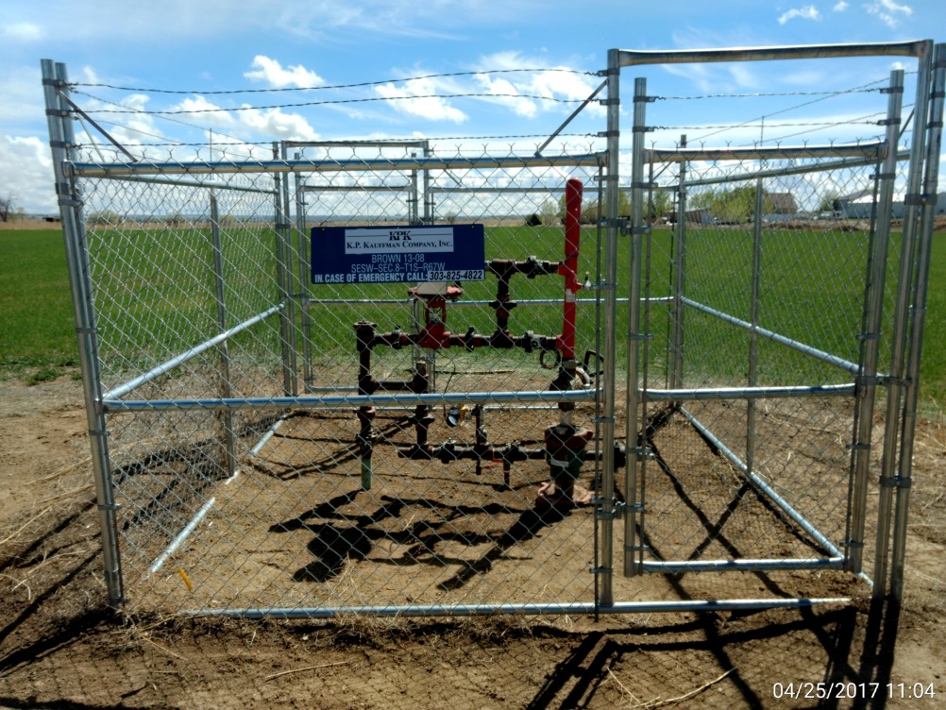
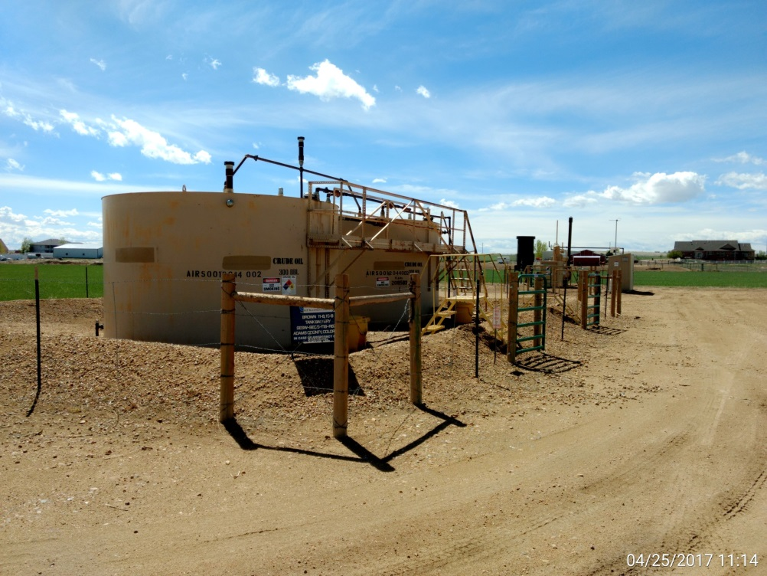
Inspection Photos
Location Name: Brown 13-8
API: 05-001-09739
Wellhead view
Battery, ECD, separator, & meter run

