Slide 1
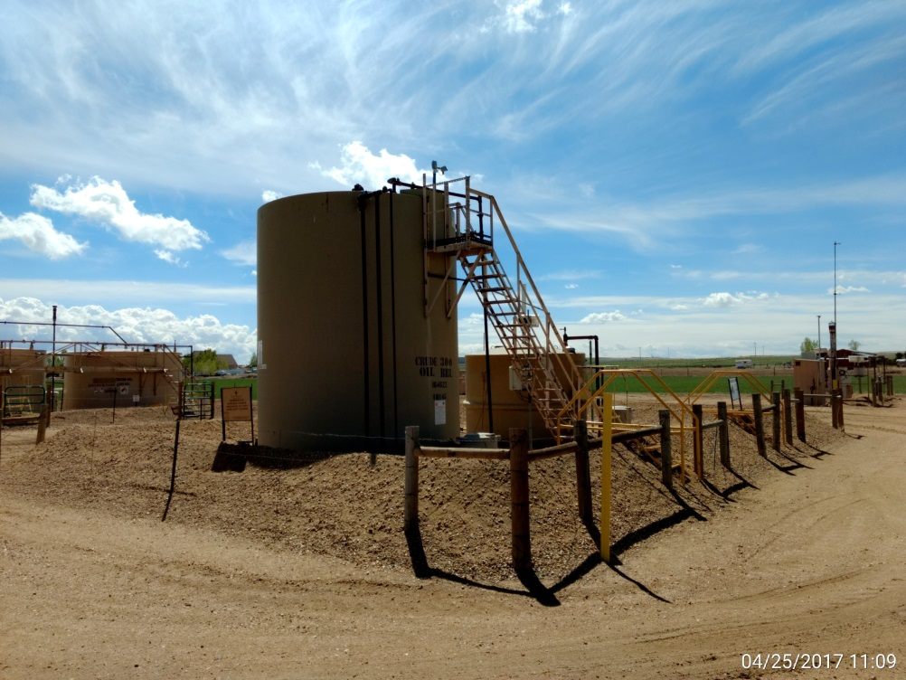
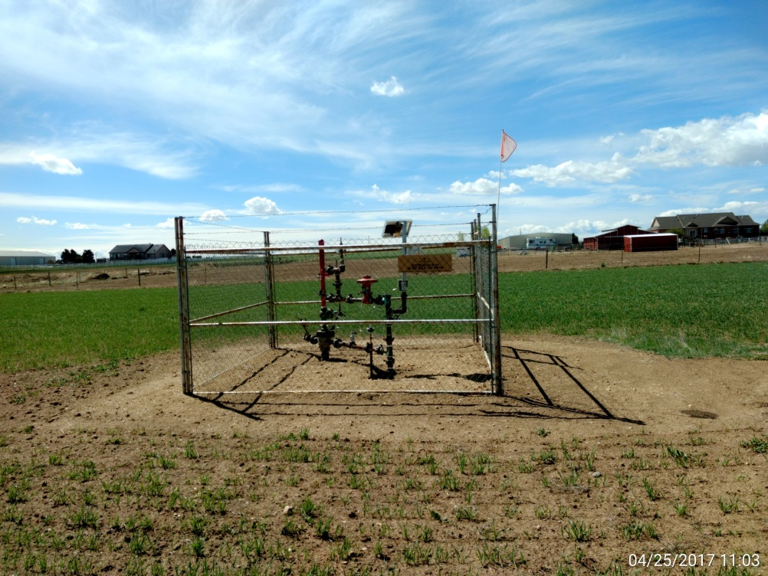
Inspection Photos
Location Name: Edstrom 24-8
API: 05-001-09031
Battery & Separator View
Well Head View

