Slide 1
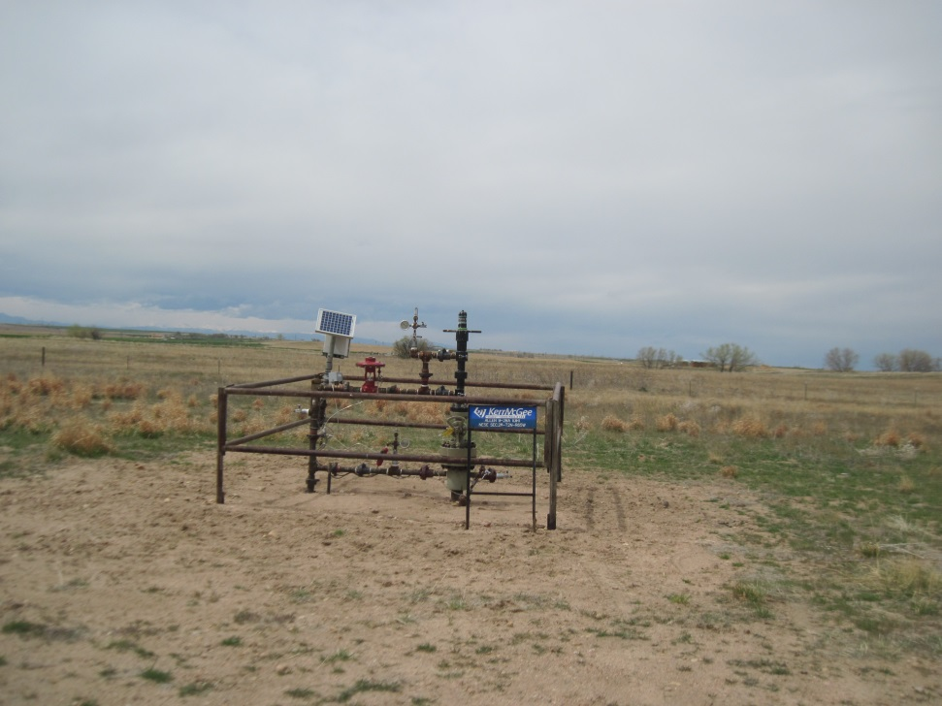
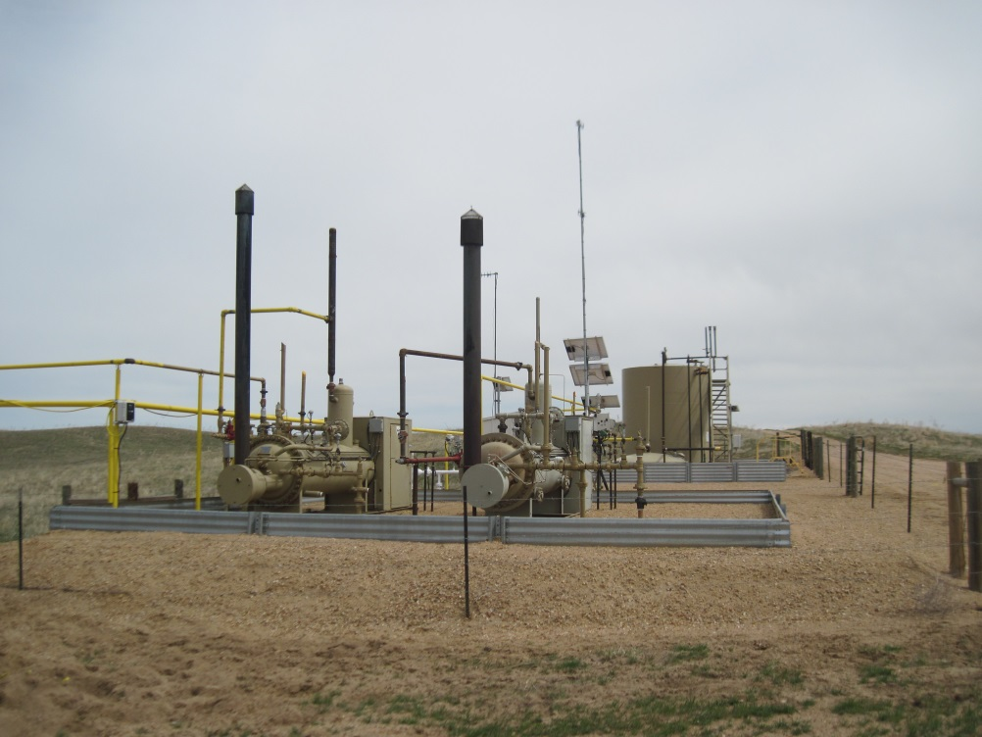
Inspection Photos
Location Name:ALLEN 9-28A
API: 05-123-20991
WELLHEAD
BATTERY AND EQUIPMENT

