Slide 1
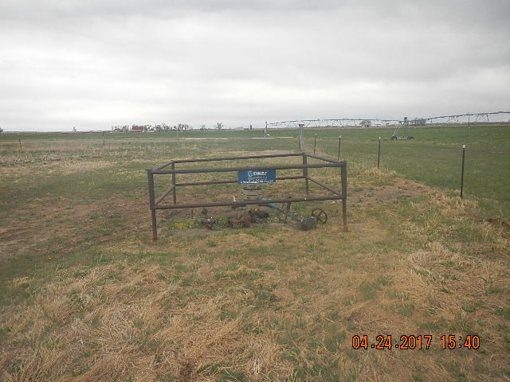
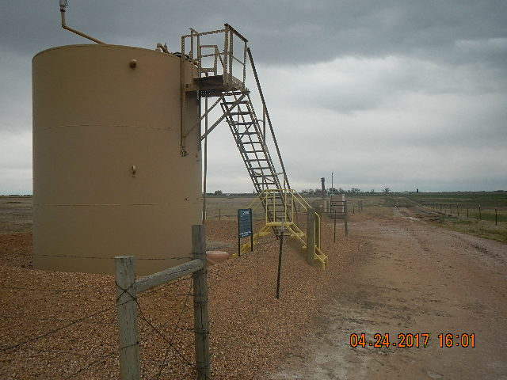
Inspection Photos
Location Name: SCHOENLEBER 16-3
API: 05-123-13324
WELL HEAD TAKEN NORTH OF WELLHEAD
TANK BATTERY AND EQUIPMENT TAKEN NORTH OF LOCATION

