Slide 1
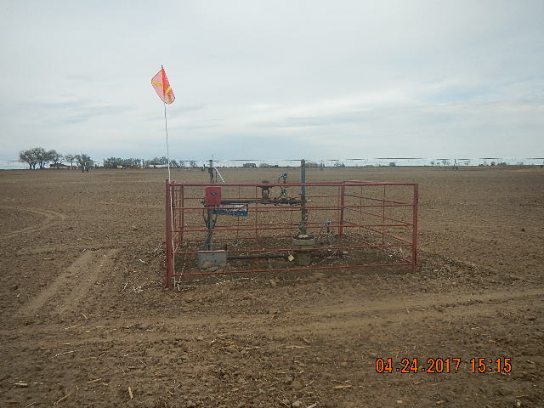
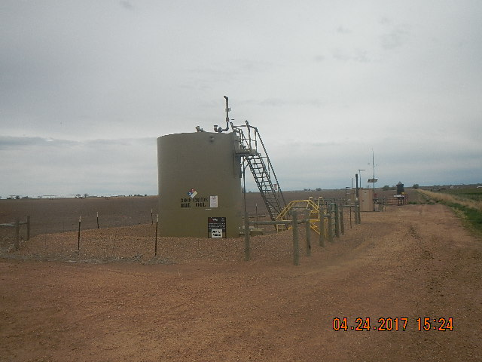
Inspection Photos
Location Name: STOUT-GRANADOS
API: 05-123-13188
WELLHEAD
EQUIPMENT AND TANK BATTERY

