Slide 1
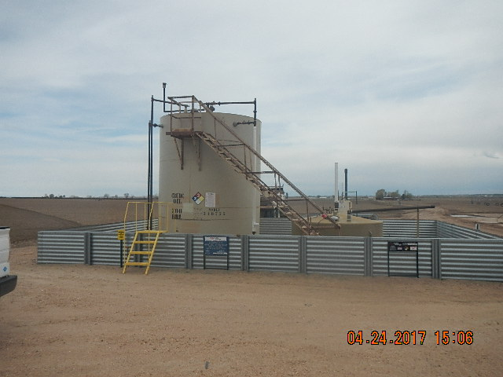
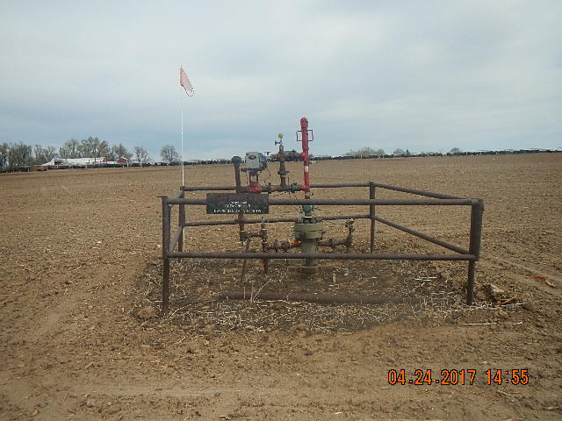
Inspection Photos
Location Name: CLEMONS 2-3
API: 05-123-13026
TANK BATTERY
WELLHEAD

