Slide 1
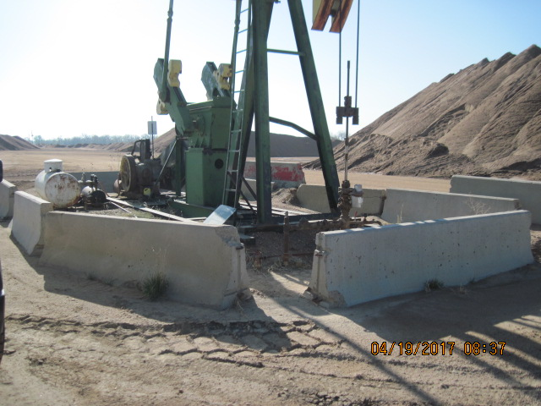
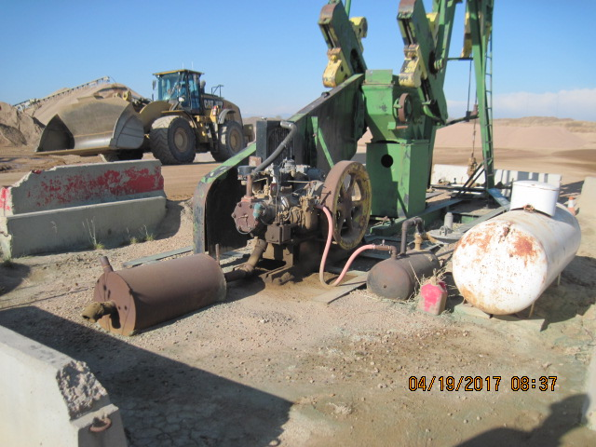
Inspection Photos
Location Name: Di-Ta well and battery
API: 05-123-08487
Pump jack and wellhead
Stained soil mechanical leak

Slide 2
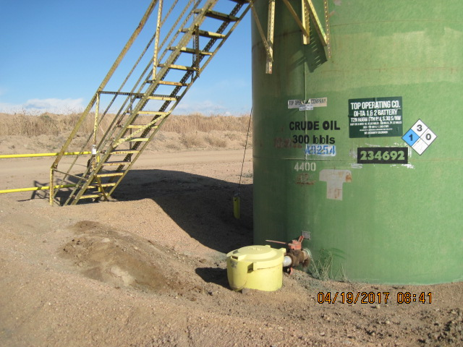
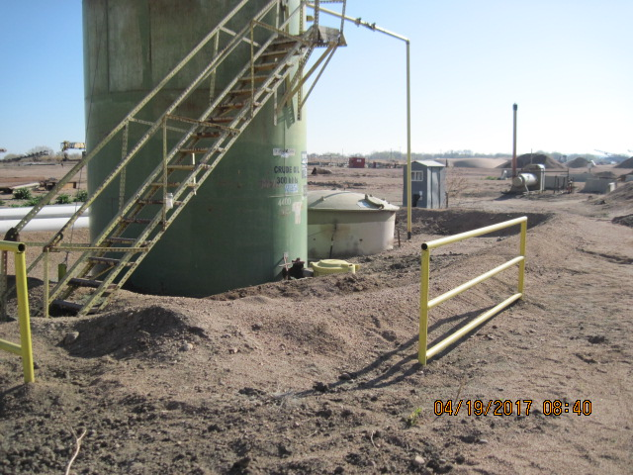
Inspection Photos
Location Name: Di-Ta well and battery
API: 05-123-08487
Stained soil in berm area
Tank Battery

Slide 3
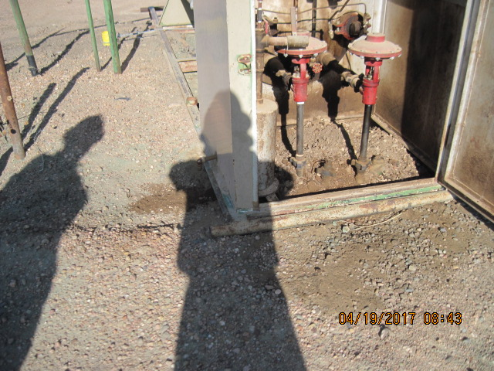
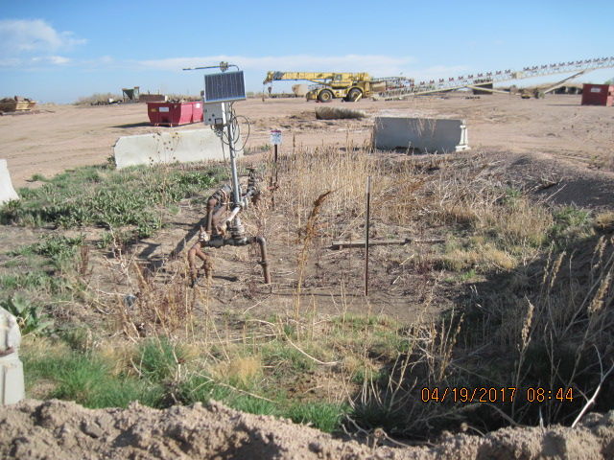
Inspection Photos
Location Name: Di-Ta well and battery
API: 05-123-08487
Stained soil around seperater
Meter run and weeds

Slide 4
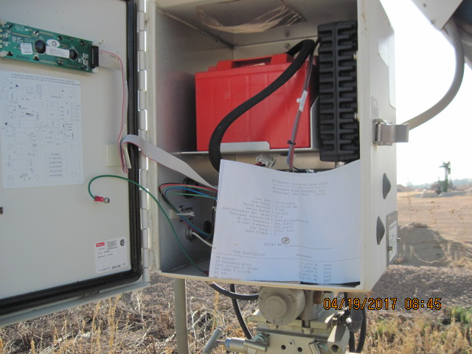
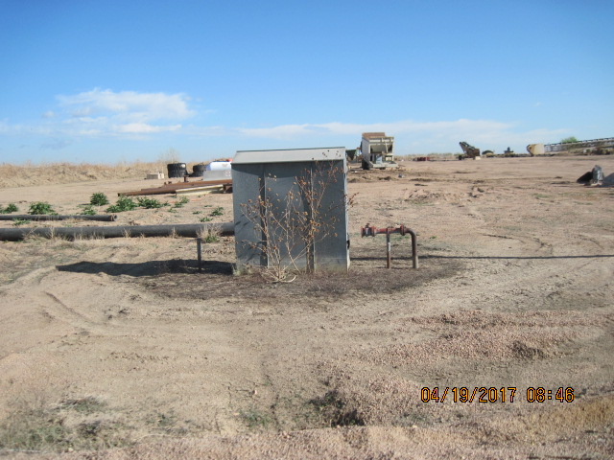
Inspection Photos
Location Name: Di-Ta well and battery
API: 05-123-08487
Meter run and calibration records
Meter run unused equipment and weeds

