Slide 1
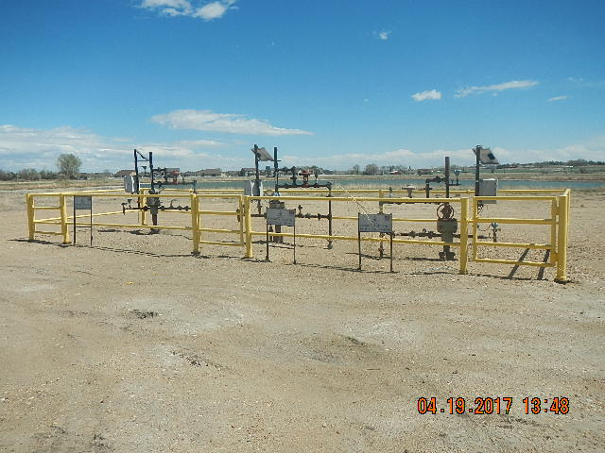
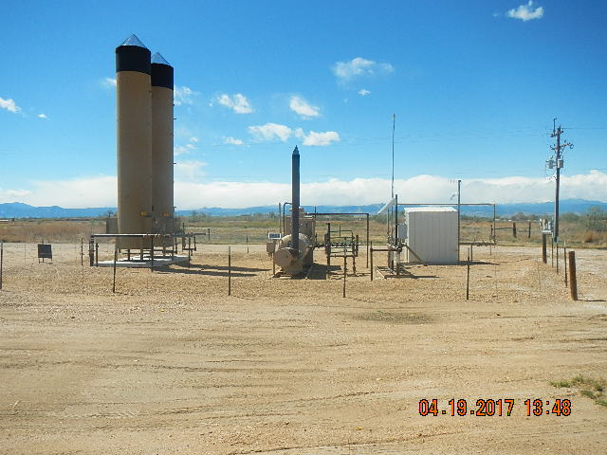
Inspection Photos
Location Name: DUCKWORTH B BATTERY
API: 05-123-#####
WELLHEADS
LOCATION EQUIPMENT ECD-SEPARATOR-METER HOUSE

Slide 2
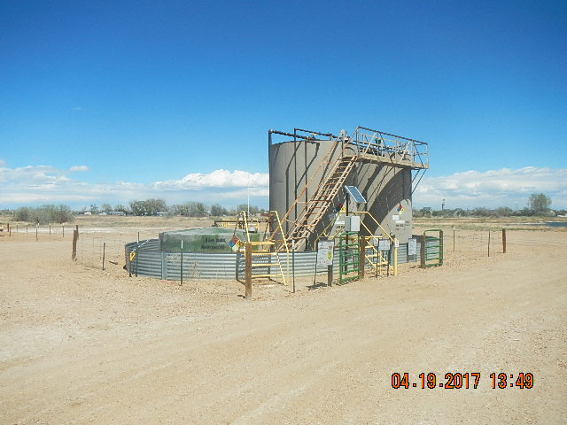
Inspection Photos
Location Name: DUCKWORTH B BATTERY
API: 05-123-#####
WELLHEADS
TANK BATTERY

