Slide 1
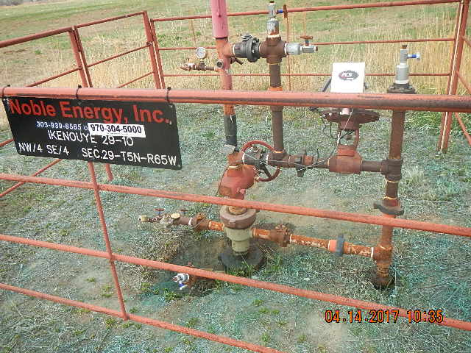
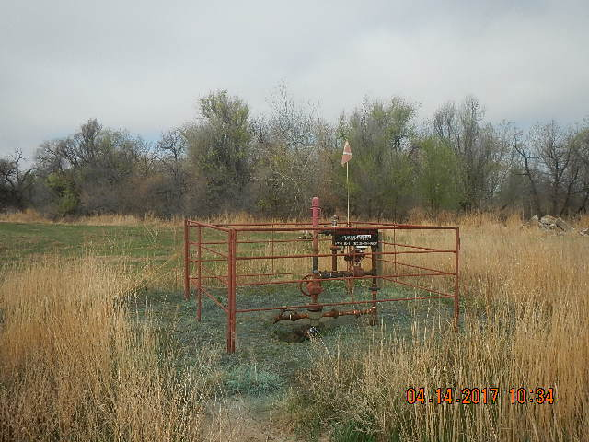
Inspection Photos
Location Name: IKENOUYE 29-10
API: 05-123-17138
IKENOUYE 29-10 STAINED SOIL APPROX 1’X1’ UNDER MASTER VALVE
IKENOUYE 29-10 TAKEN FROM SE OF WELLHEAD

