Slide 1
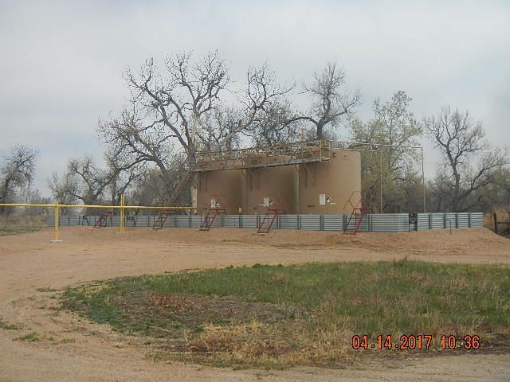
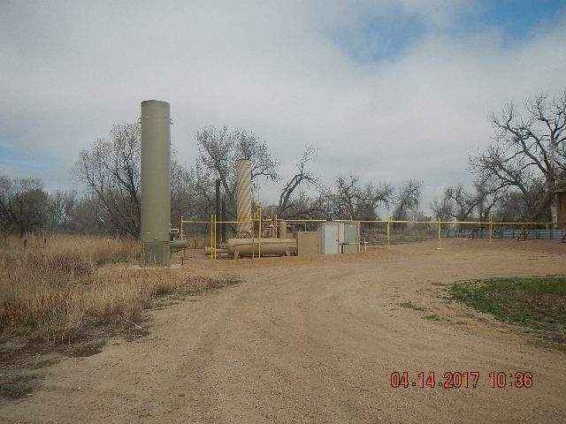
Inspection Photos
Location Name: IKENOUYE BATTERY
API: 05-123-#####
PHOTO TAKEN FROM THE SW OF IKENOUYE TANK BATTERY
IKENOUYE EQUIPMENT PHOTO TAKEN FROM SW

