Slide 1
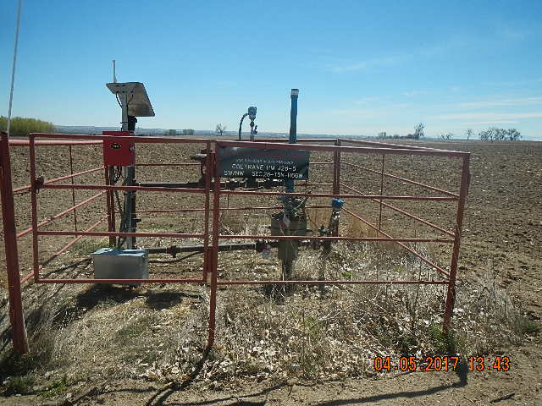
Inspection Photos
Location Name: COLTRANE-PM J28-5
API: 05-123-13989
PHOTO TAKEN FROM THE NORTH FACING SOUTH WEEDS AT WELLHEAD

