Slide 1
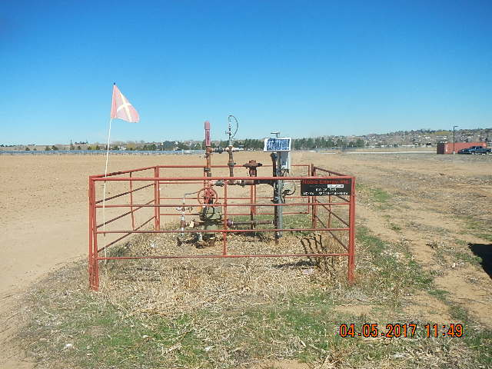
Inspection Photos
Location Name: IGO 28-3H6
API: 05-123-18373
WEEDS AT WELLHEAD PHOTO TAKEN FROM SOUTH FACING NORTH

