Slide 1
Bydalek 1-11
Inspection Photos
Date: 4/4/2017
DOC# 667601566
Adam Kraich
Oil & Gas Inspector, Community & Economic Development Department
ADAMS COUNTY, COLORADO
4430 South Adams County Parkway, W2000A
Brighton, CO 80601
O: 720.523.6886 | akraich@adcogov.org
www.adcogov.org

Slide 2
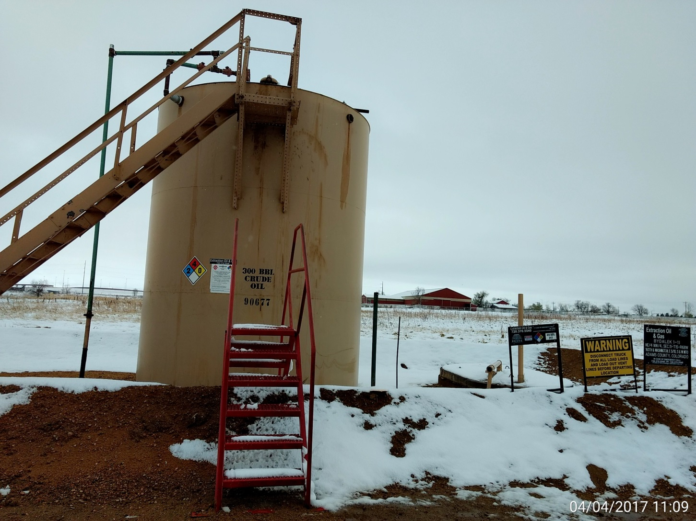
Battery

Slide 3
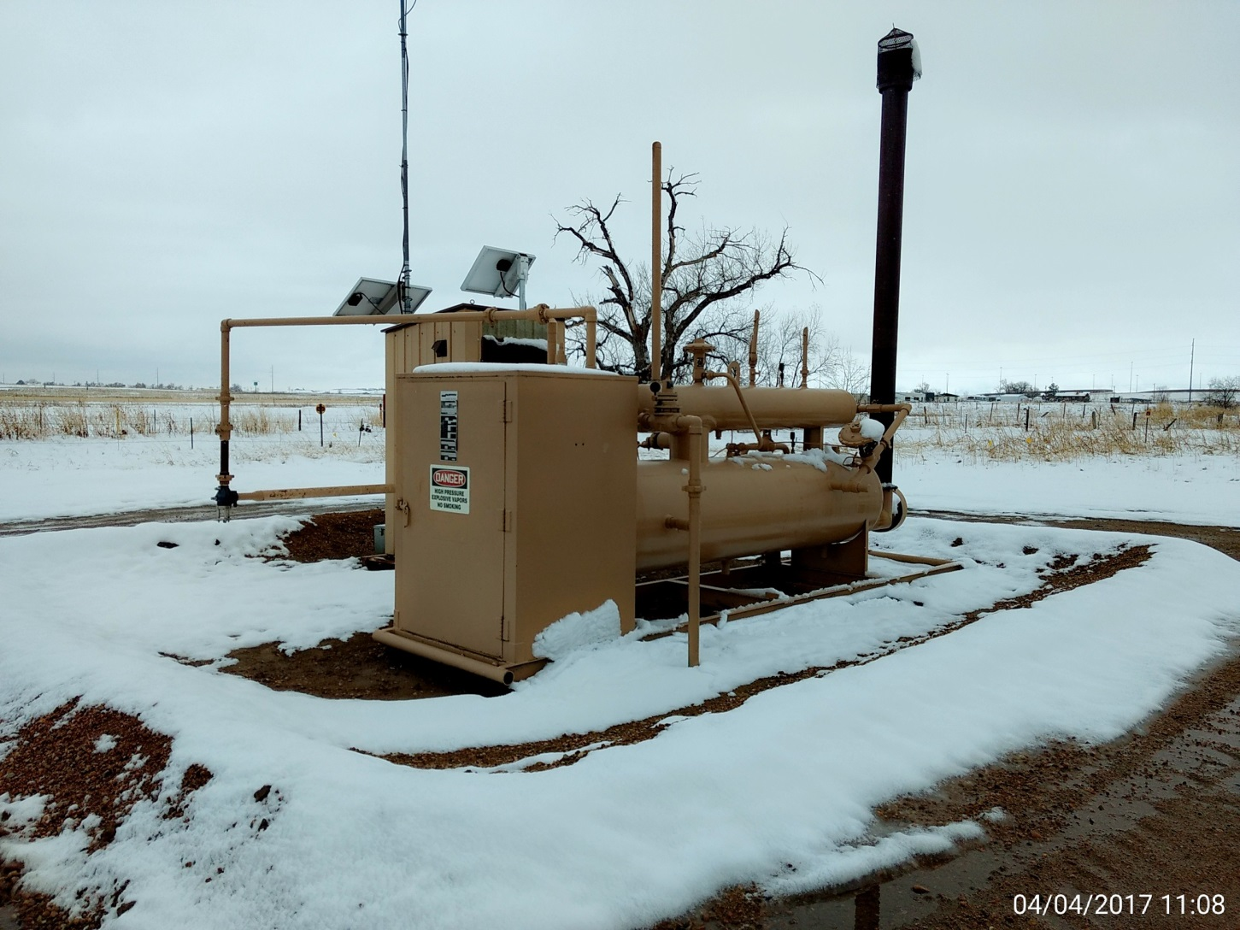
Separator & meter run

Slide 4
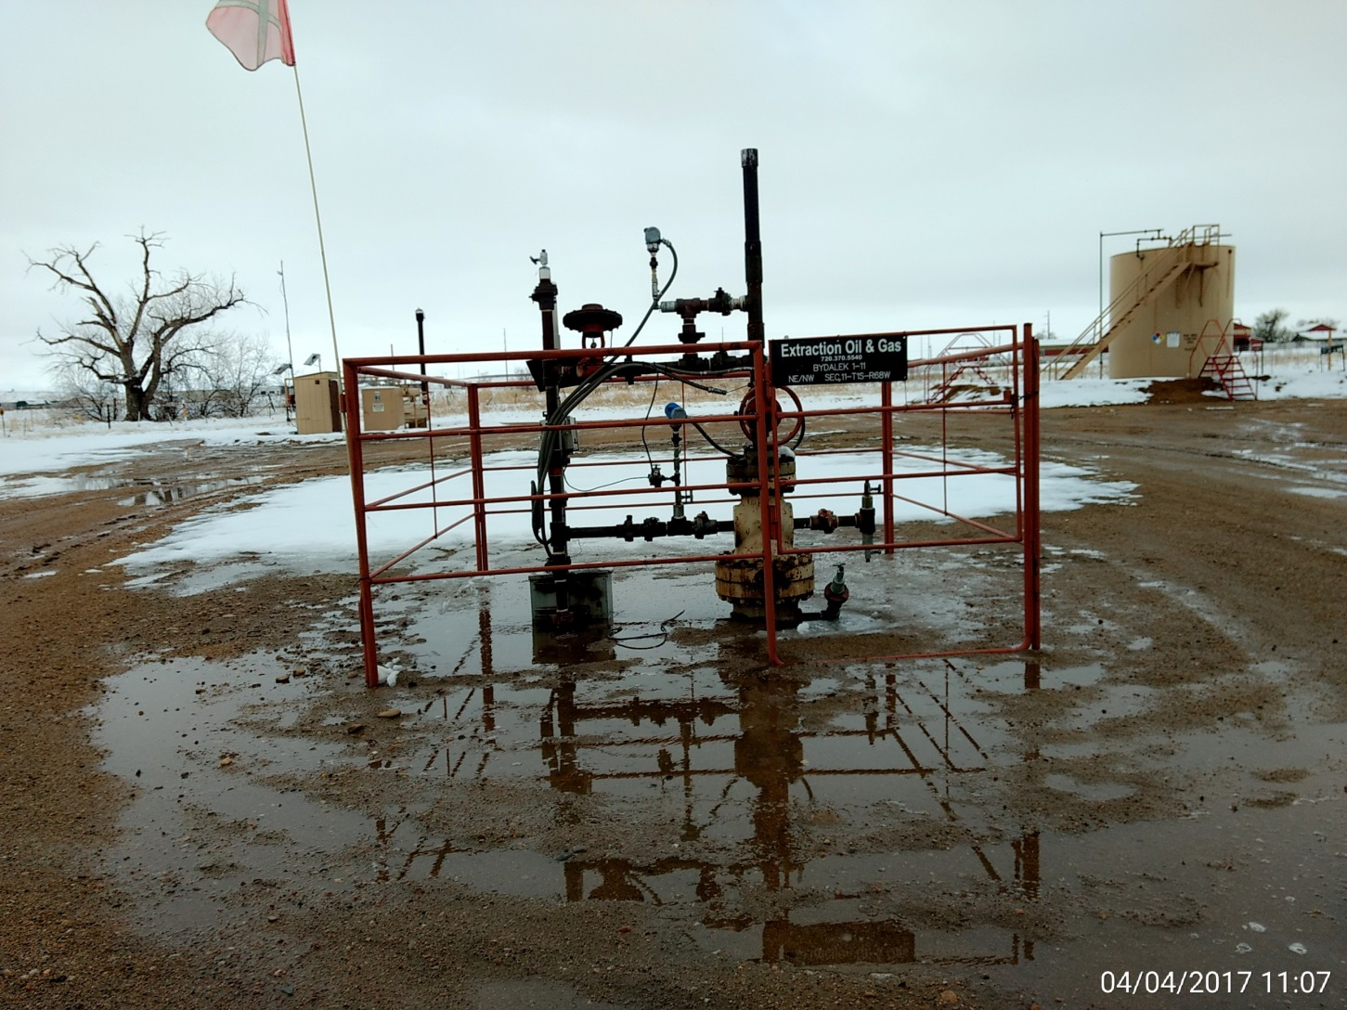
Wellhead

