Slide 1
Schimpf 11-23
Inspection photos
Date: 4/4/2017
Doc# 667601559
Adam Kraich
Oil & Gas Inspector, Community & Economic Development Department
ADAMS COUNTY, COLORADO
4430 South Adams County Parkway, W2000A
Brighton, CO 80601
O: 720.523.6886 | akraich@adcogov.org
www.adcogov.org

Slide 2
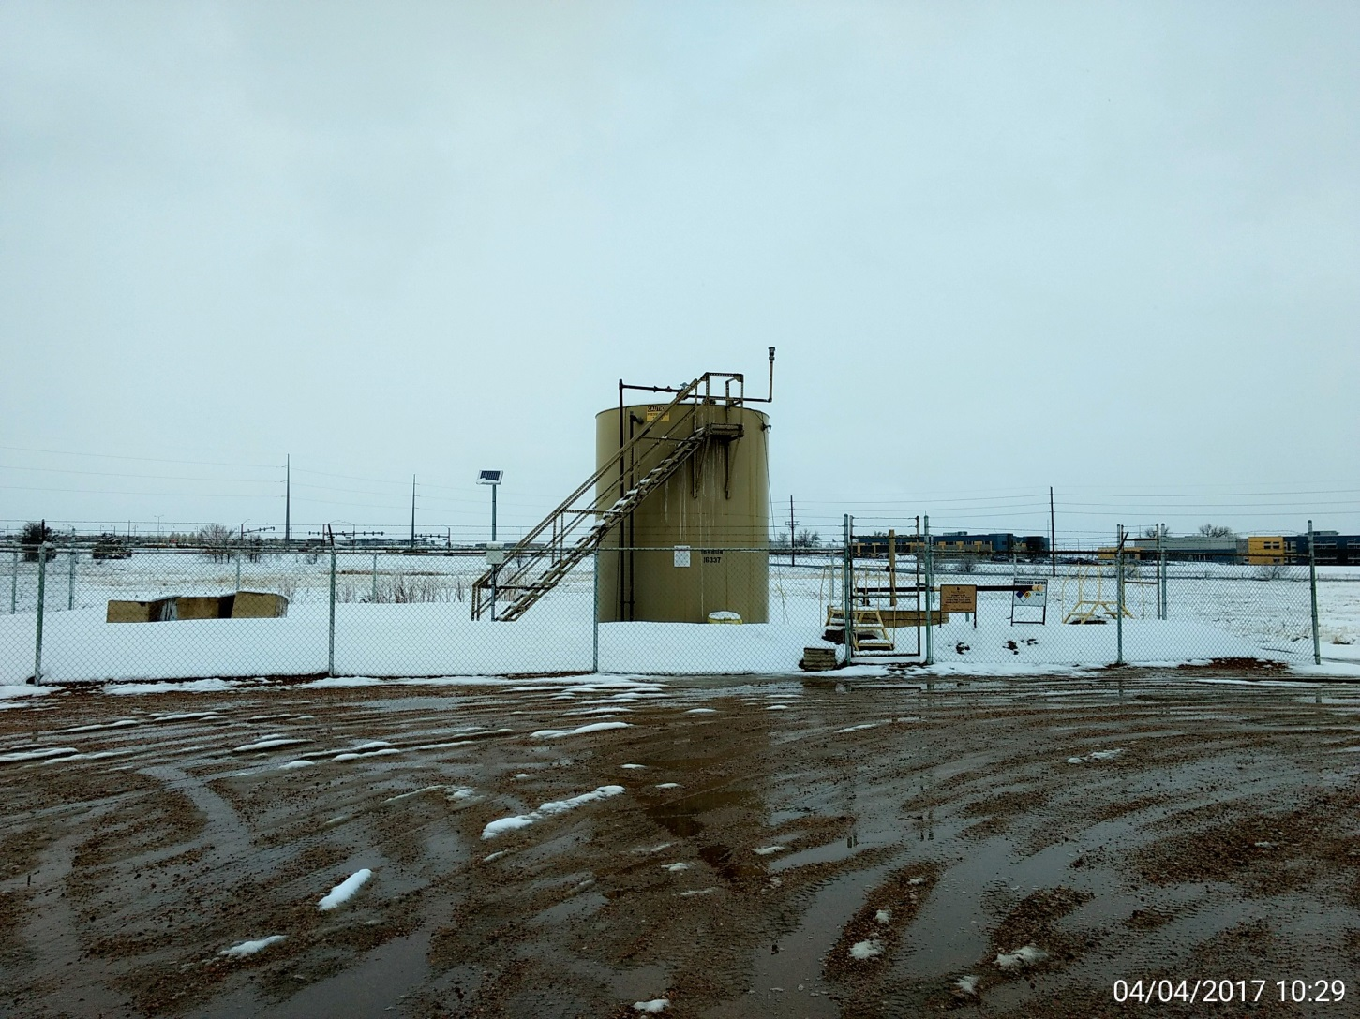
Battery view

Slide 3
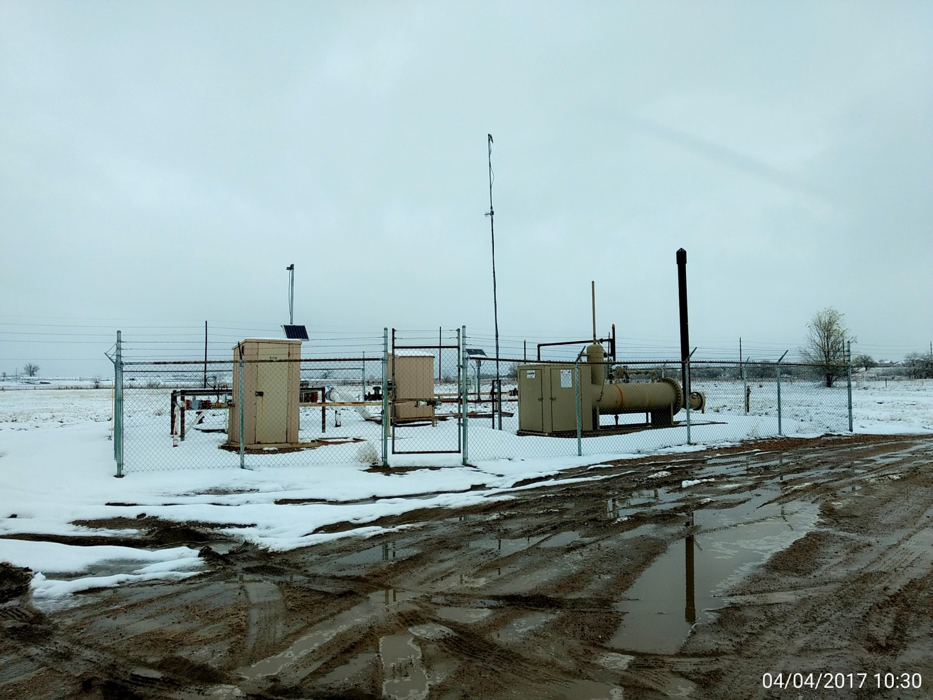
Separator, meter runs, and pig station.

Slide 4
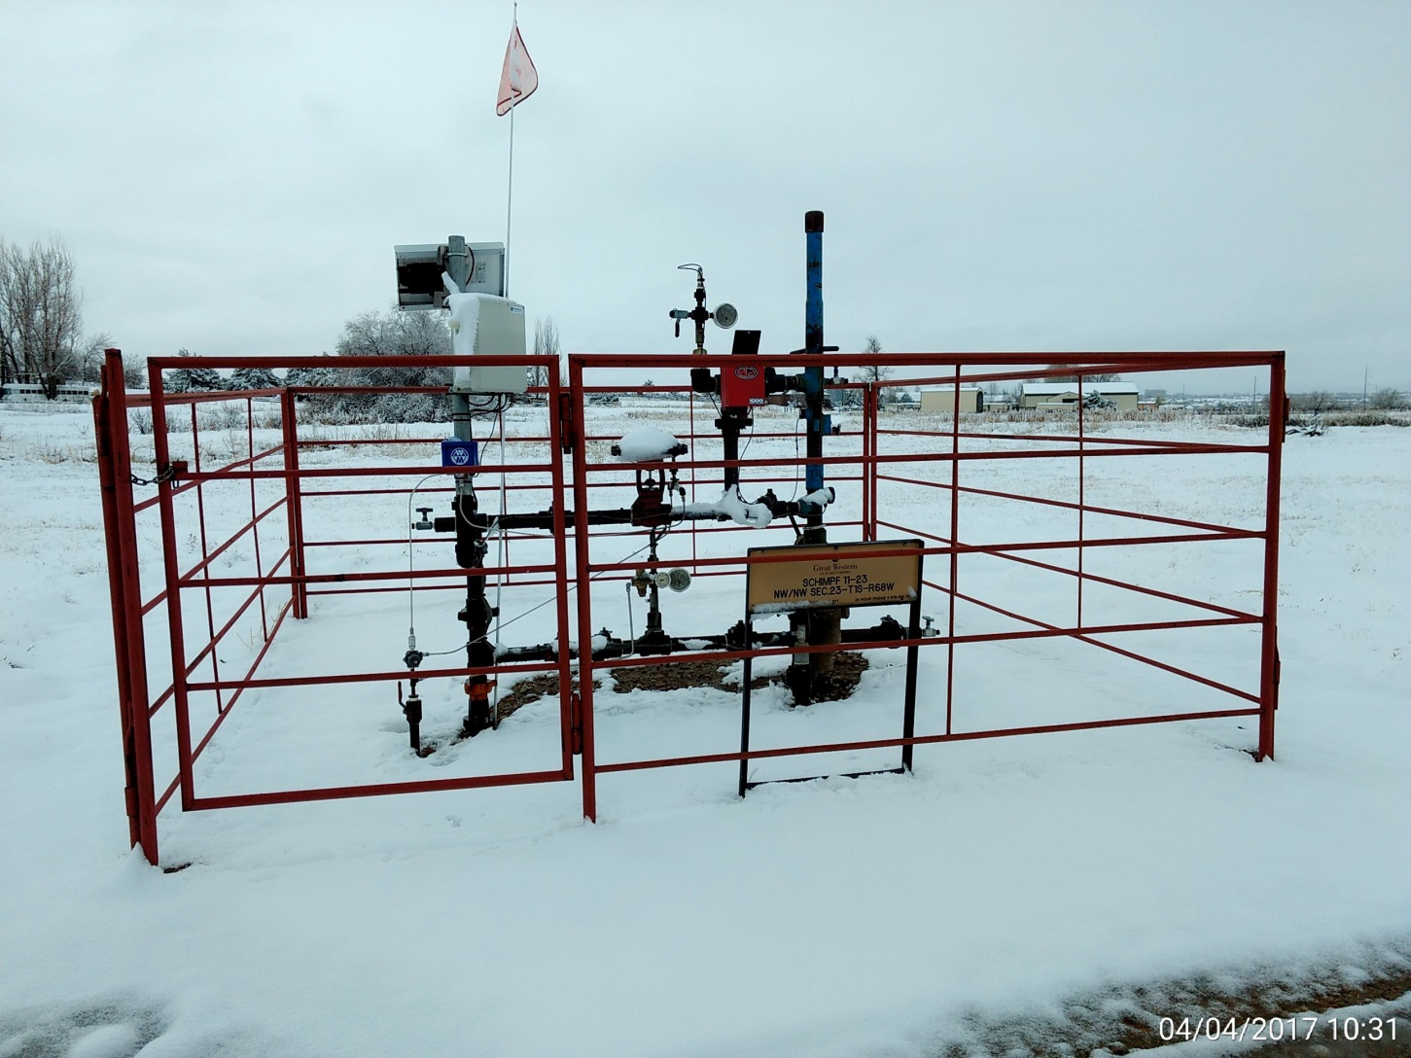
Wellhead.

