Slide 1
Sack G Unit 2-X
Synergy Resources
Inspection photos
4/4/2017
Doc# 667601557
Adam Kraich
Oil & Gas Inspector, Community & Economic Development Department
ADAMS COUNTY, COLORADO
4430 South Adams County Parkway, W2000A
Brighton, CO 80601
O: 720.523.6886 | akraich@adcogov.org
www.adcogov.org

Slide 2
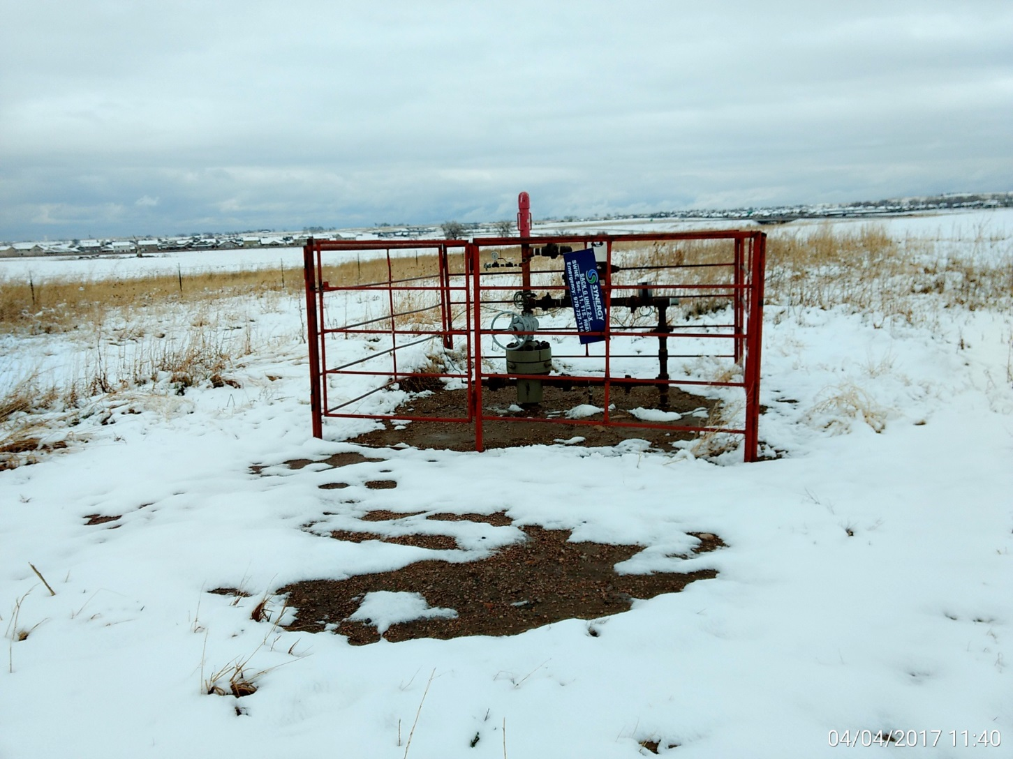
Wellhead

Slide 3
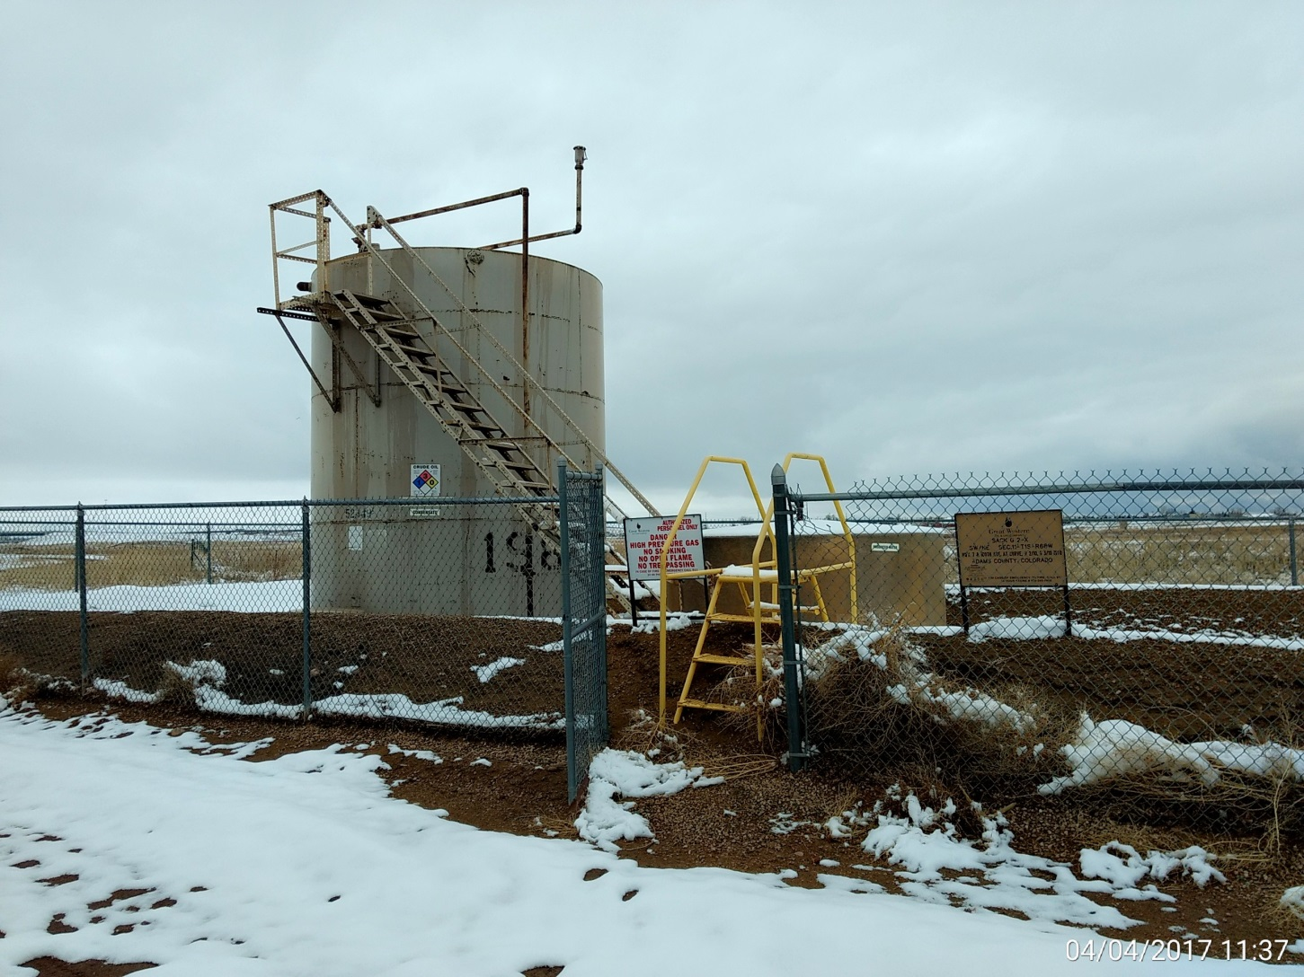
Battery,
Note: Incorrect signage and contact info
Weeds in fencing

Slide 4
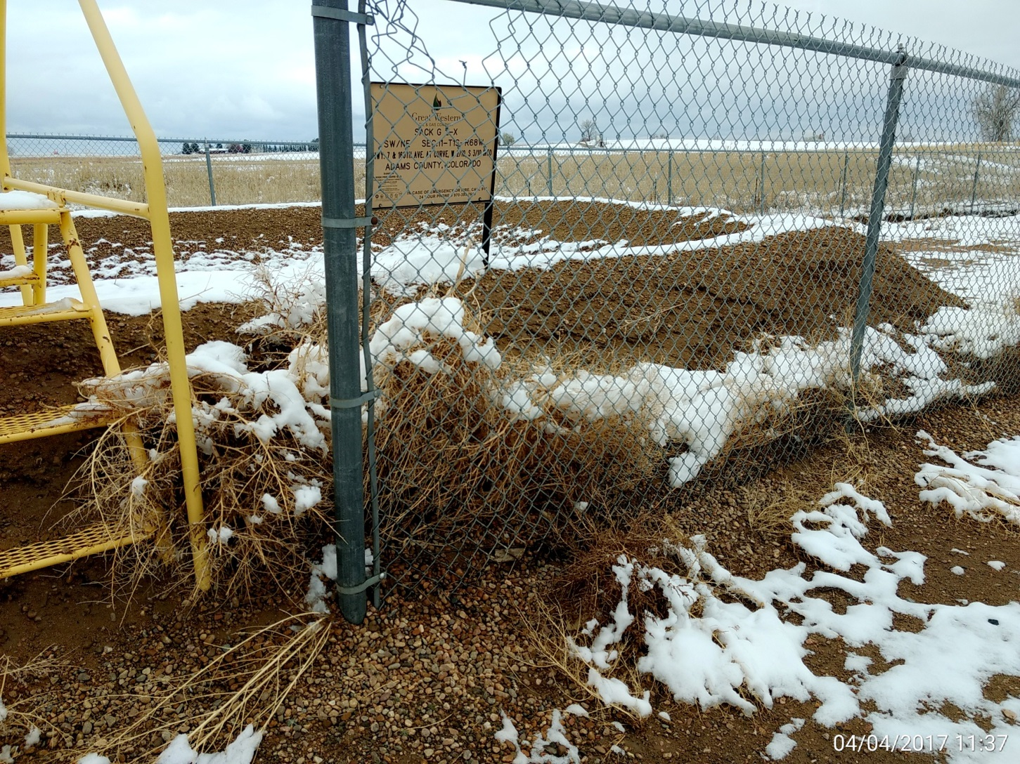
Incorrect signage and weeds detailed.

Slide 5
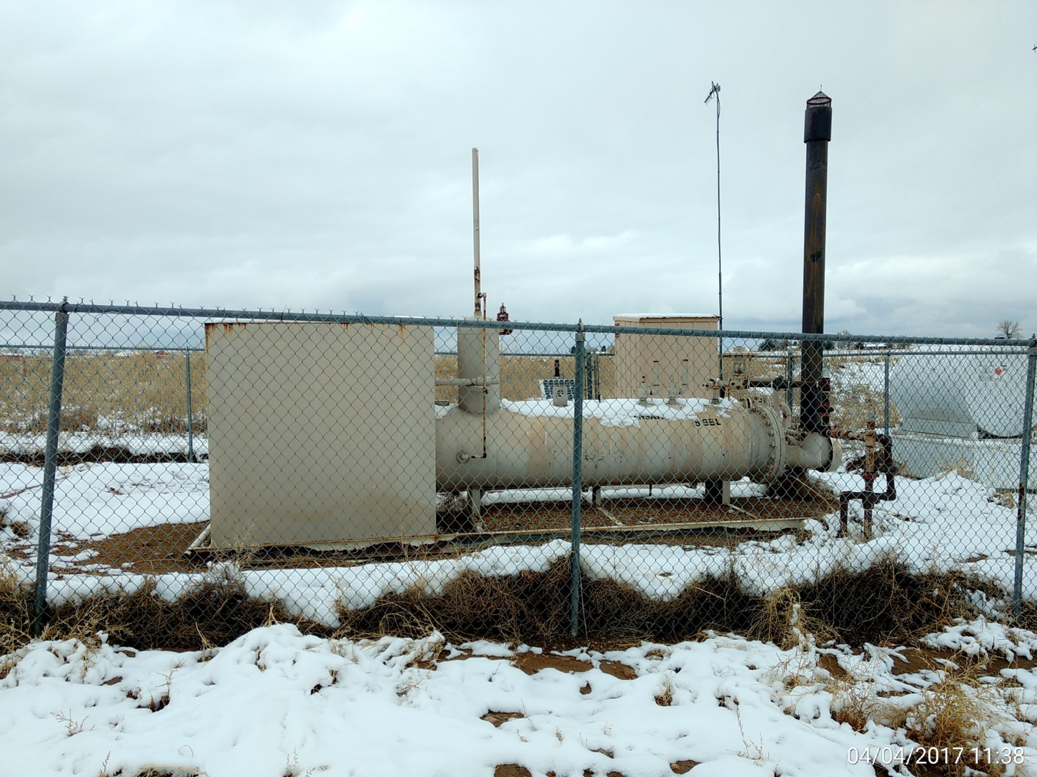
Separator & meter run
Note: Weeds in fencing.

Slide 6
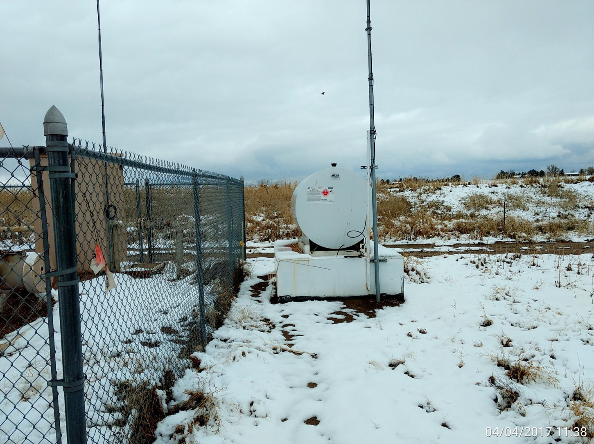
Chemical storage and containment

Slide 7
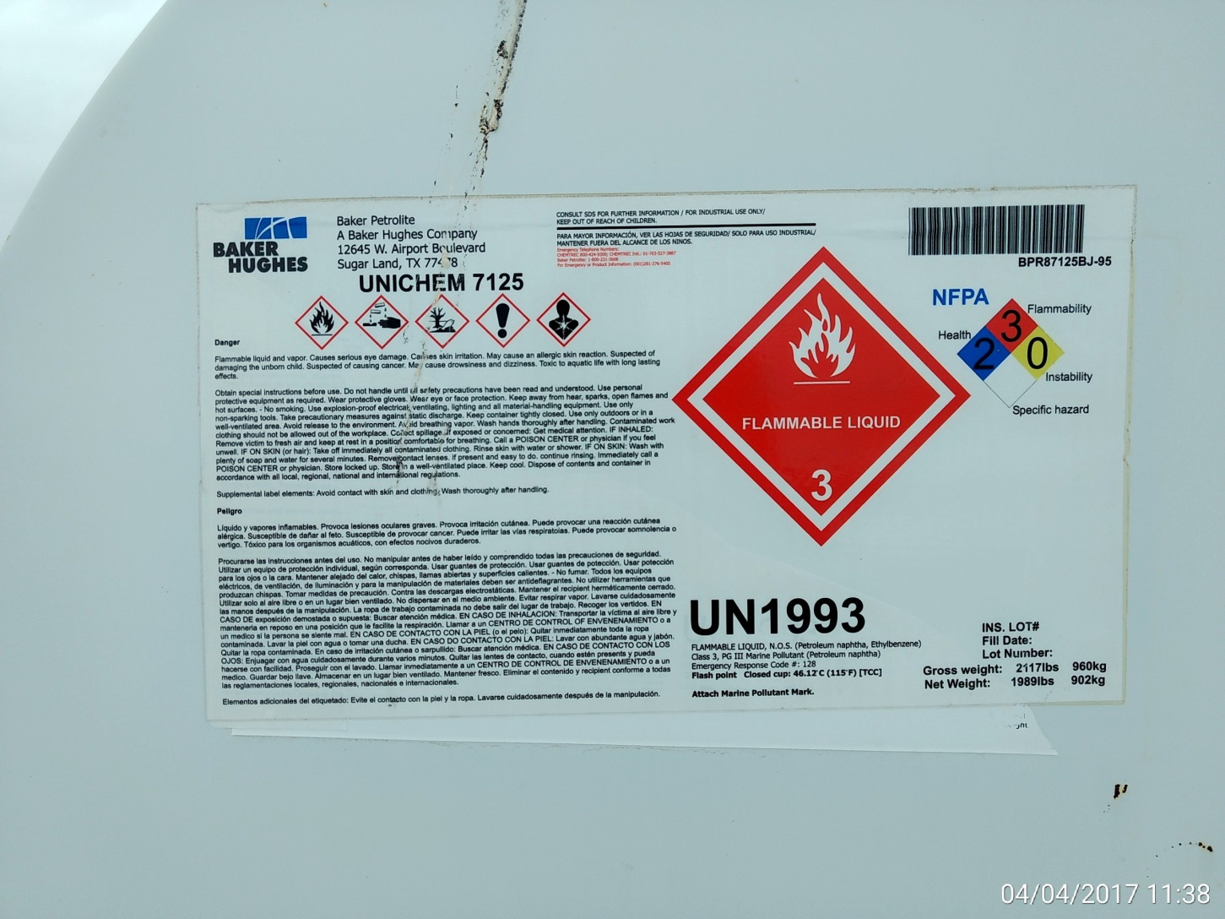
Chemical storage detail

Slide 8
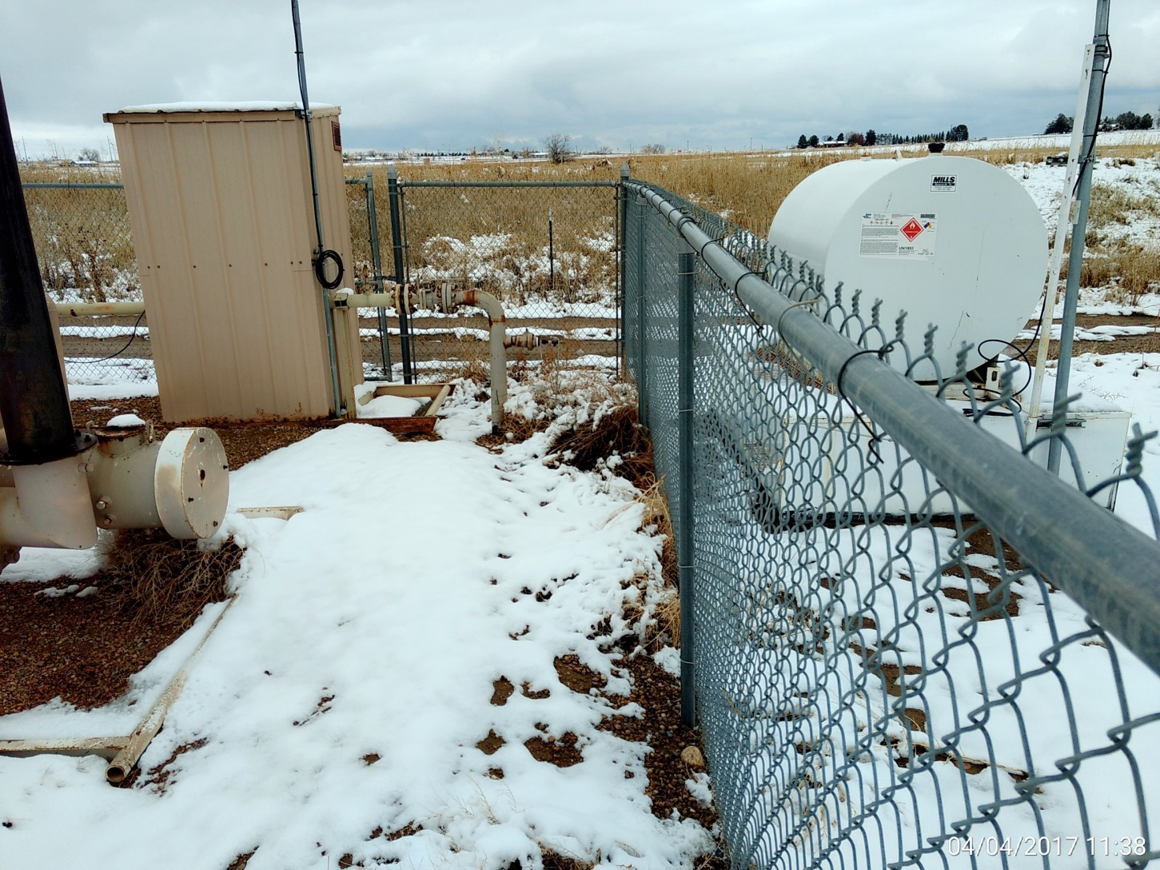
Tumbleweed’s at separator fire tube and along fencing.

