Slide 1
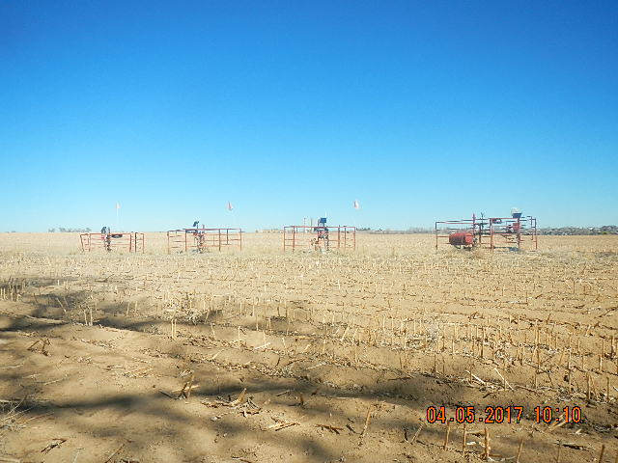
Inspection Photos
Location Name: IGO FARMS
API: 05-123-30887/30889/30891/30895
PHOTOOF WELLS TAKEN FROM SOUTH FACING NW

