Slide 1
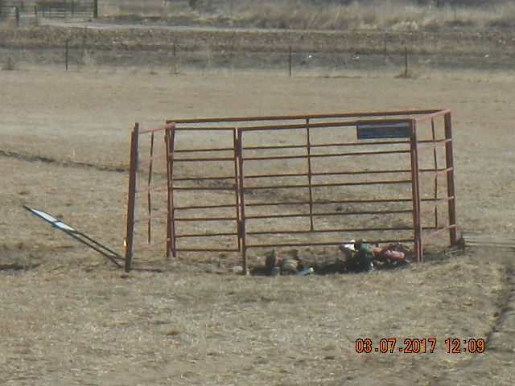
Inspection Photos
Location Name: Bloskas 12-9
API: 05-123-19366
Photo take from West facing East TA Equipment

