Slide 1
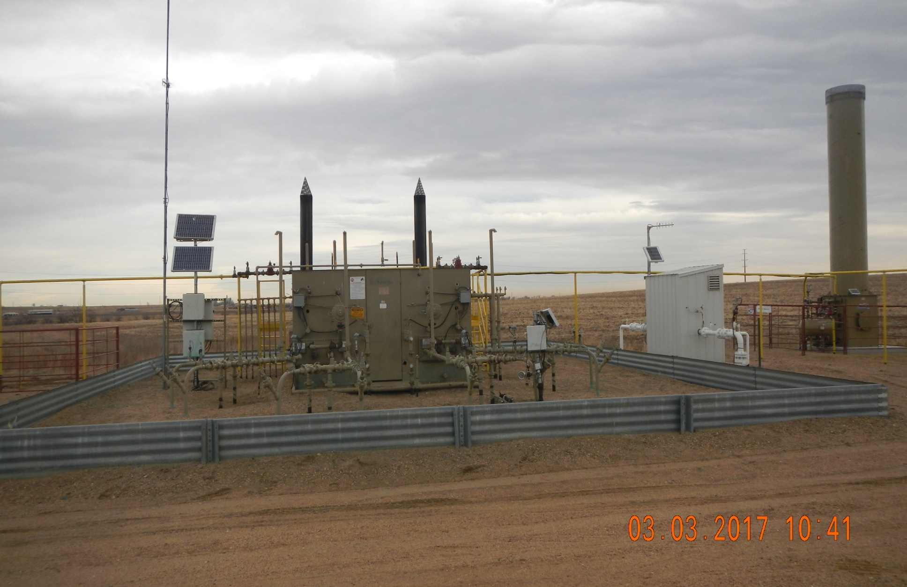
Location # 317843. Separators, meter run, emission control device.

Slide 2
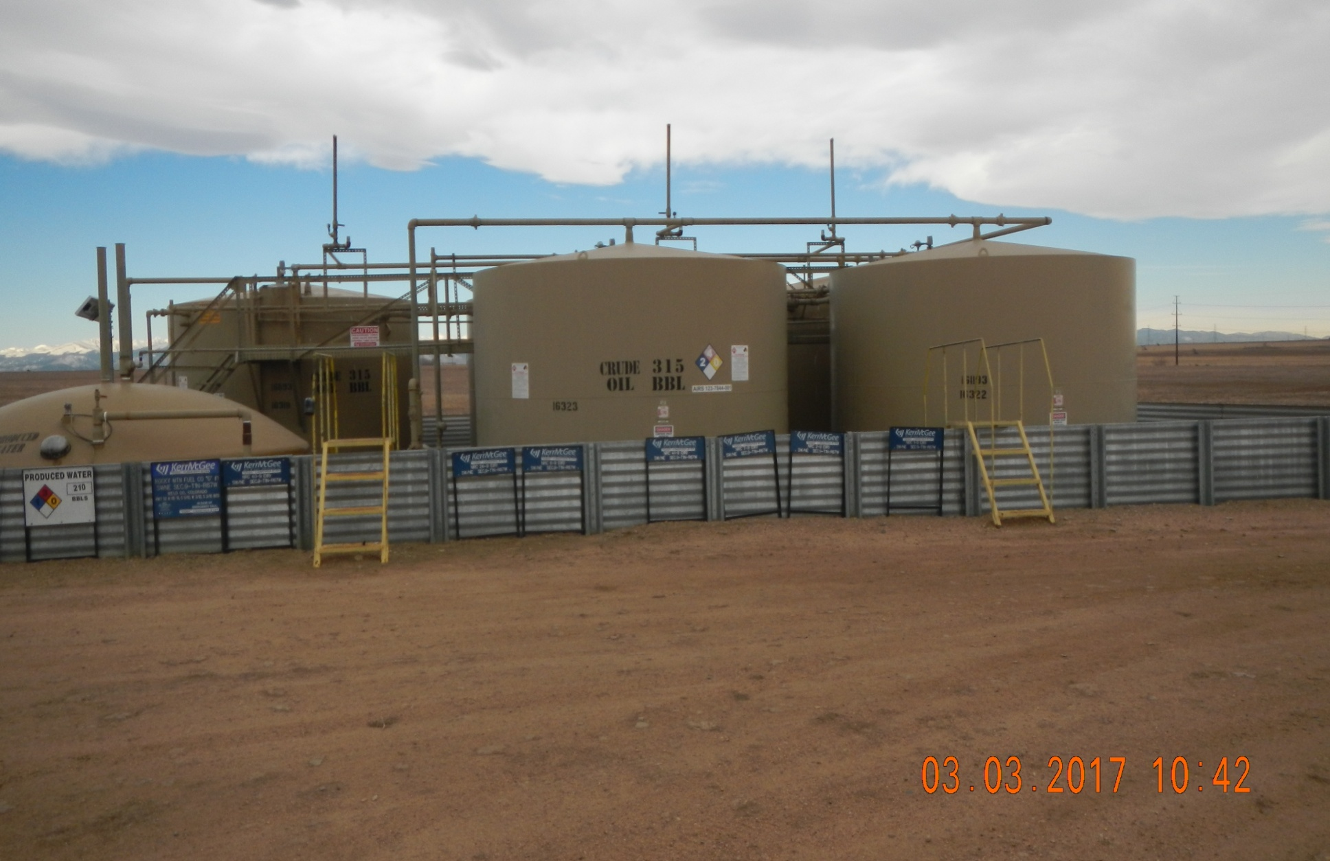
OIL TANKS, PRODUCED WATER TANK.

