Slide 1
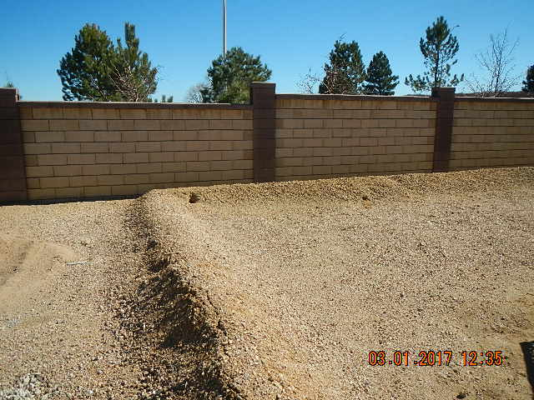
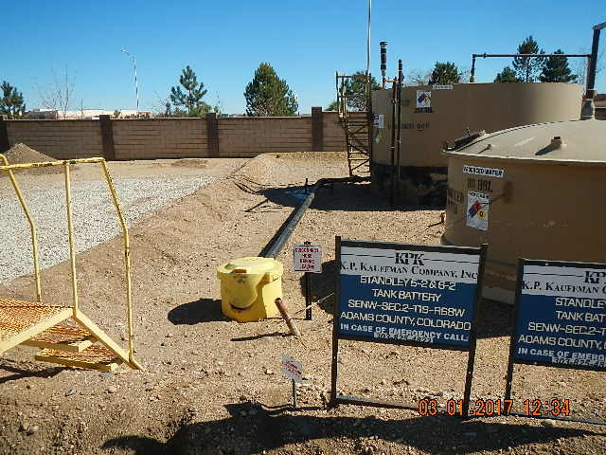
Inspection Photos
Location Name: KPK STANLEY 5-2 6-2-8-3
HOLES IN BERM WALLS TAKEN FROM THE WEST
HOLE IN BERM WALL HIEGHT OF WALLS TAKEN FROM THE WEST

