Slide 1
Wiepking-Fullerton Energy LLC, Bubba-State #3
073-06432
10/28/2016

Slide 2
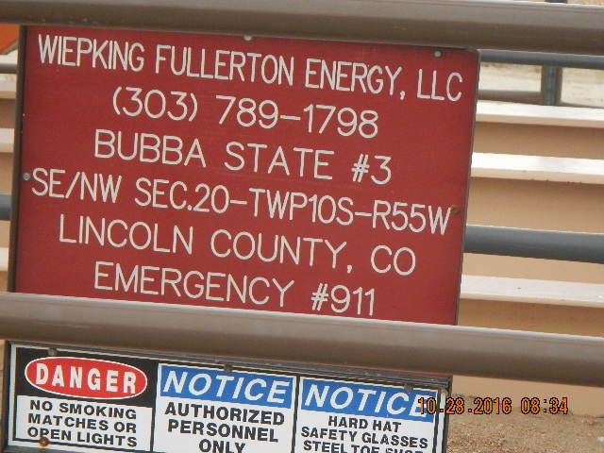

Slide 3
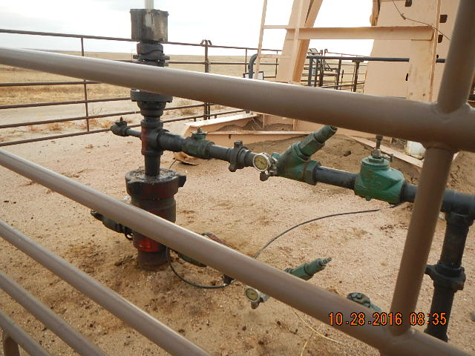

Slide 4


