Slide 1
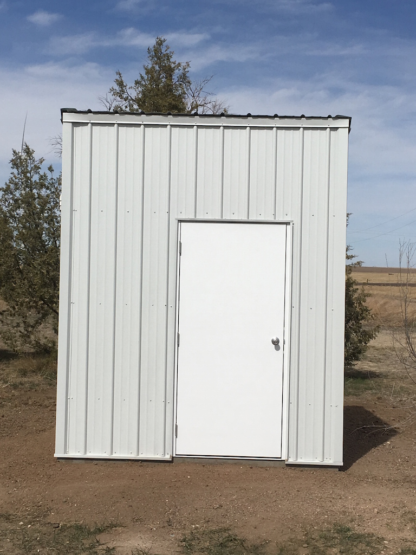
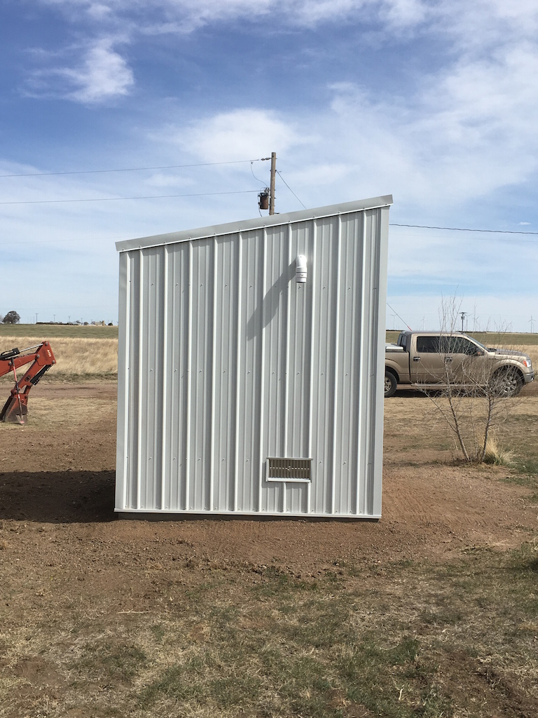
Nelson Water Well Aeration System – Building Exterior
South Wall
West Wall

Slide 2
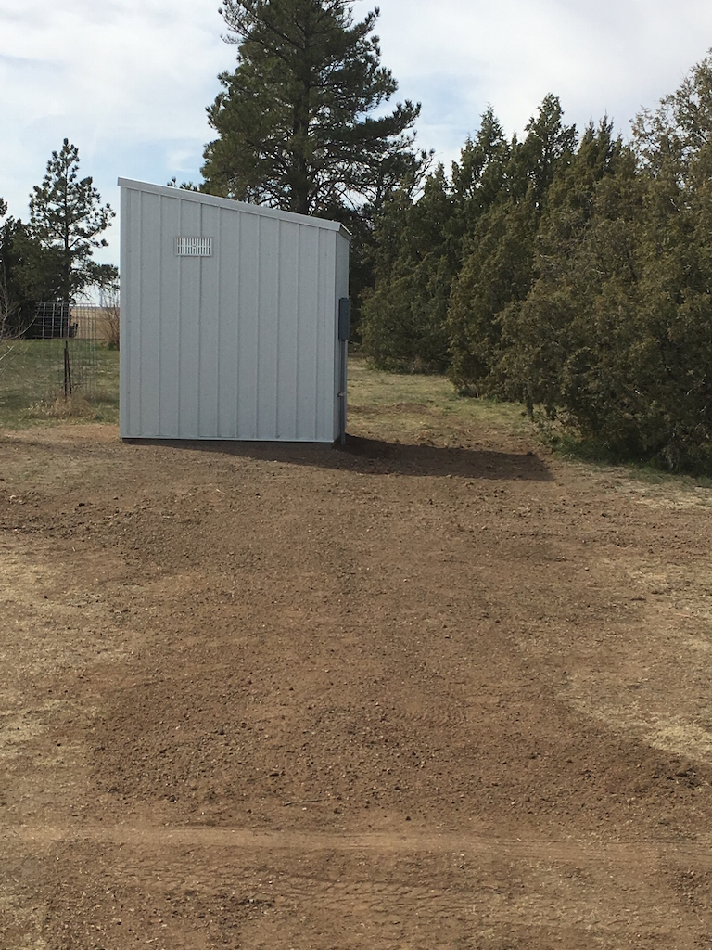
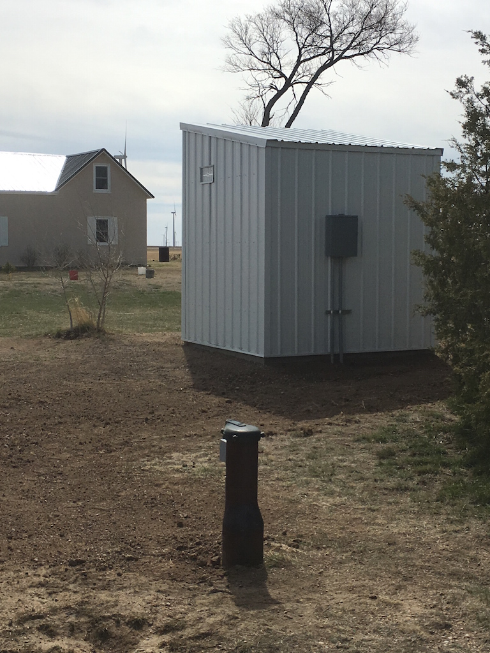
Nelson Water Well Aeration System – Building Exterior
East Wall
North Wall and Water Well

Slide 3
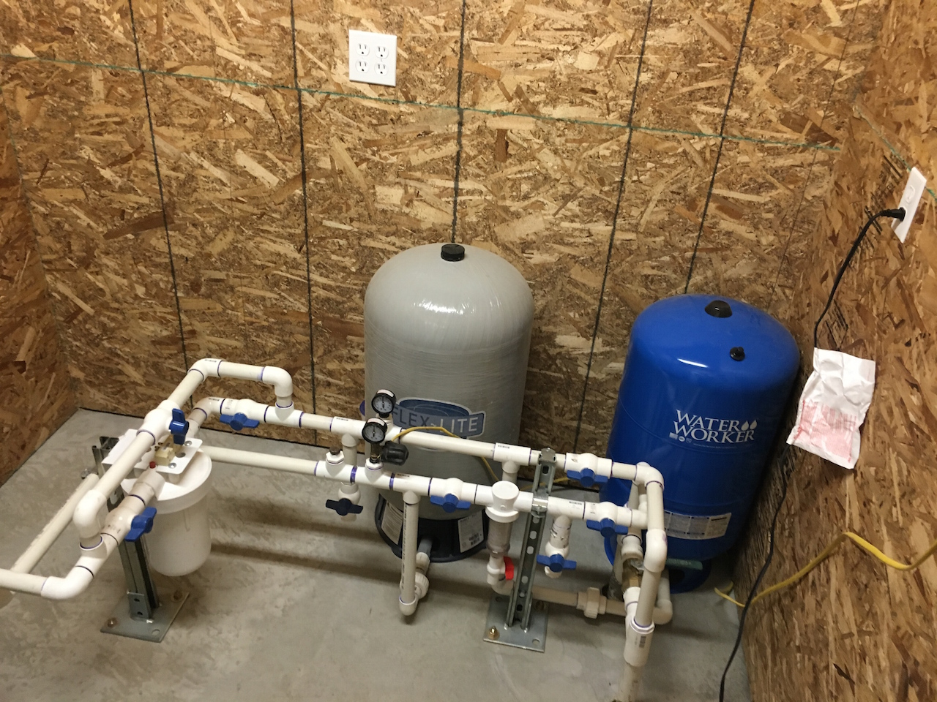
Nelson Water Well Aeration System – Building Interior
Pressure Tanks and Filtration

Slide 4
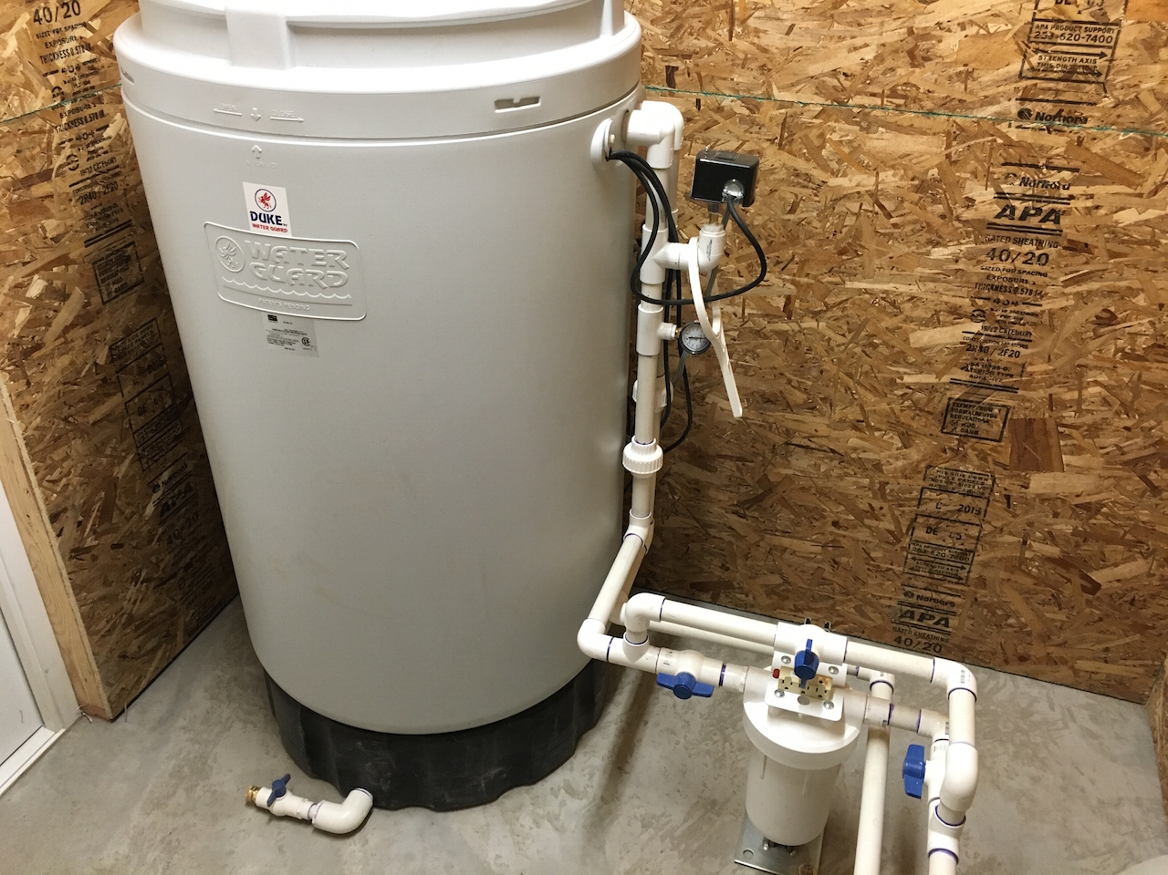
Nelson Water Well Aeration System – Building Interior
Aeration Tank

Slide 5
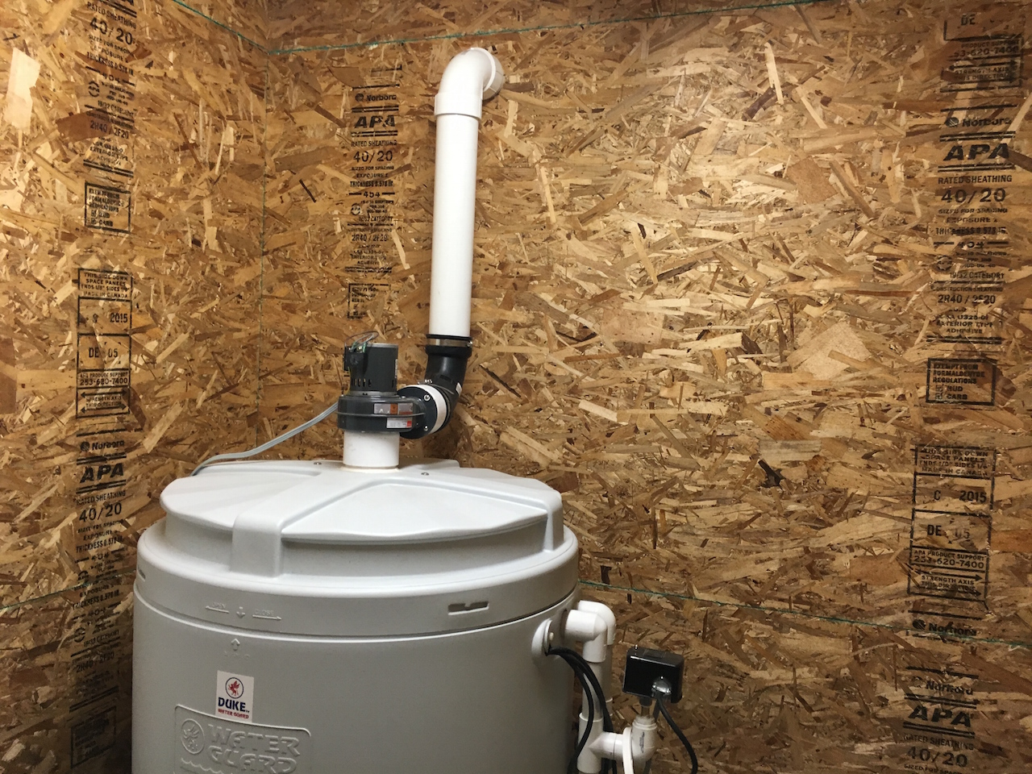
Nelson Water Well Aeration System – Building Interior
Aeration Tank Blower

Slide 6
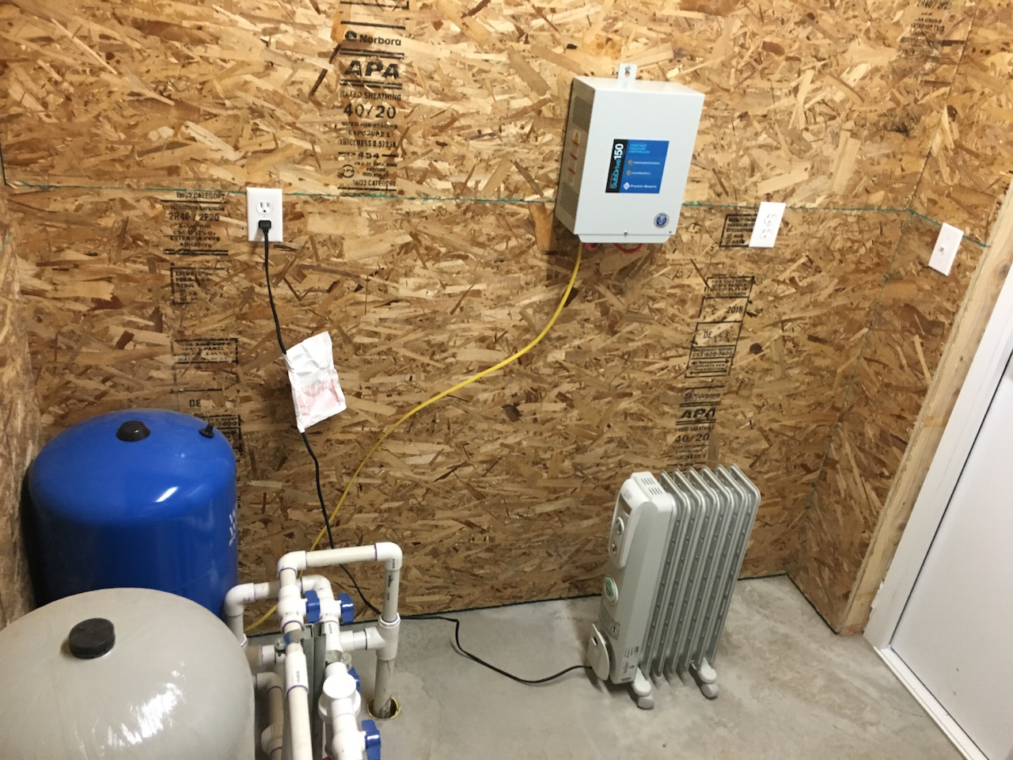
Nelson Water Well Aeration System – Building Interior
Well Pump Controller and Building Heater

Slide 7
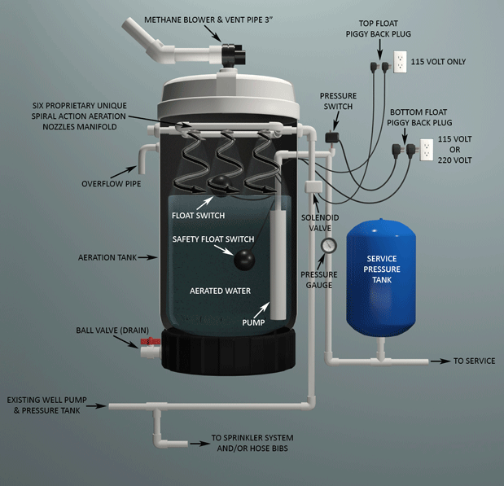
Nelson Water Well Aeration System – Schematic

