Slide 1
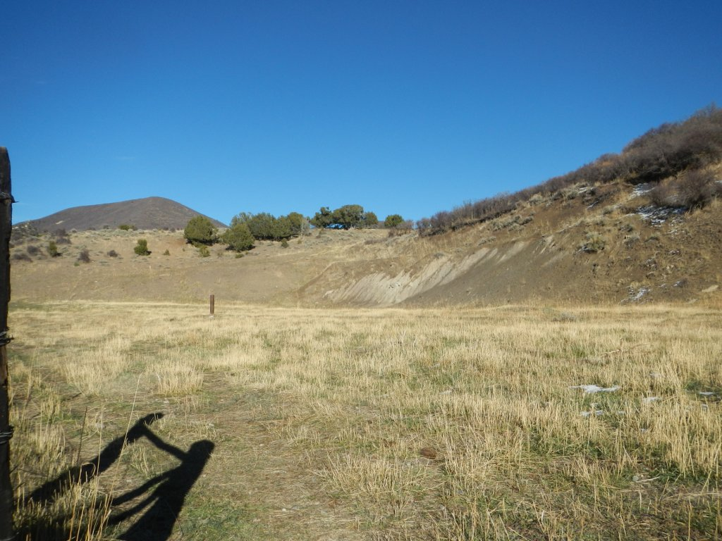
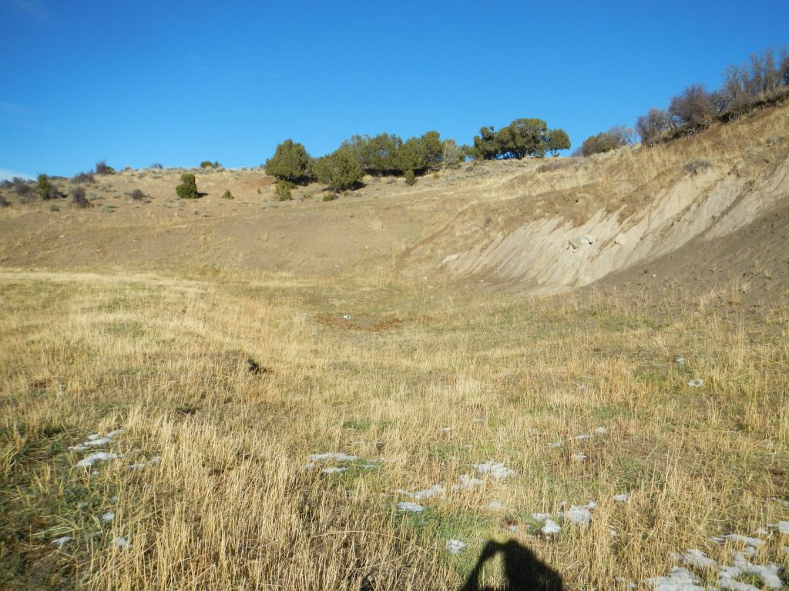
Snyder Oil 045- 06388
#1: Over view of Location , facing SE #2: Shallow pit and cut slope area

Slide 2
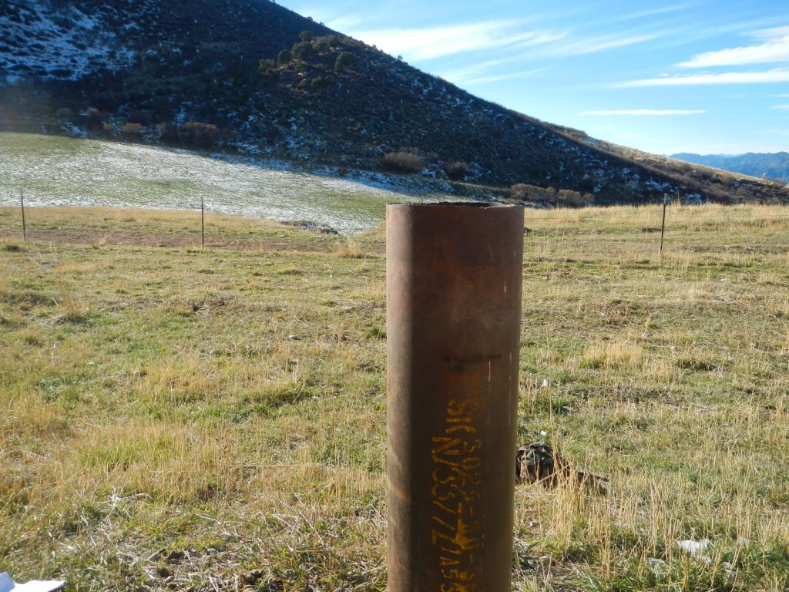
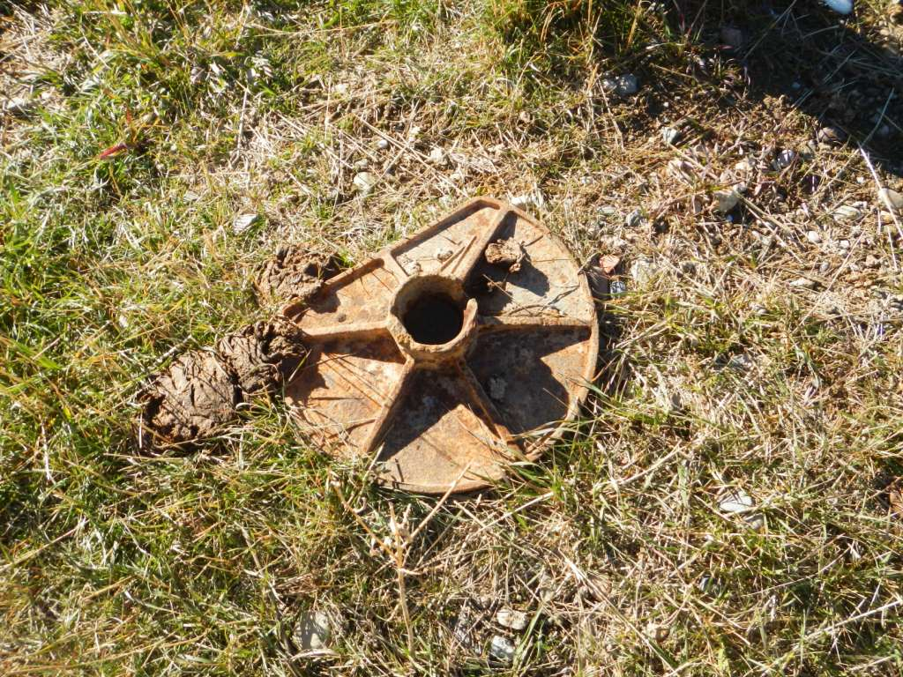
Snyder Oil 045-06388
#3: Suspected open Bore Hole #4:Resting beside S Bore hole, used as cap / lid?

Slide 3
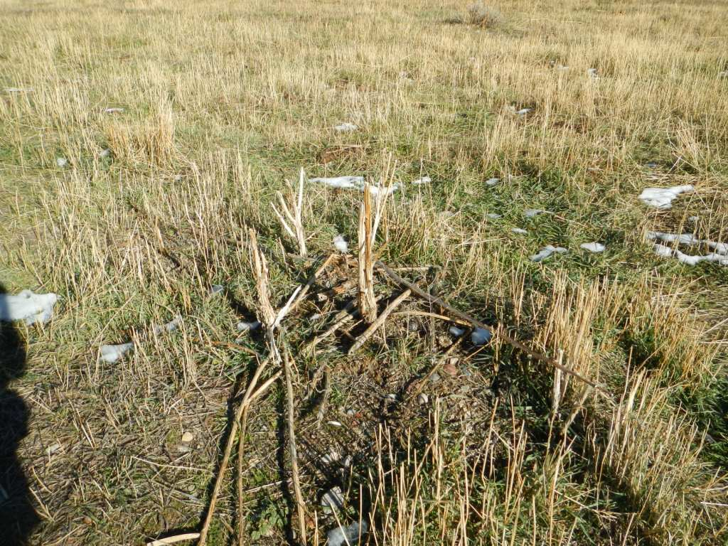
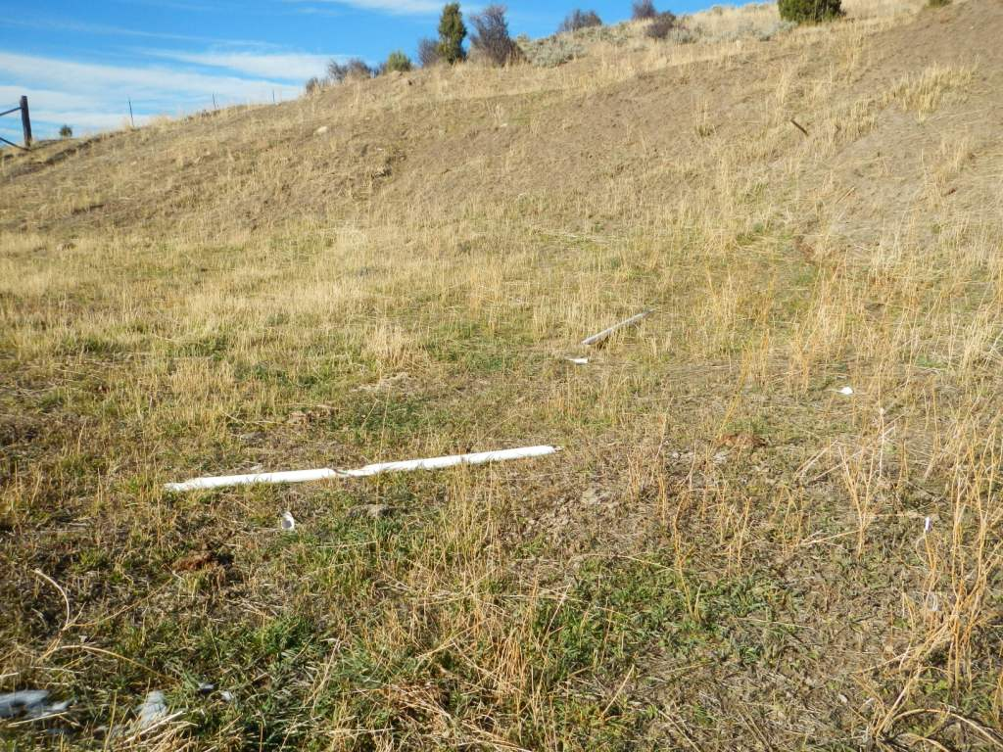
Snyder Oil -045-06388
#5: Matured Thistle #6: Miscellaneous, Debris on Location

Slide 4
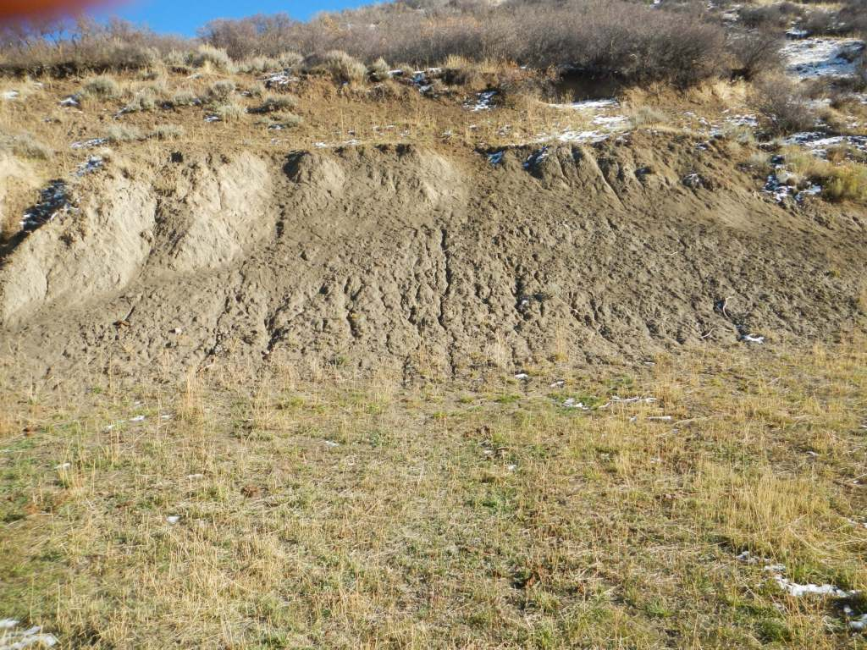
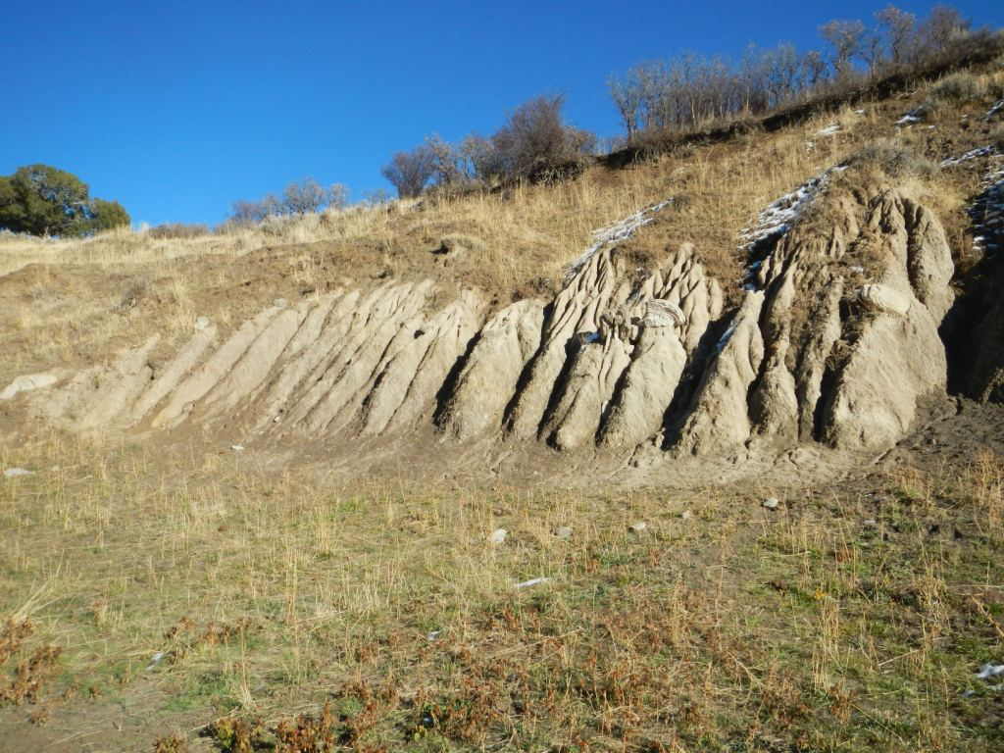
Snyder Oil – 045 06388
Cut Slope Erosion on South edge of Location
#7: #8:

