Slide 1
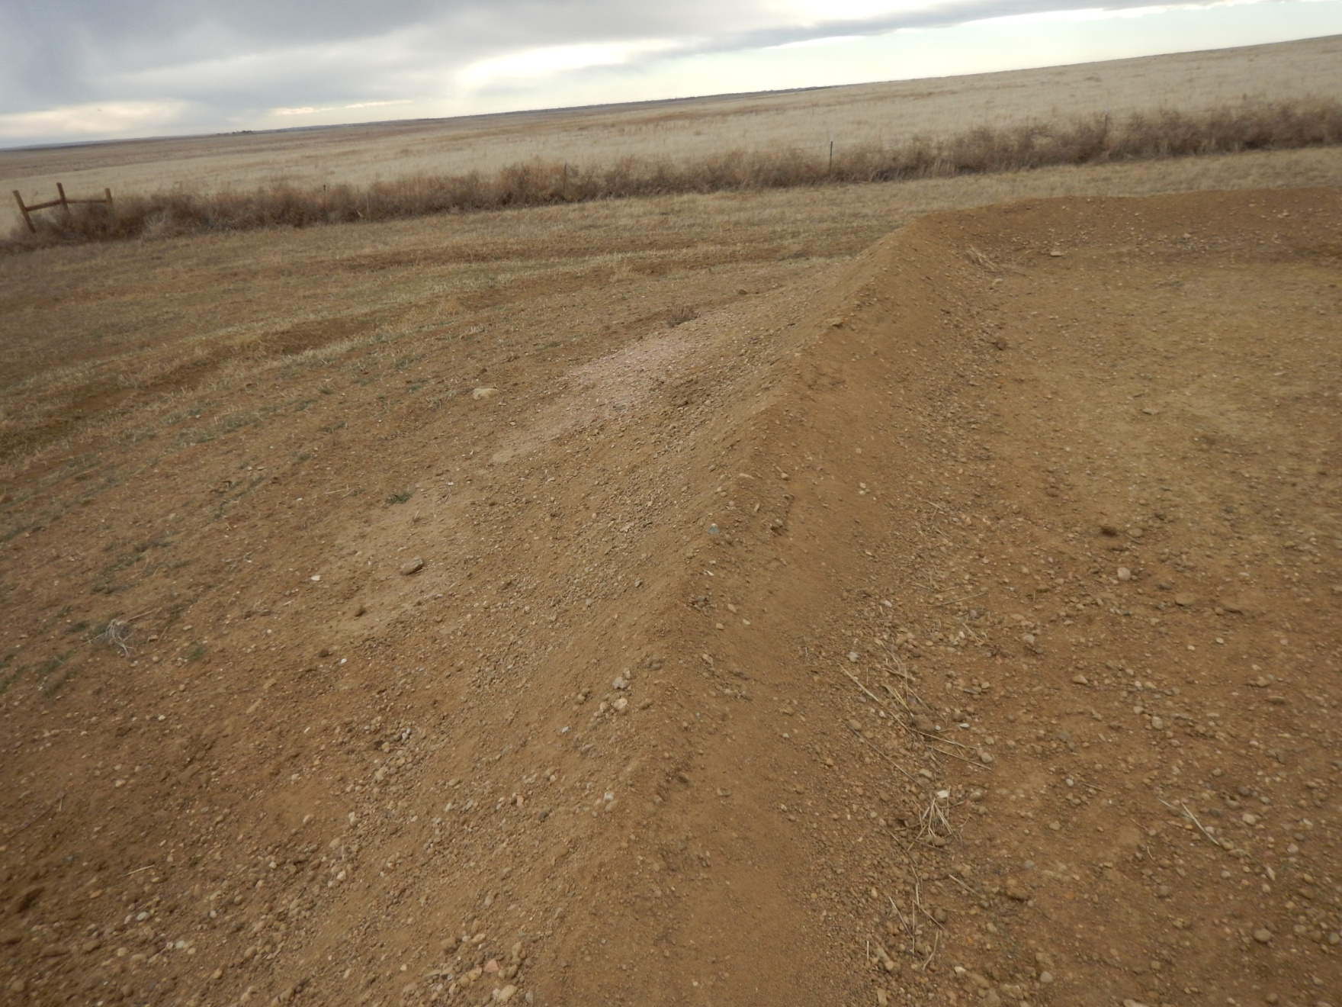
Photo 1: Photo taken from northeast part of location, facing north. Photo of stormwater berm and ditch.

Slide 2
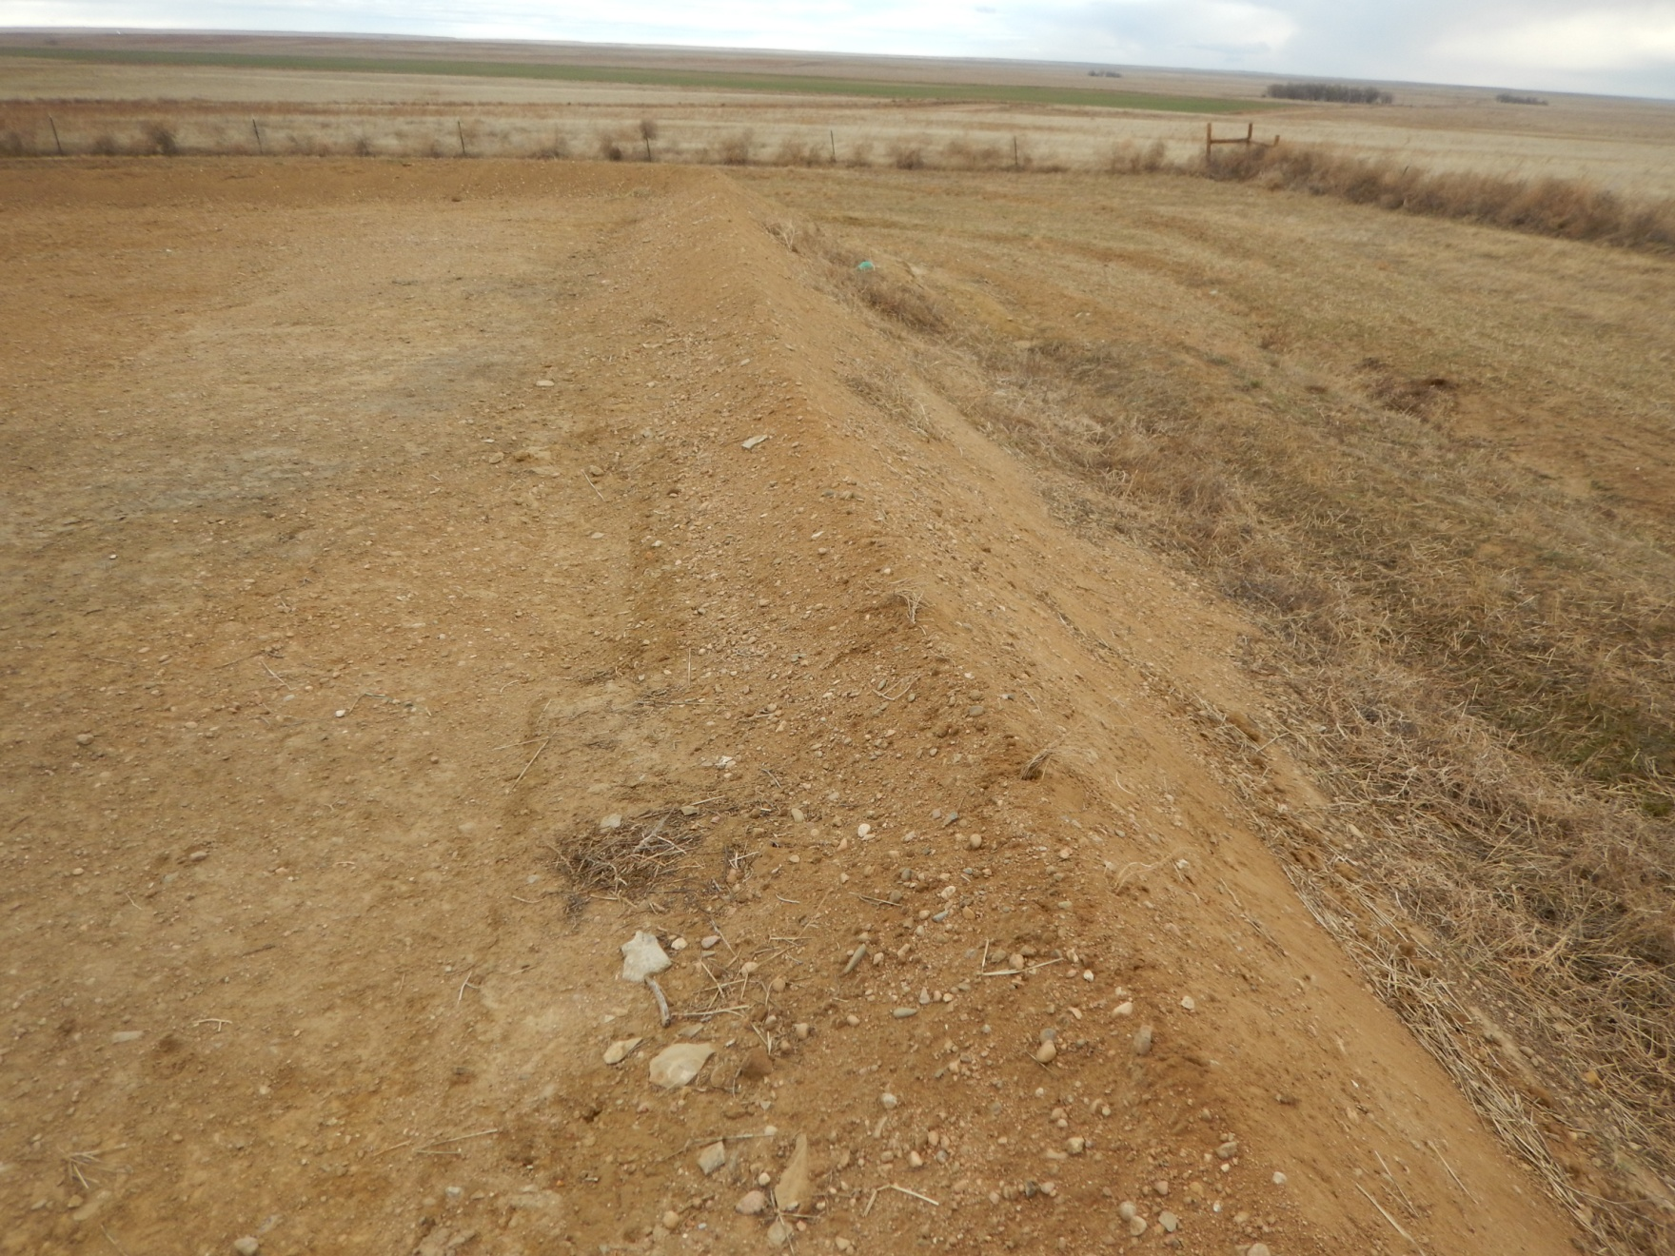
Photo 2: Photo taken from northeast part of location, facing east. Photo of stormwater berm and ditch.

Slide 3
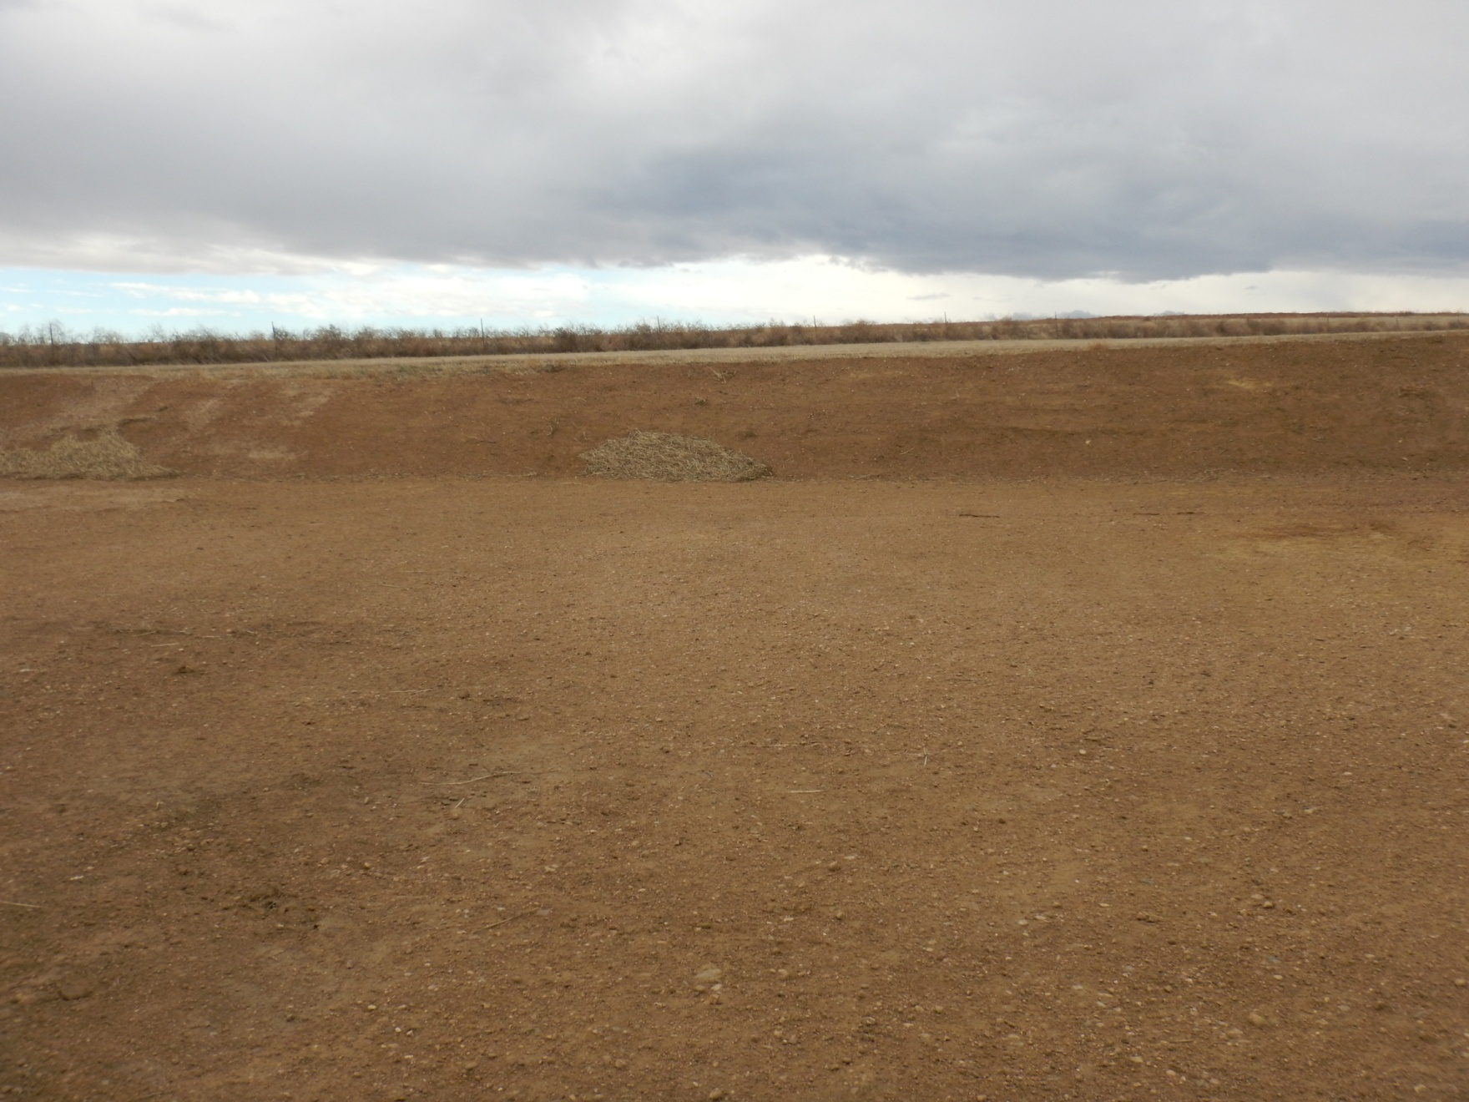
Photo 3: Photo taken from northwest part of location, facing west. Photo of stormwater managememt.

