Slide 1
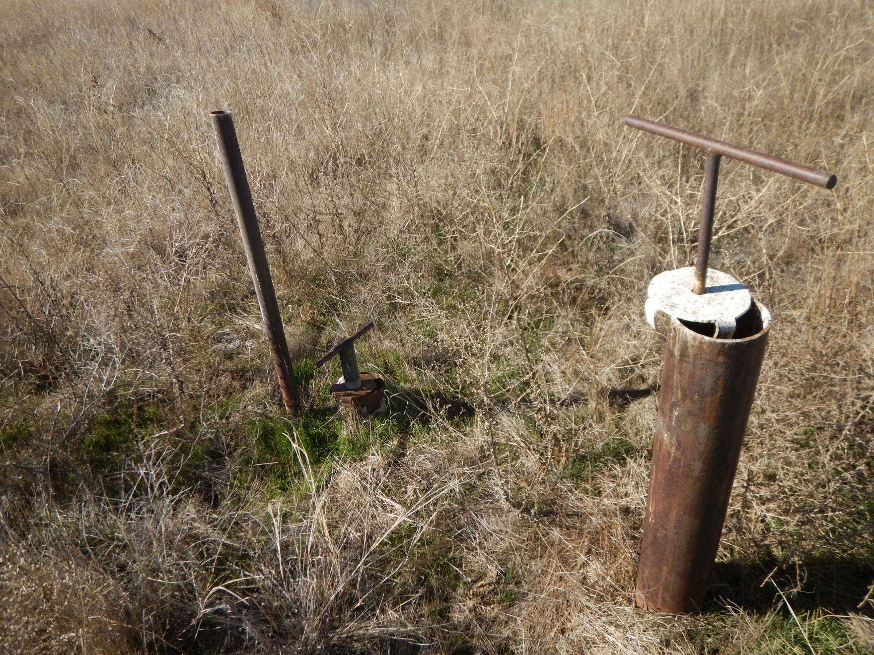
Photo 1: Photo of exposed pipe on western end of location.

Slide 2
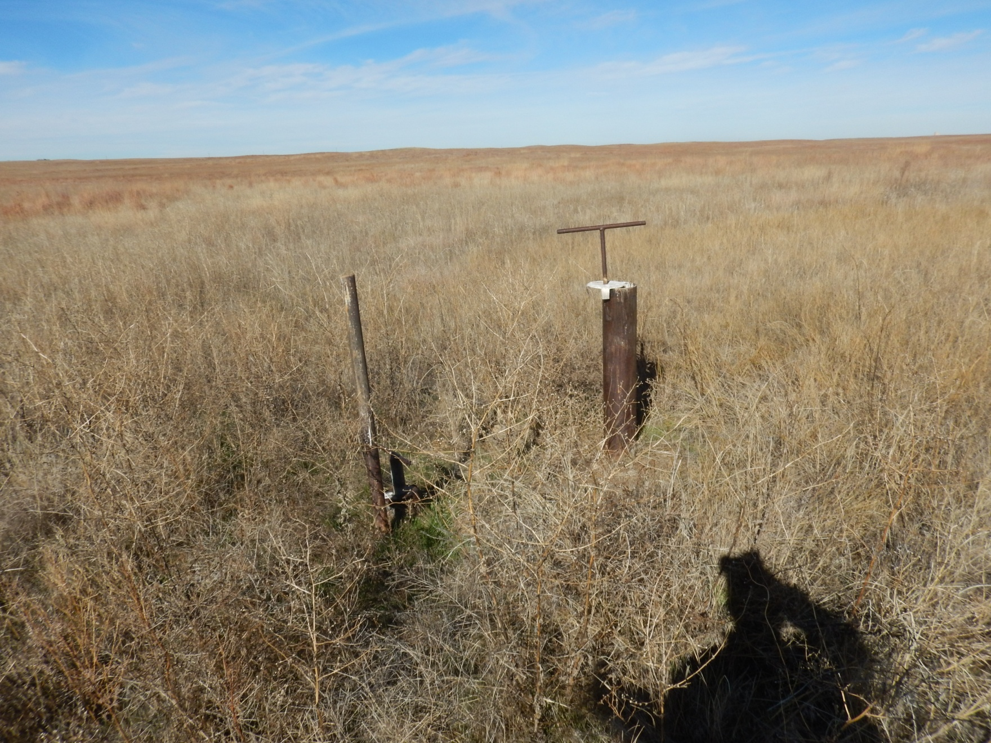
Photo 2: Photo of exposed pipe on western end of location.

