Slide 1
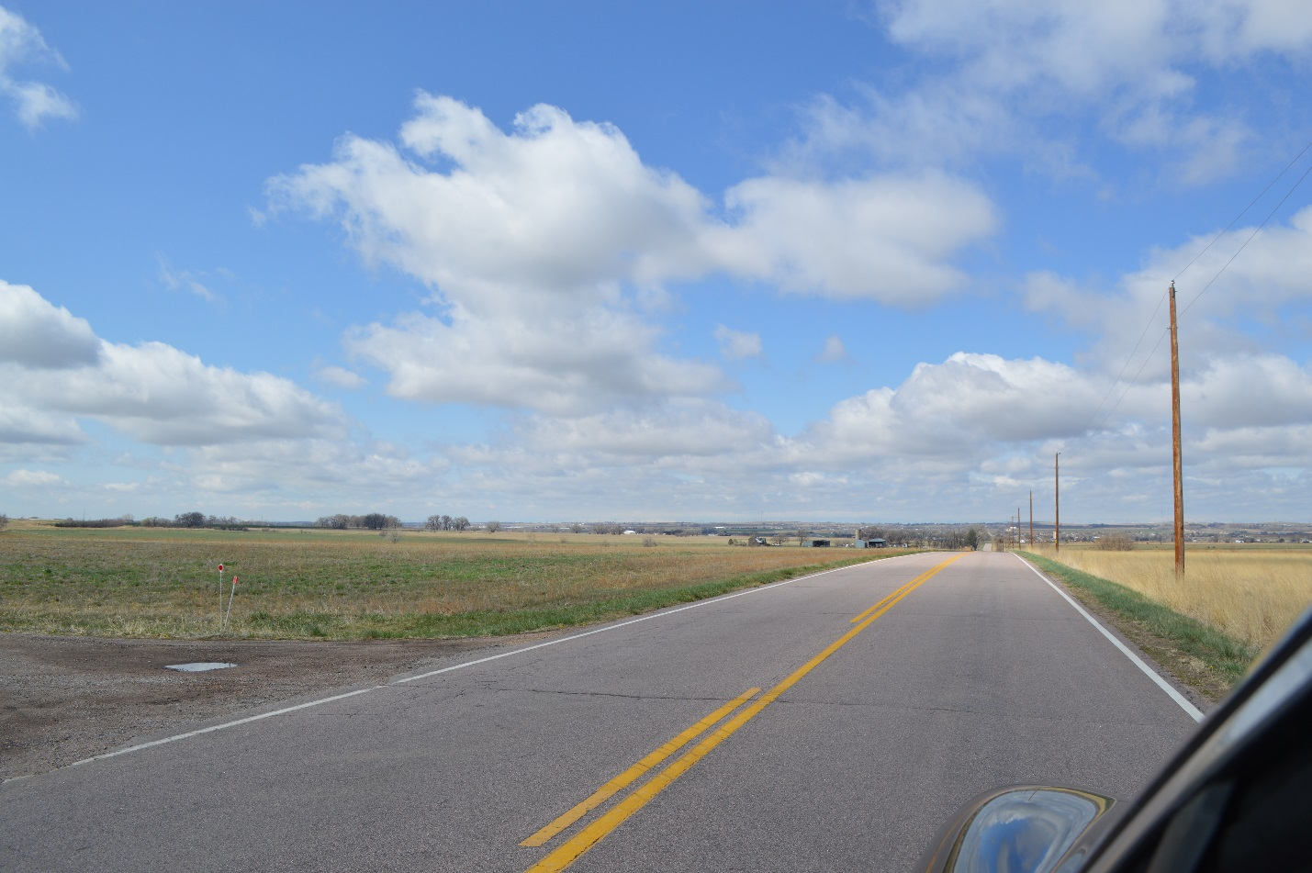
West view from end of Humphrey driveway on County Road 8 (no zoom)

Slide 2
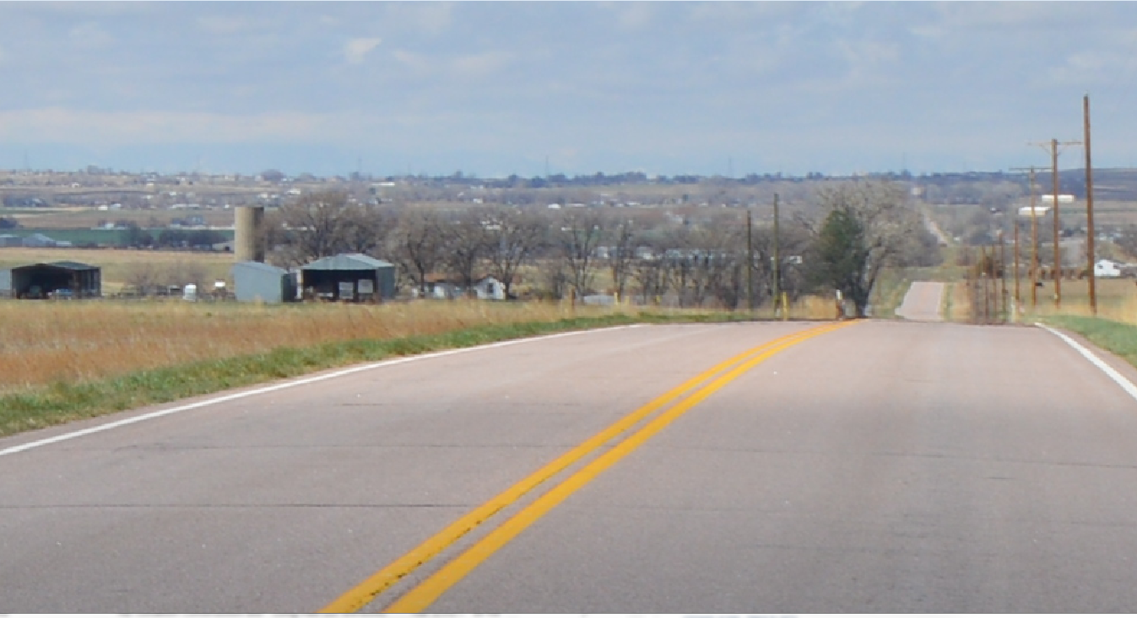
Telephone pole on south side County Road 8 on edge of Long 22-B pad
Note that pole does not block the mountain view
West view zoom from end of Humphrey driveway on County Road 8

Slide 3

Zoomed view of telephone pole on south side County Road 8 on edge of Long 22-B pad

Slide 4
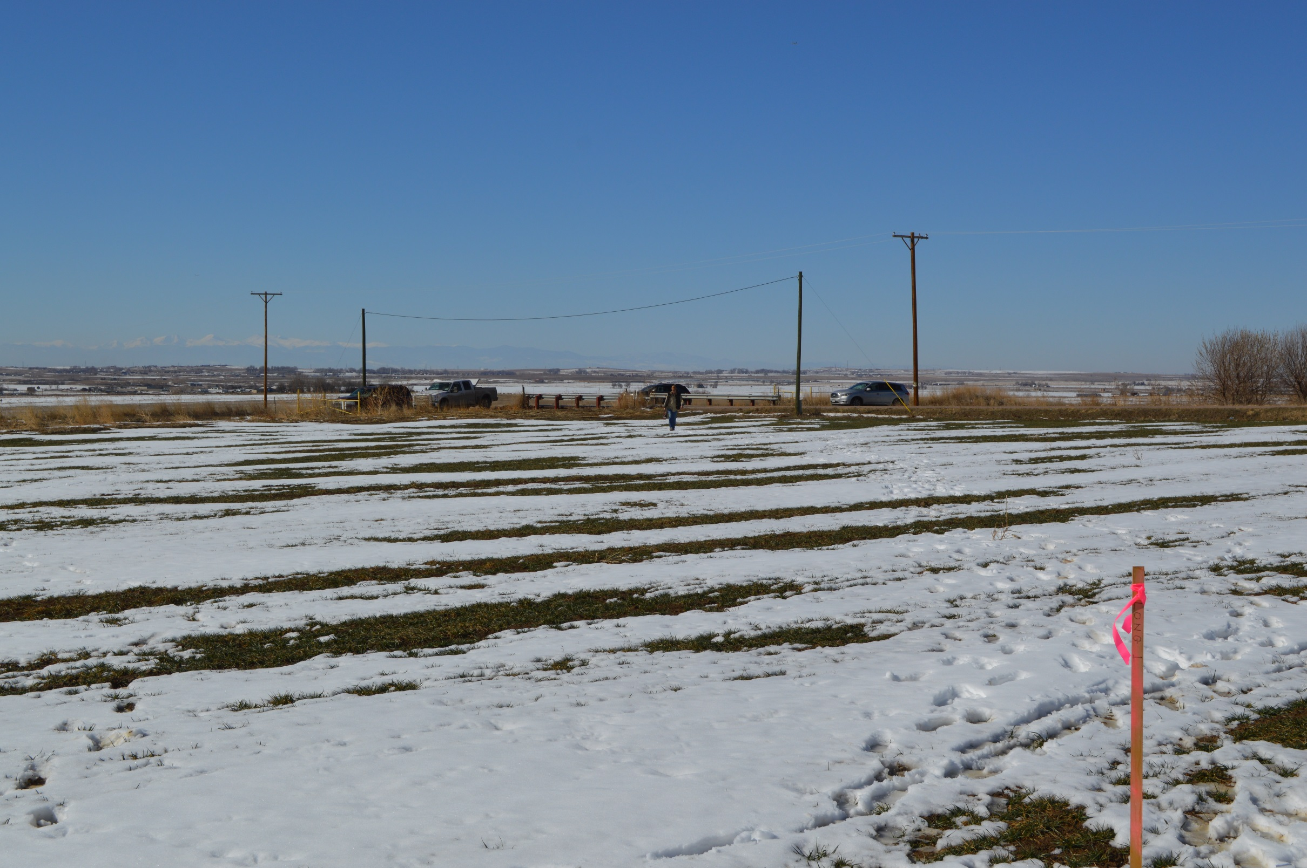
View of the same telephone pole from the Long 22-B pad
Man for scale - 6 ft

Slide 5
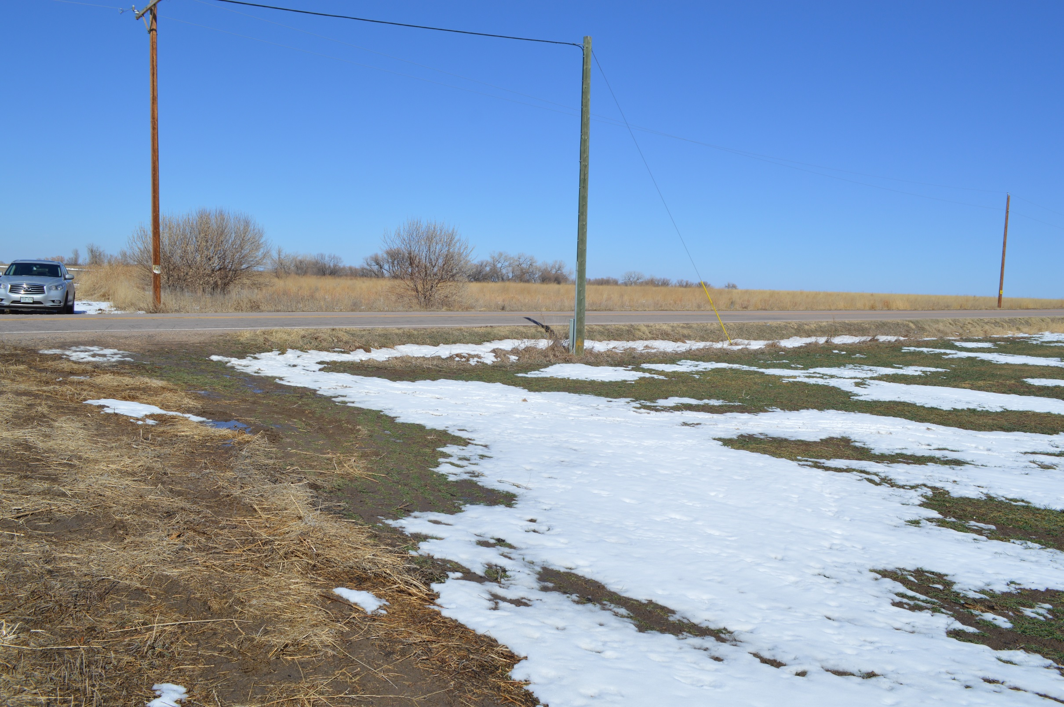
Height of telephone pole is 20-25 ft
Storage Tank Height will be 20 ft
Approximately 4 ft

