Slide 1
Reference Area Photographs
Inspection Conducted on April 07, 2015
URSA Operating Company
Lundgren Pad
Location ID #324342
Centralized Facility ID # 149019
Photos taken by Carlos Lujan

Slide 2
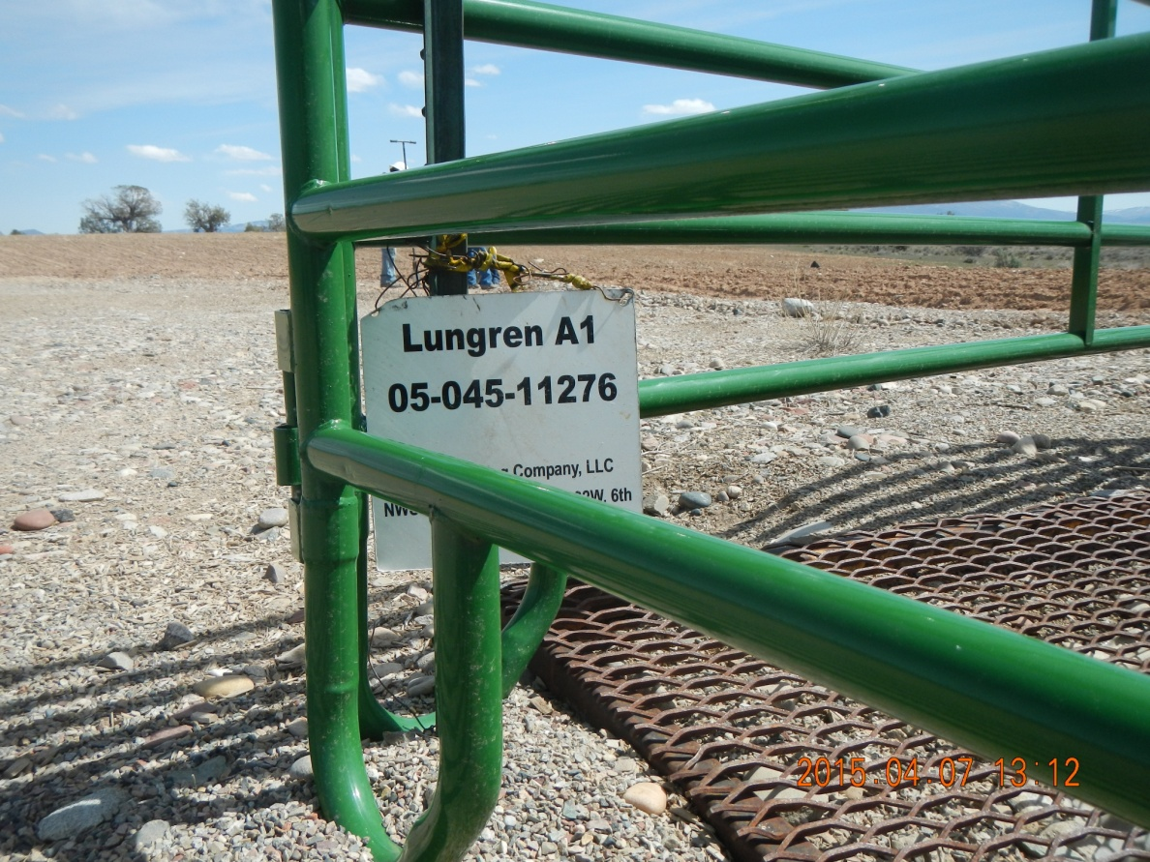
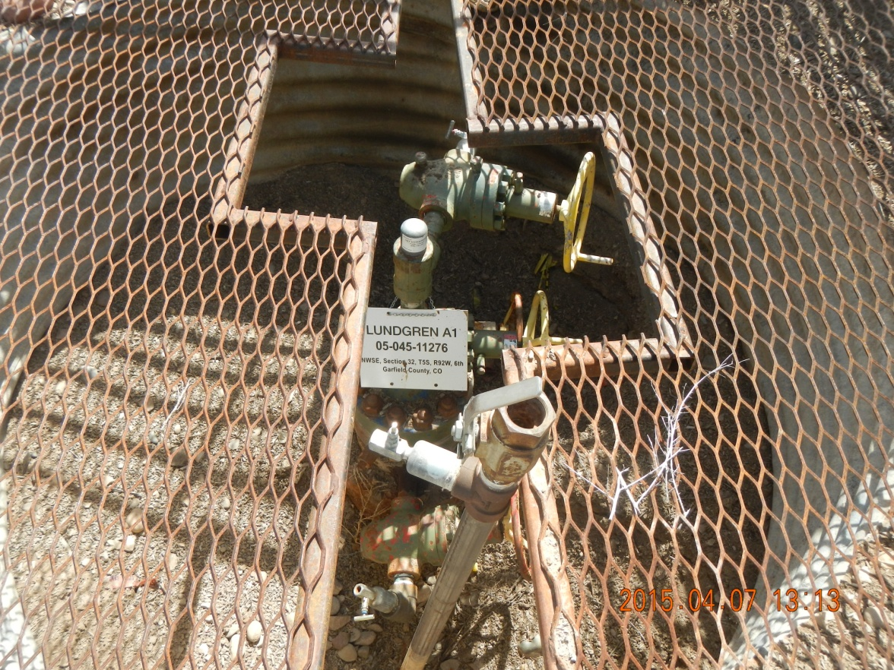
Lundgren Pad
Lundgren Sign on well fence.
Lundgren well, API #045 11276. Well is temporarily abandoned.

Slide 3
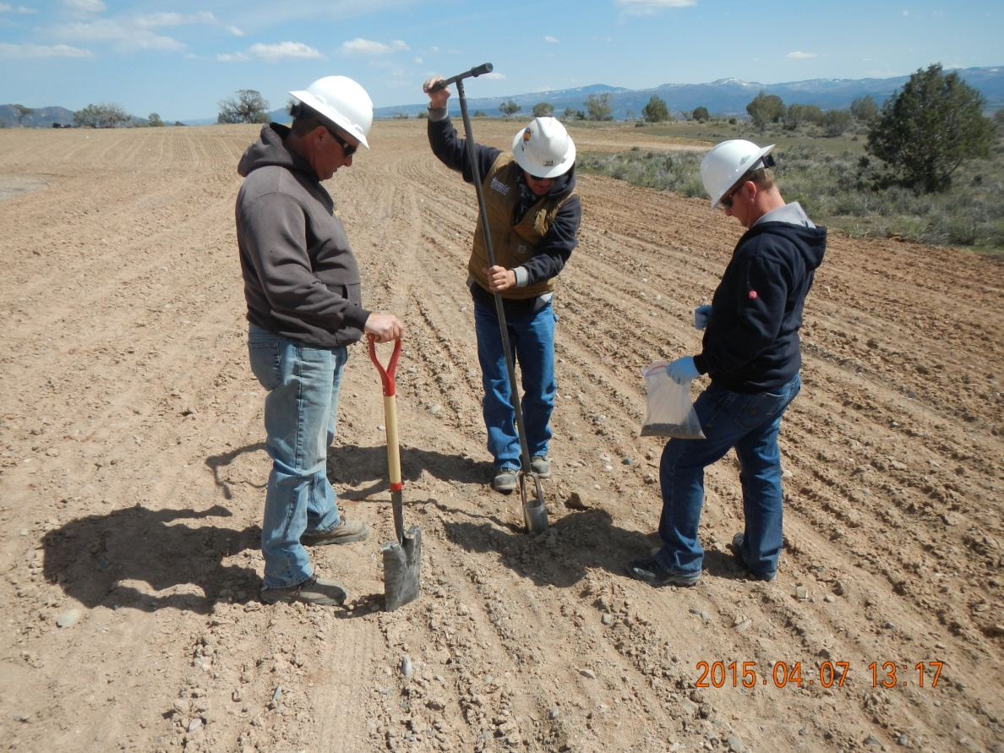
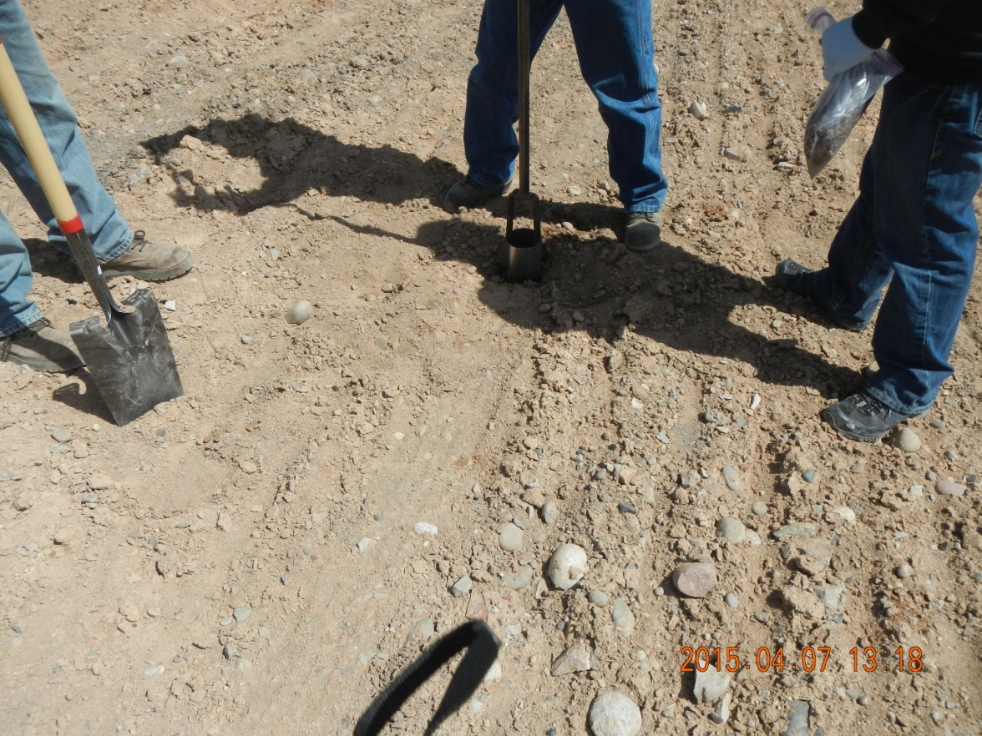
Lundgren Pad
Sampling on the footprint of the former landfarming operation.
Collecting a confirmation sample 4 to 6 inches below the original pad surface.

Slide 4
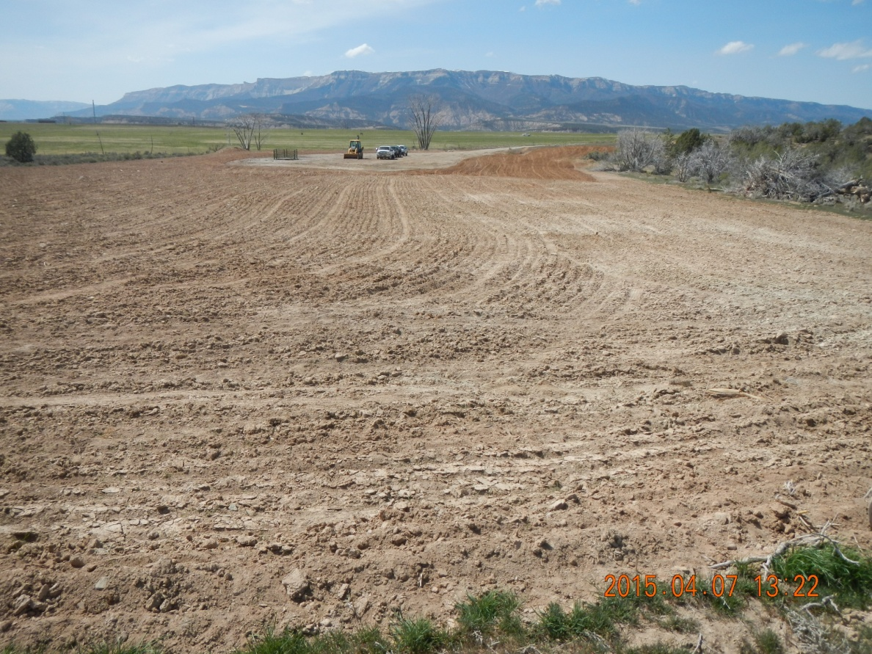
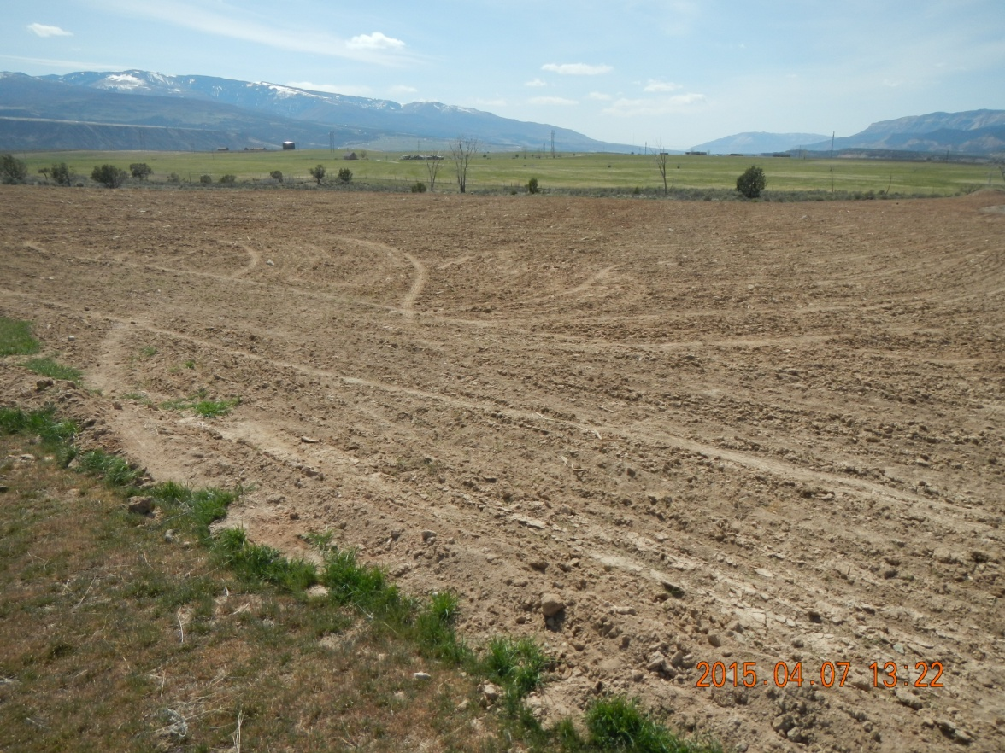
Lundgren Pad
View of the pad looking west, showing the former location of the Centralized Facility (Frac/flowback Pit Facility ID # 149019) and the pad at the distance.
View looking southwest. Pit has been remediated and backfilled. The area has been recontoured and seeded. Vegetation is starting to grow.

Slide 5
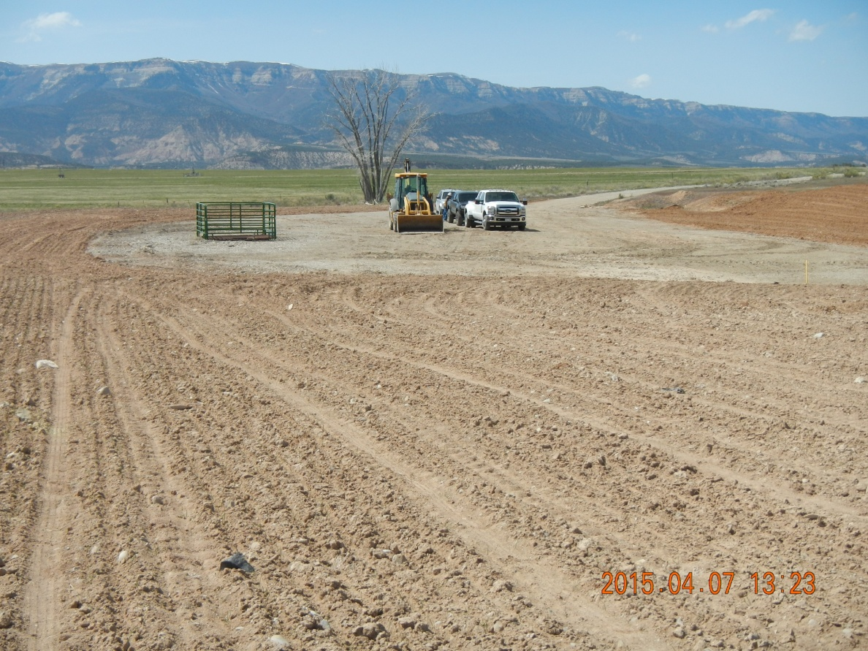
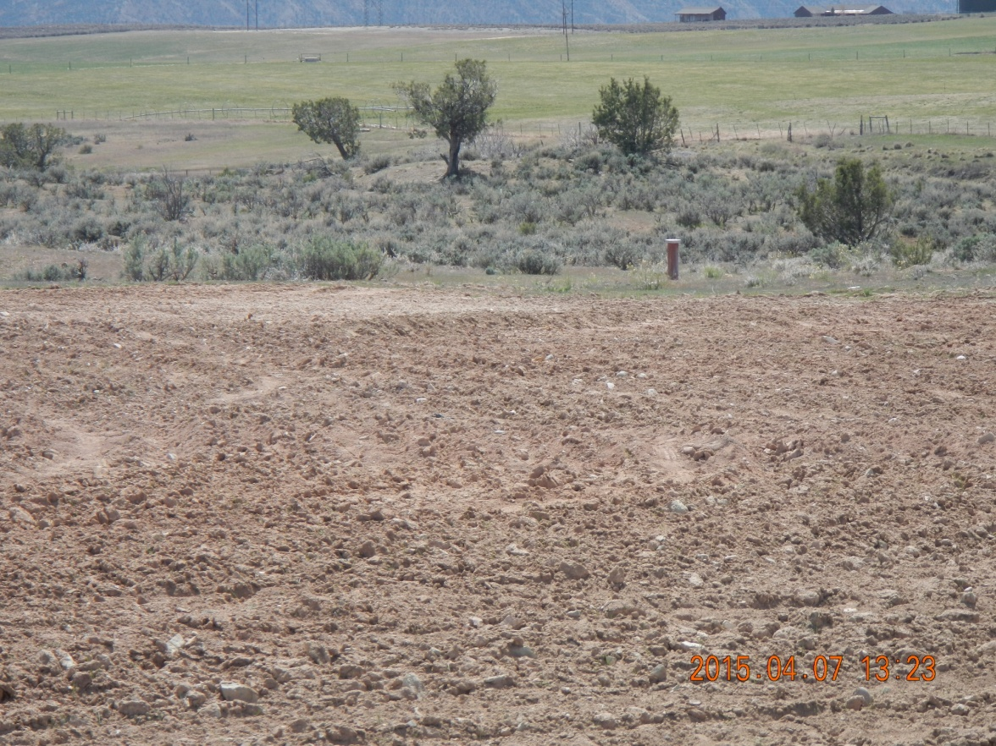
Lundgren Pad
Closer view of the pad. Some pieces of liner, plastic and PVC piping were observed.
Monitoring well south and downgradient of the former pit location. Not in use anymore.

