Slide 1
Ursa
10447
B & V Pad
440643

Slide 2
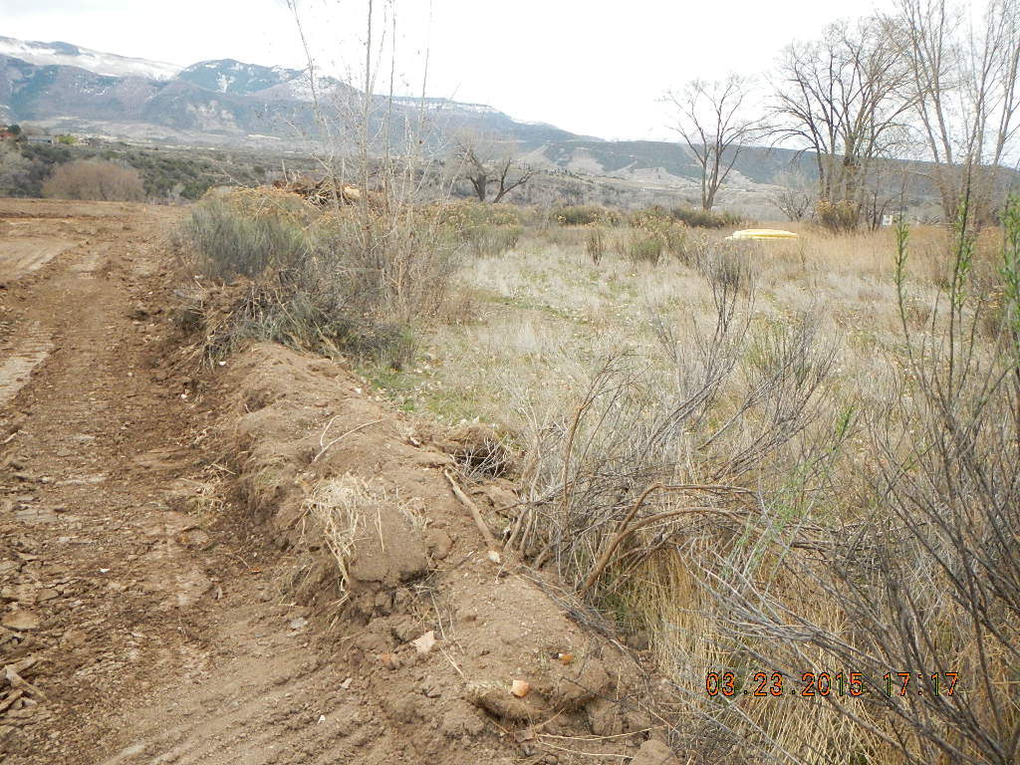
West side of pad

Slide 3
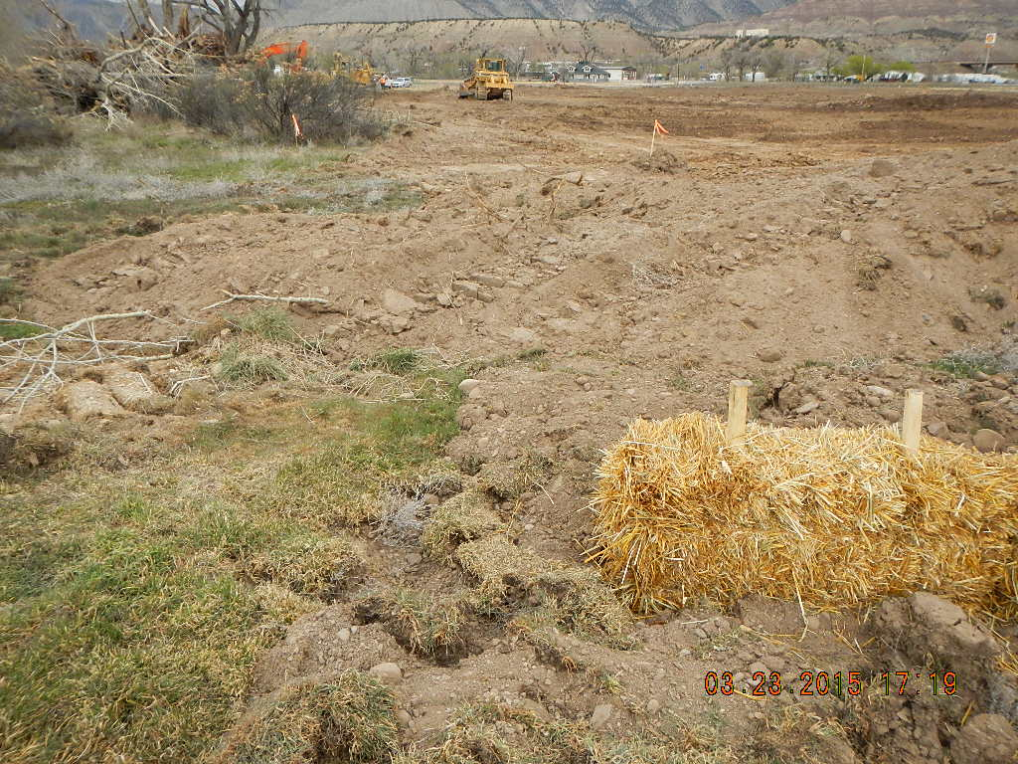
SW corner of pad

Slide 4
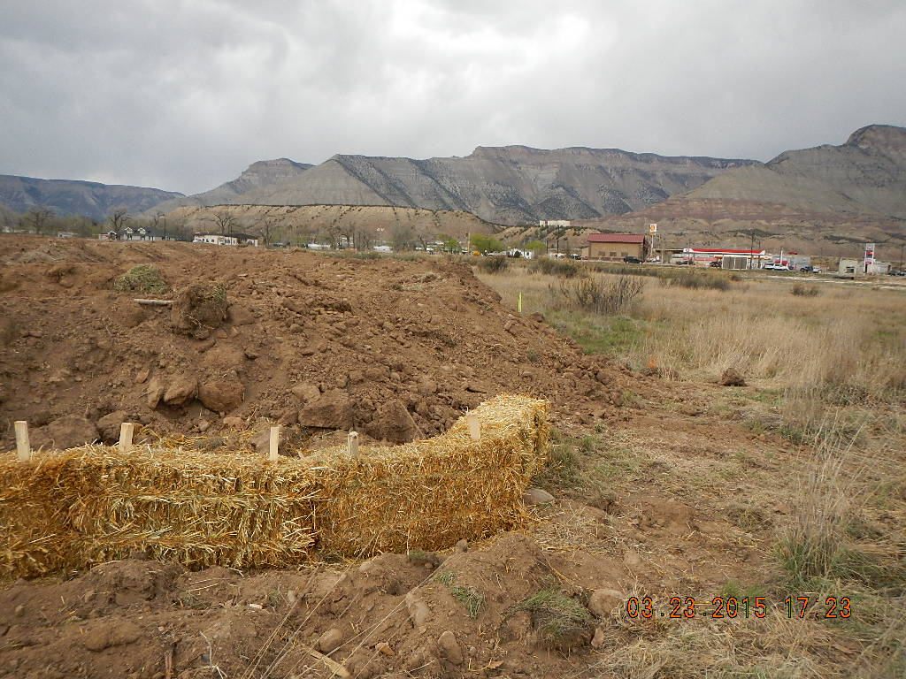
SE Corner of Pad

Slide 5
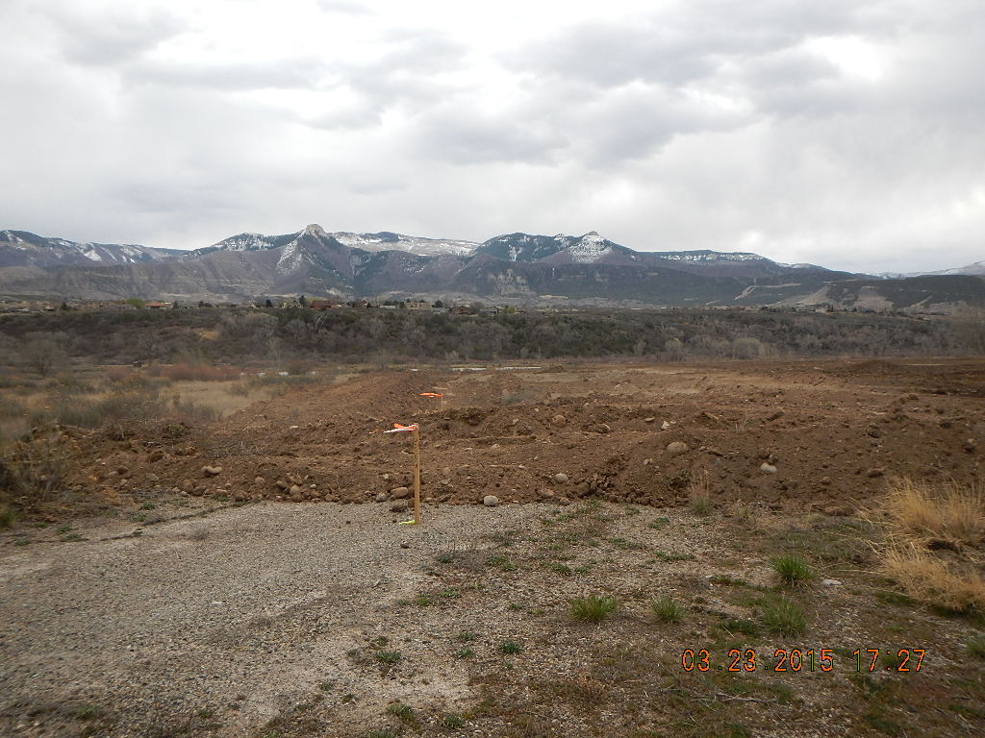
West Side of pad

Slide 6
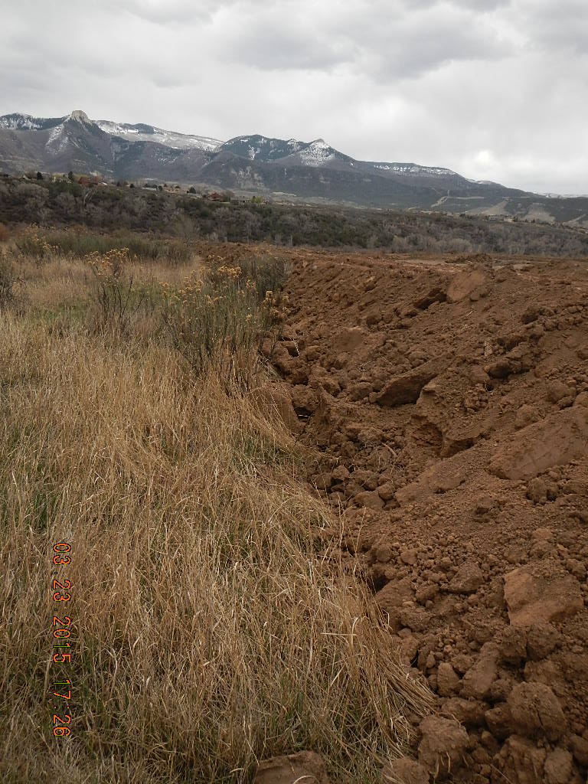
East side of pad

Slide 7
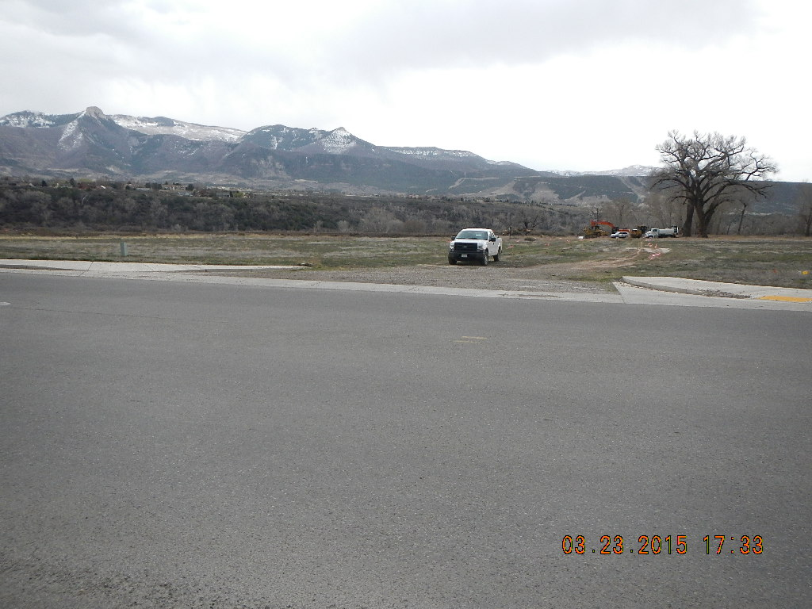
Entry off of cardinal Way

Slide 8
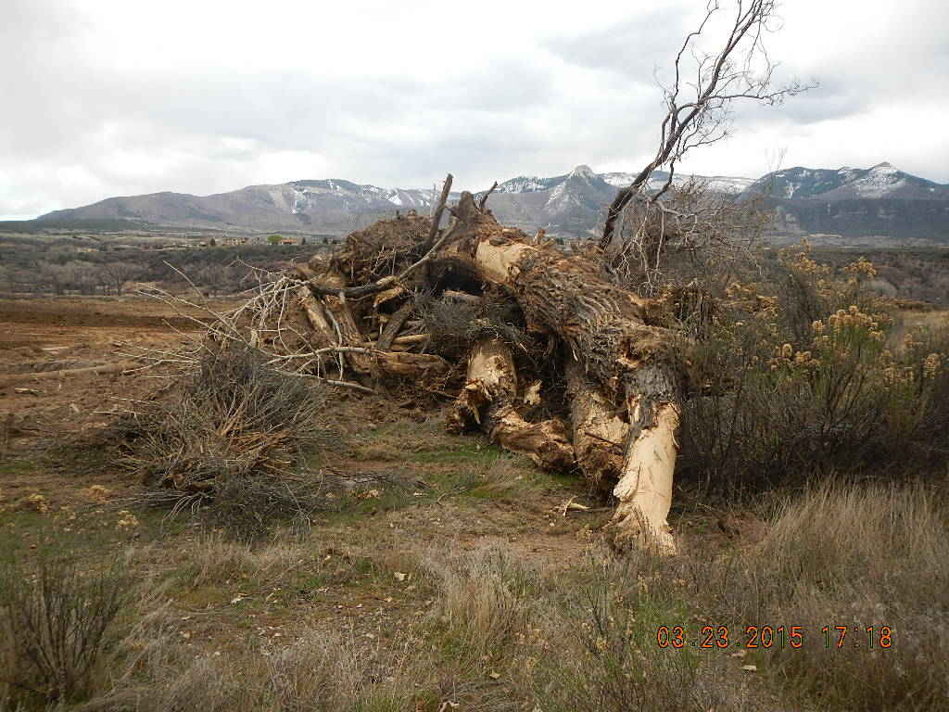
Debris

Slide 9
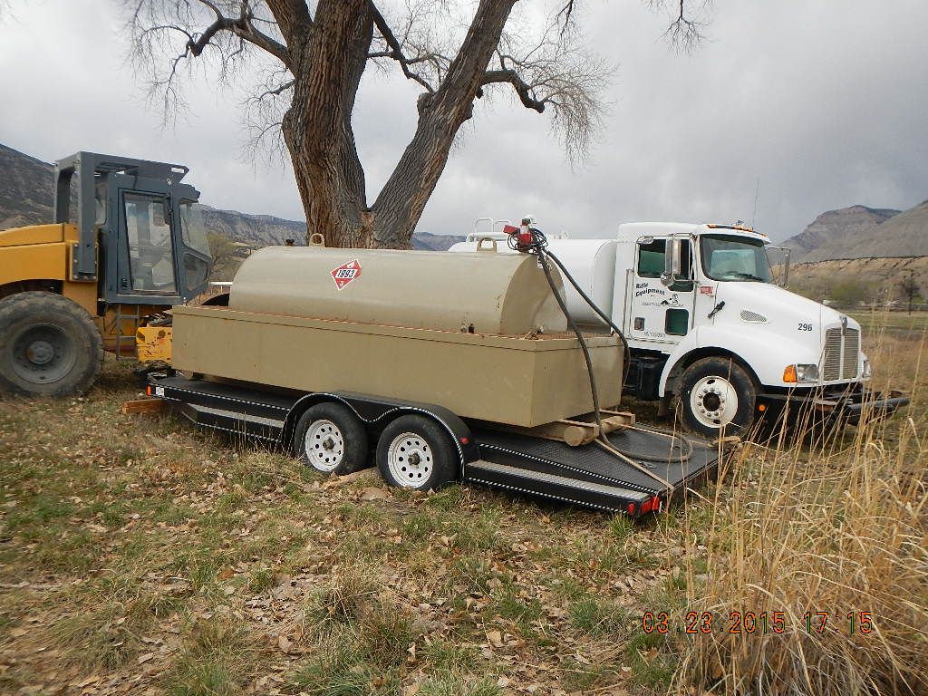
Fueling

Slide 10
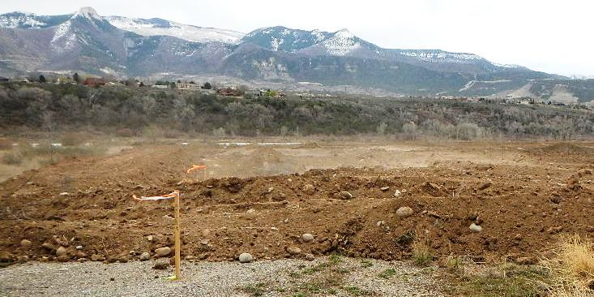
No Dust Control

