Slide 1
Reference Area Photographs
Inspection Conducted on 12, 2015
Grynberg Petroleum Company
Federal 1-32
Location ID #312478
Pit Facility ID # 112102
REM #8943 (Pit Closure)
Spill Report Doc #400789453
Photos taken by Carlos Lujan

Slide 2
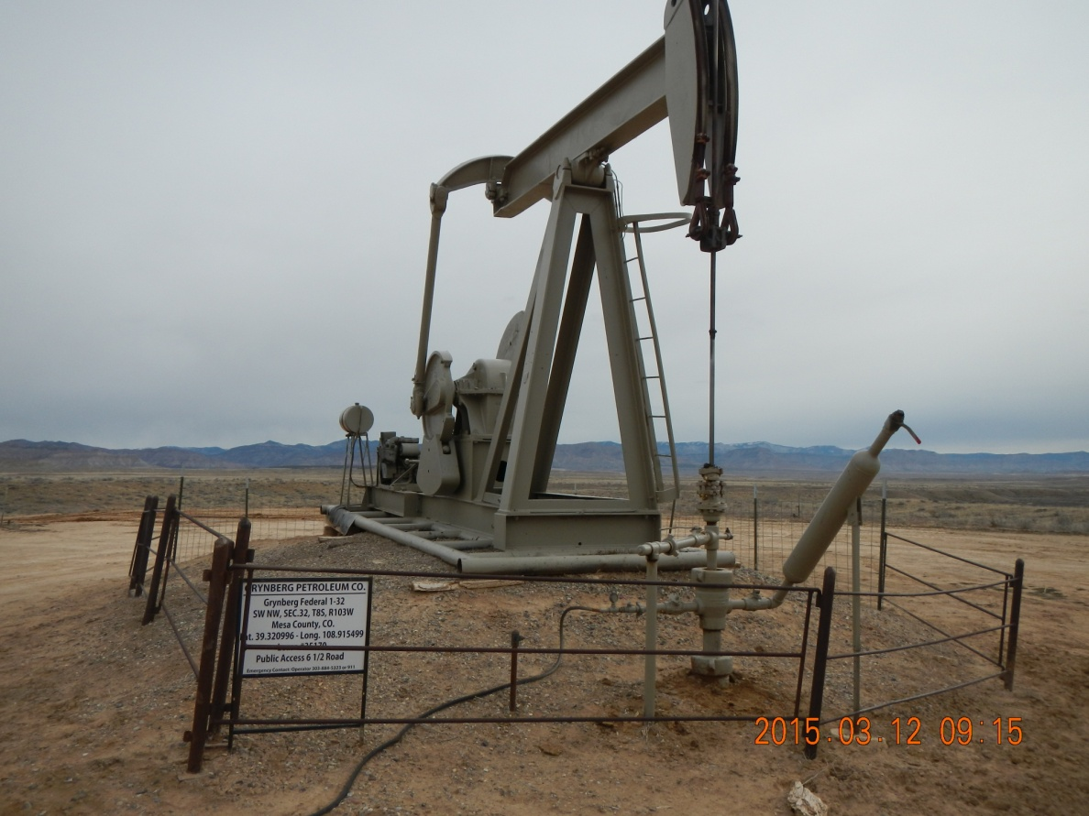
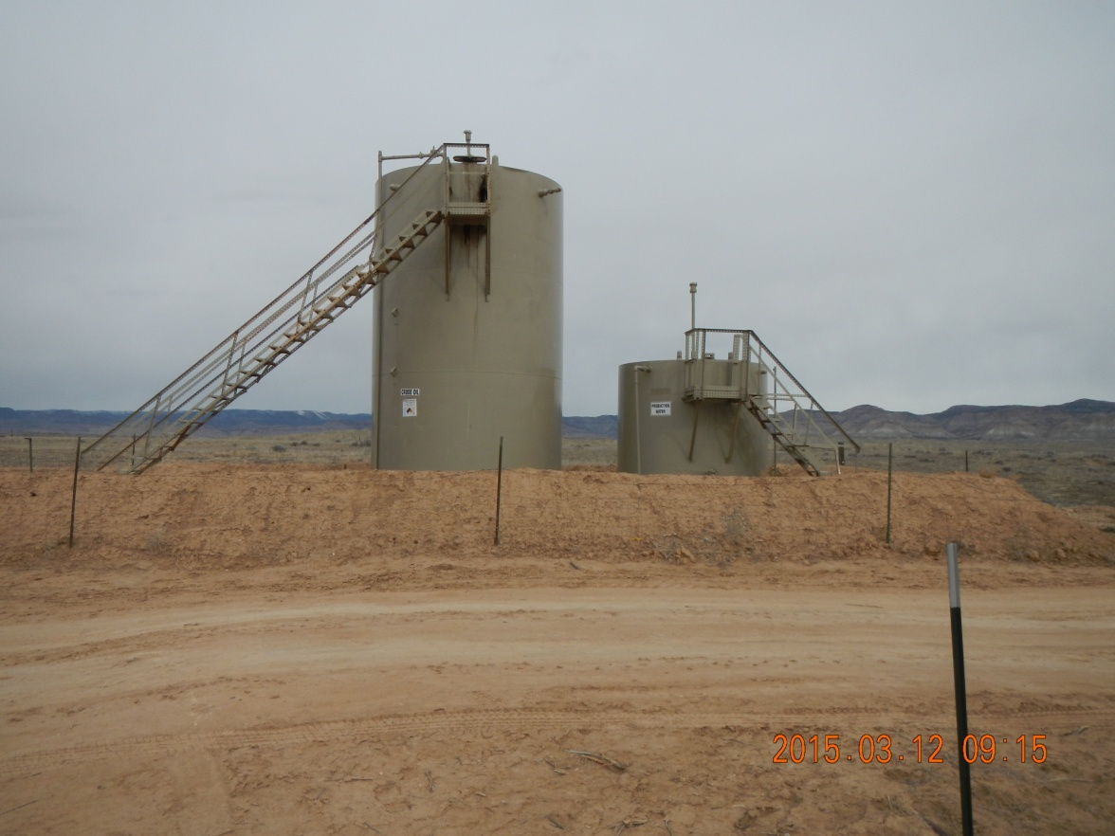
Grynberg Federal 1-32
Pump jack and grasshopper. Label. Fenced.
Tanks are labeled and have secondary containment and fence.

Slide 3
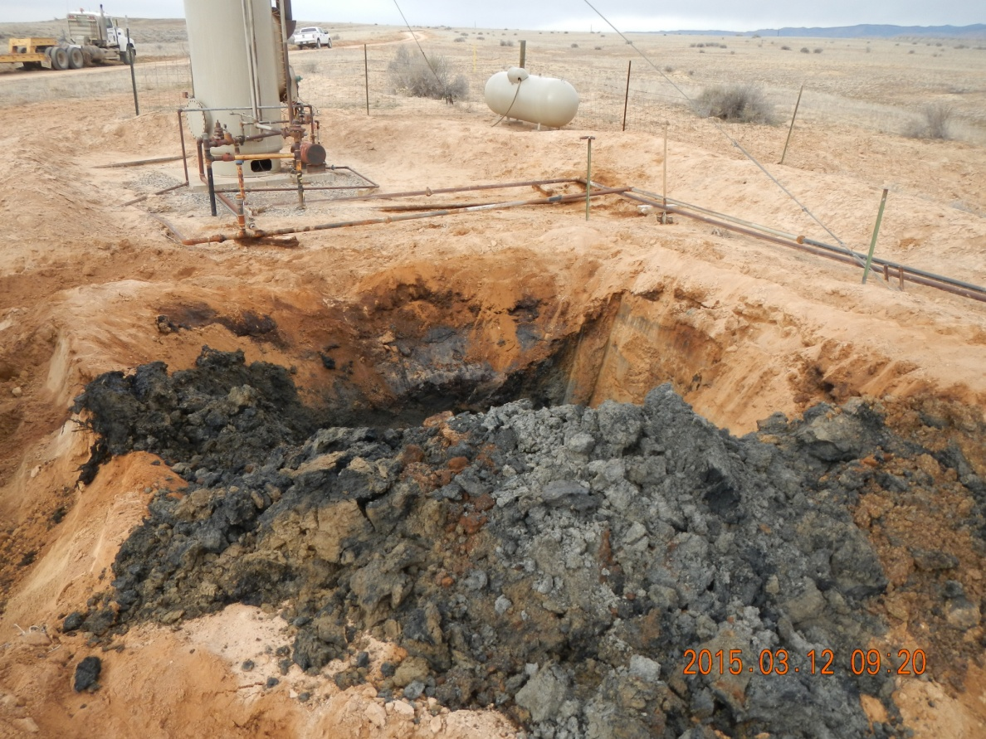
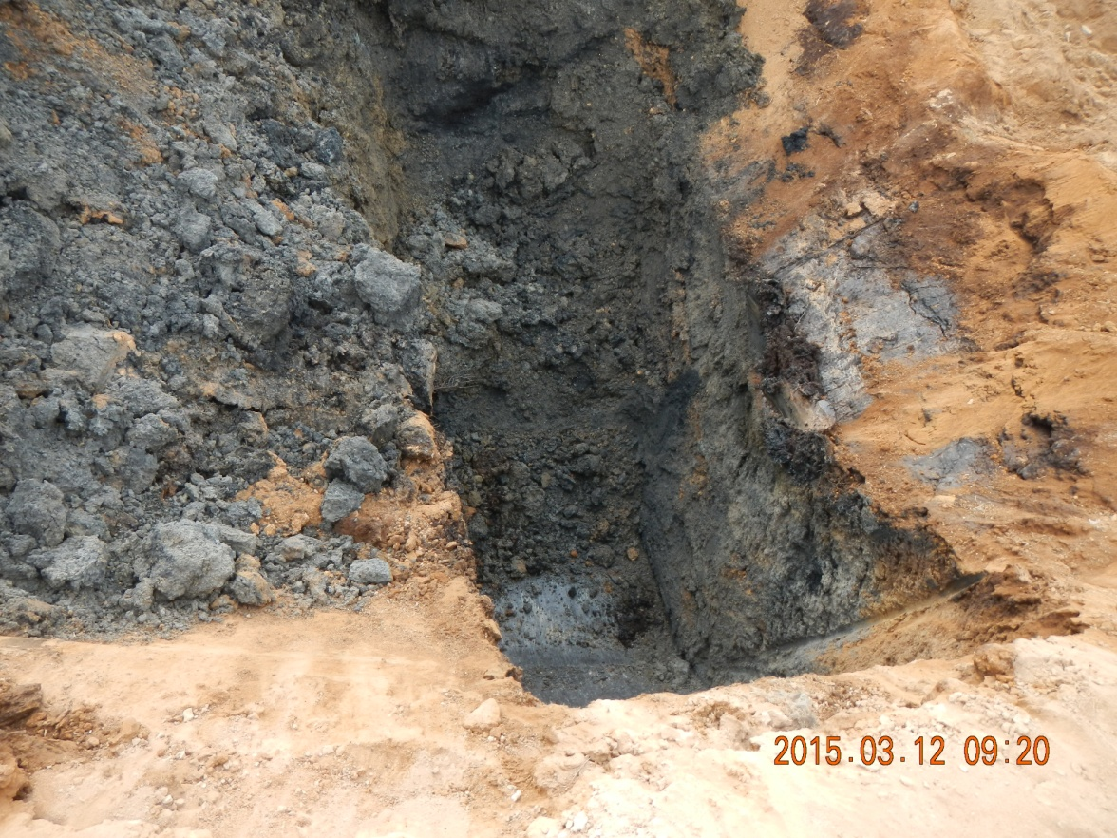
Grynberg Federal 1-32
Beginning of excavation work of 12 X 12 X 6 feet pit (original measures). Impacted material with strong hydrocarbon odor is excavated and stockpiled on the north side of the pad.
Detail of initial excavation. Silty sandy soil impacted with hydrocarbons (black color).

Slide 4
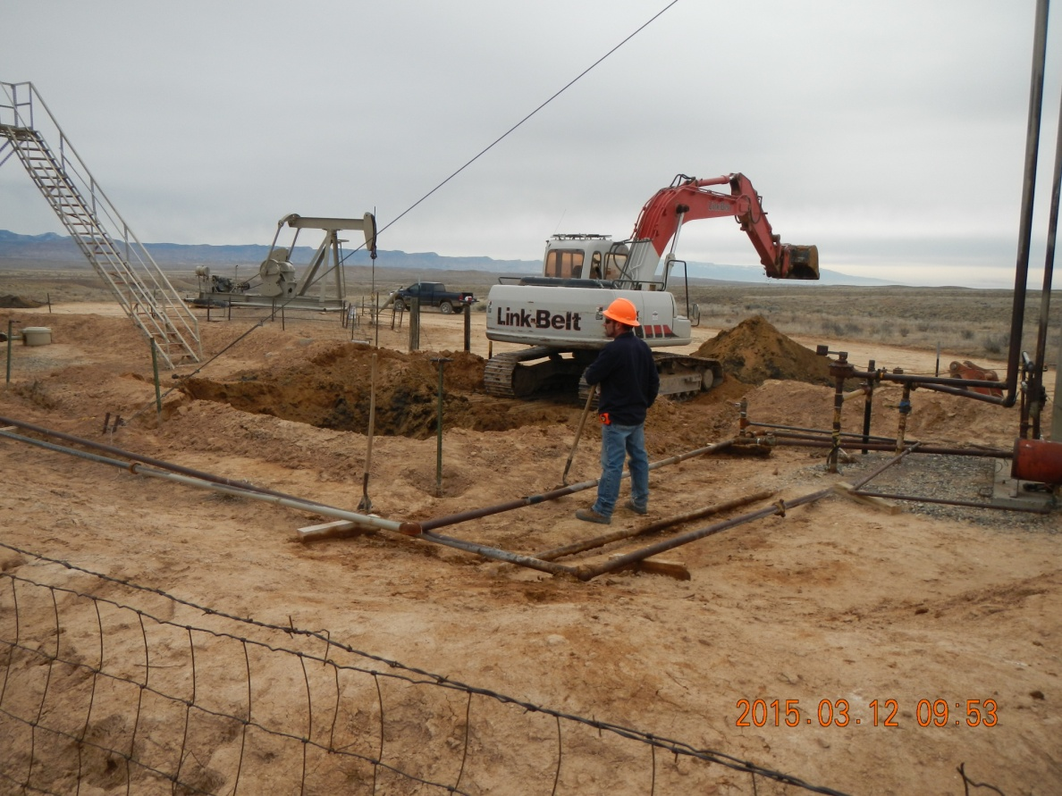
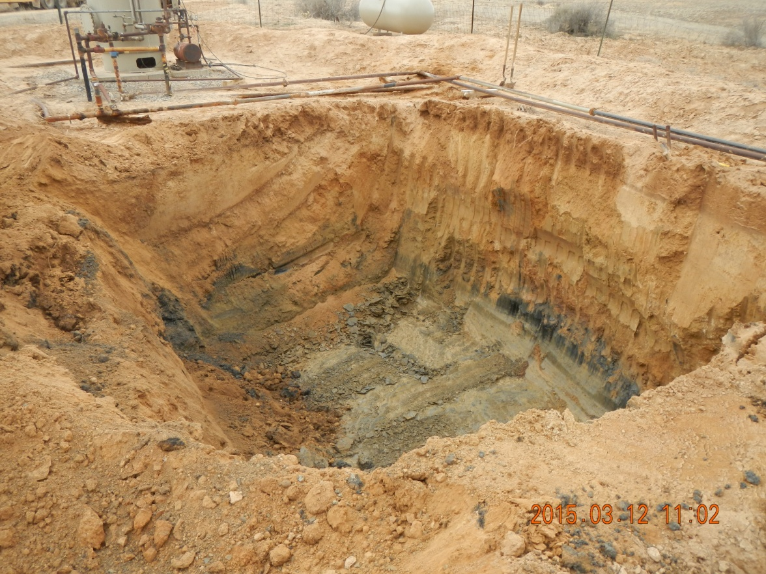
Grynberg Federal 1-32
Excavation in progress. Silty sand, approximately 8 feet thick, underlain by weathered shale.
TPH concentration in walls and bottom closer to Table 910-1. Excavation work almost completed. Consultant will take confirmation samples. Grey material at the bottom is shale..

Slide 5
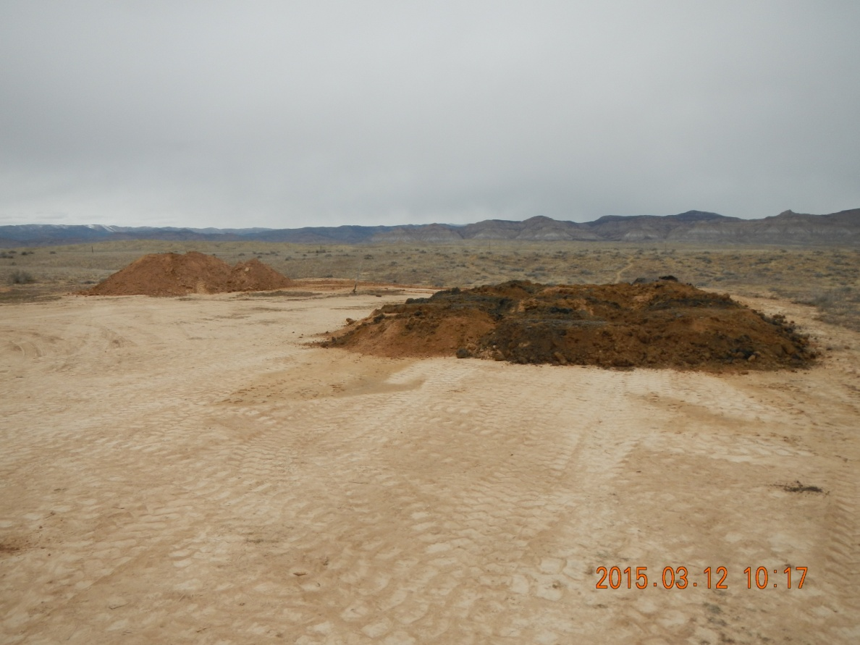
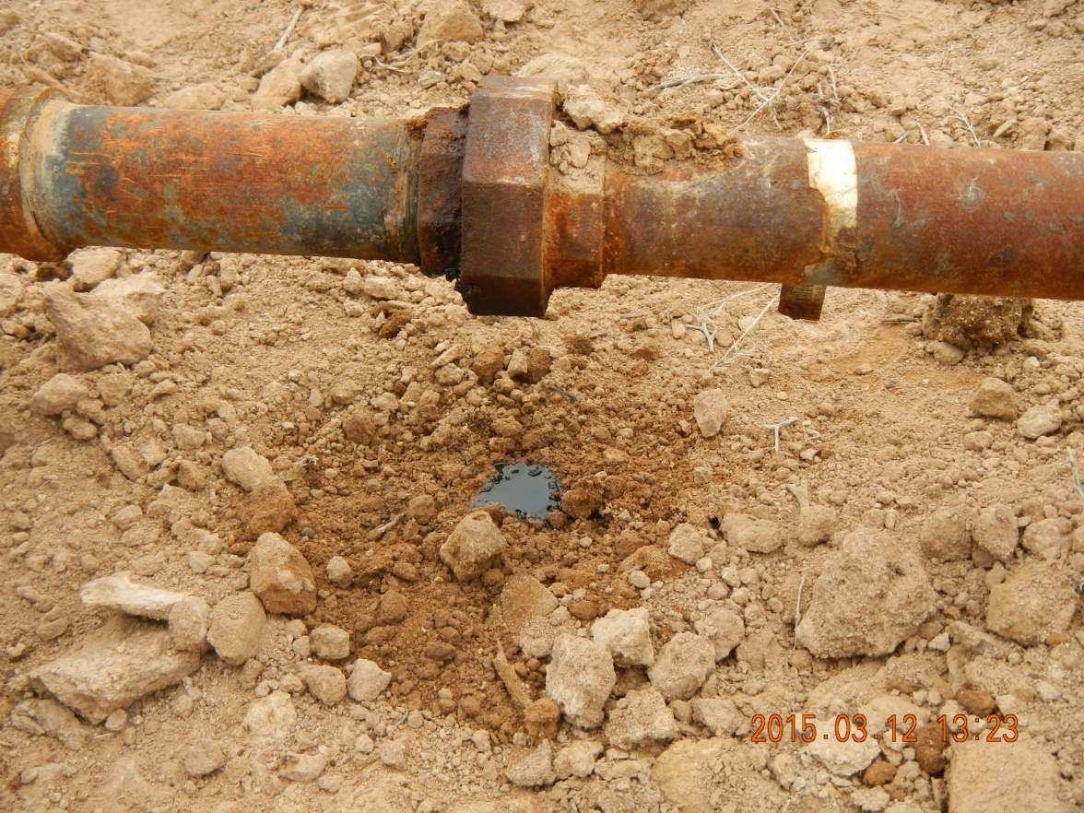
Grynberg Federal 1-32
Impacted material segregated. At the end of the day, volume was considerably larger. Grynberg will manage E&P waste in consultation with BLM and COGCC.
Leak of condensate was fixed immediately. Some maintenance required on flowlines and piping in general.

Slide 6
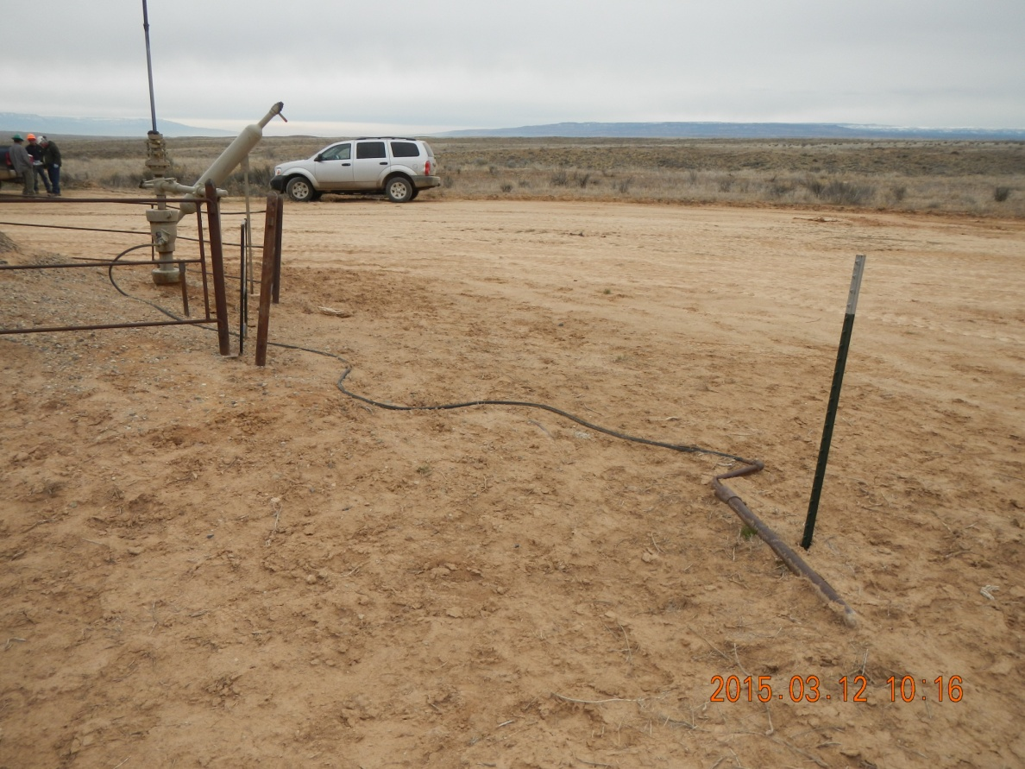
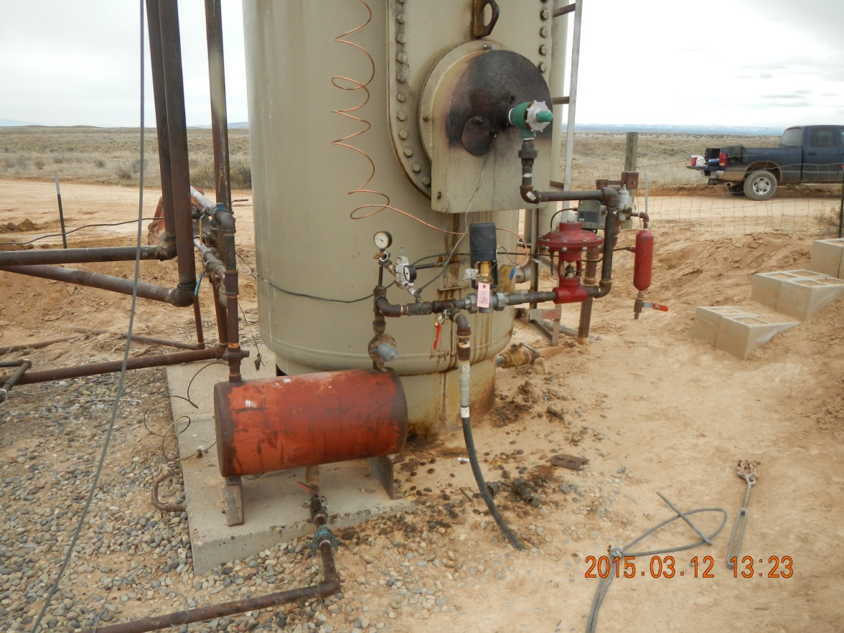
Grynberg Federal 1-32
Piping and tubing requires maintenance.
Maintenance required. Staining.

Slide 7
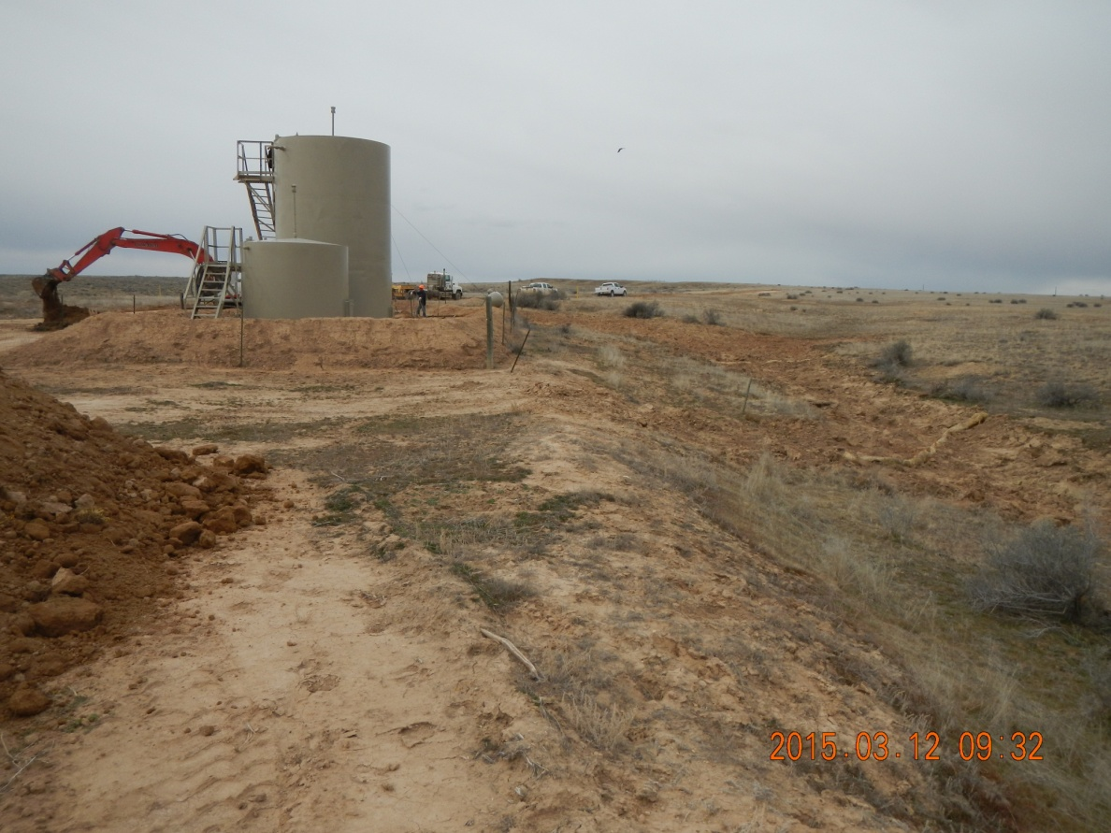
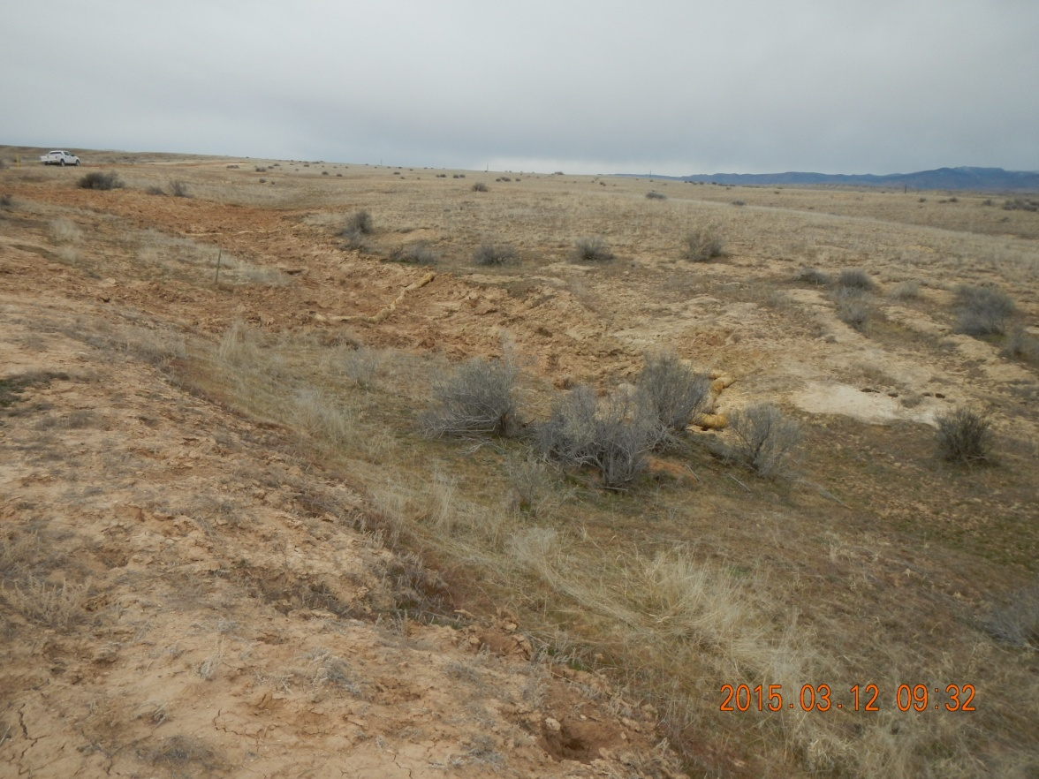
Grynberg Federal 1-32
Right side of the picture: Natural drainage were condensate was spilled (See Spill report doc # 400789453. Impacted material excavated; area re-contoured.
Impacted area after remediation, waiting for reseeding. The BLM is supervising the reclamation and specifying the seed mix.

