Slide 1
WPX Energy
Location # 335214

Slide 2
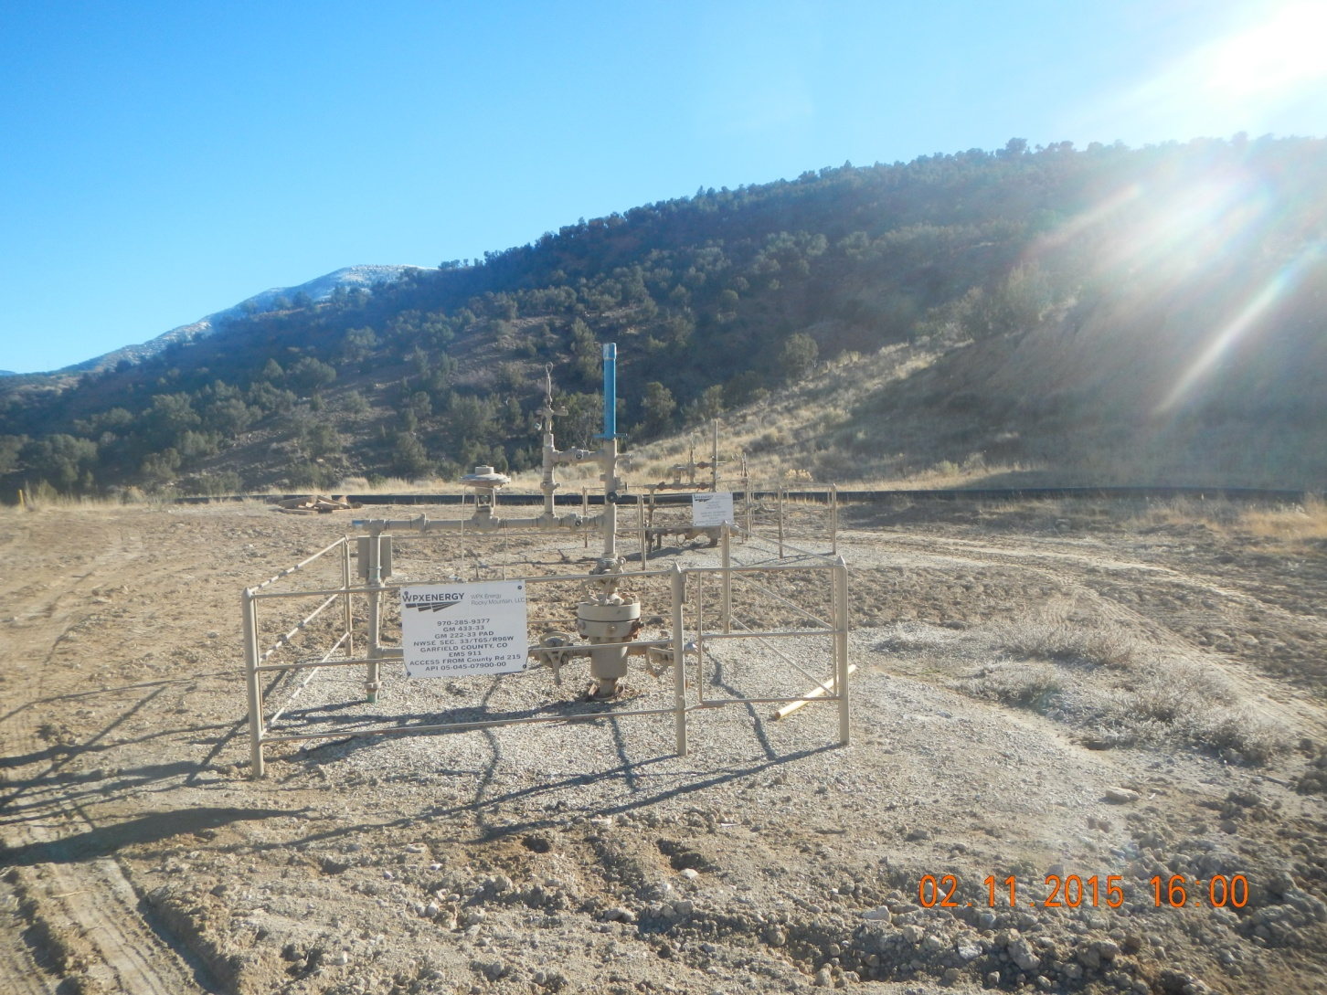
Wood blocks and poly water line

Slide 3
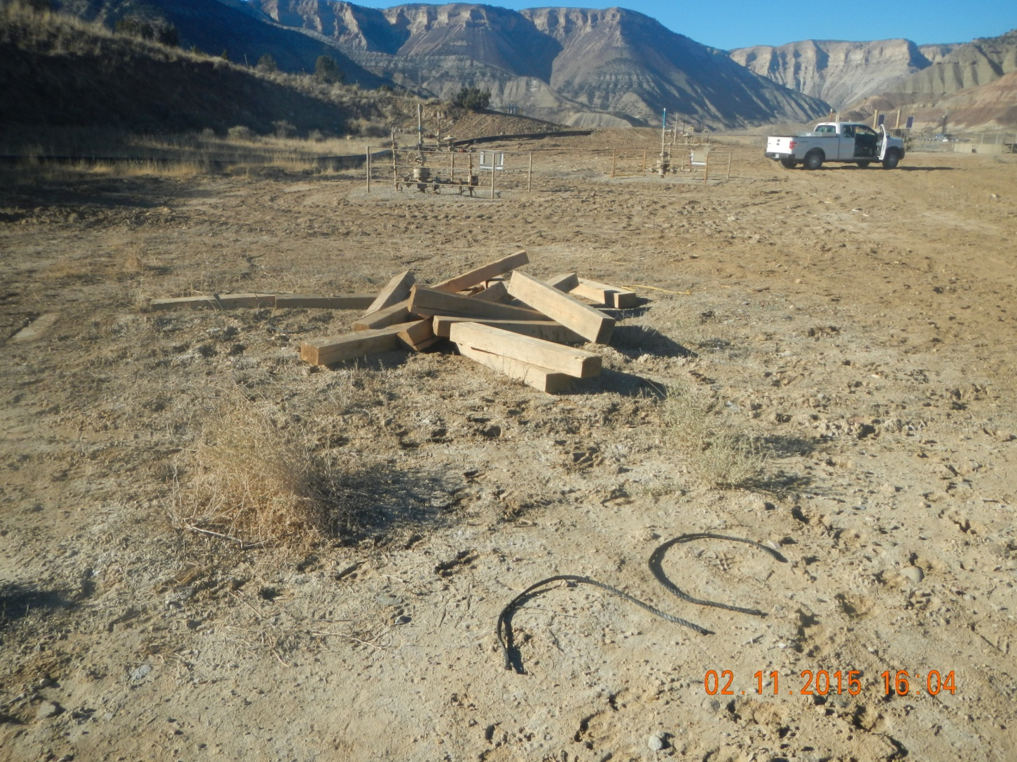
Wood blocks and poly water line

