Slide 1
Caerus Piceance LLC
Unocal-EnCana 23D-4D
Location # 335618

Slide 2
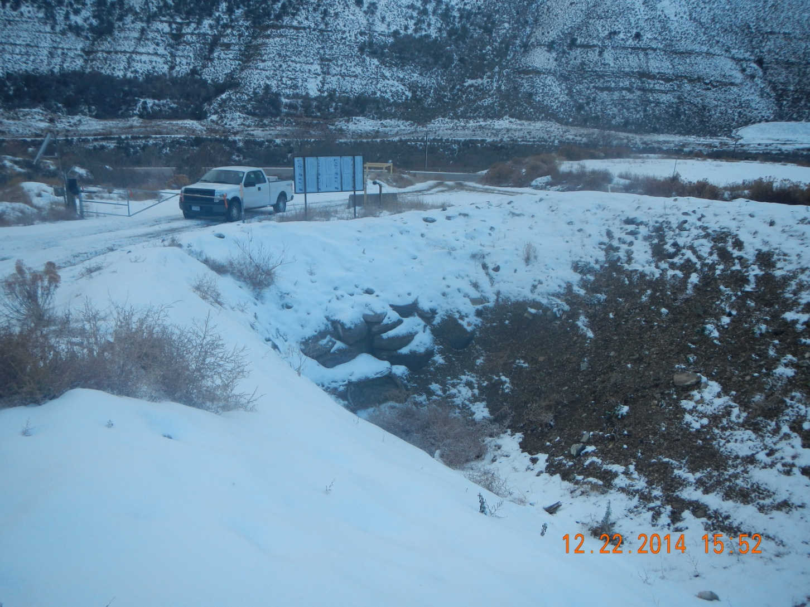
Plugged culvert

Slide 3
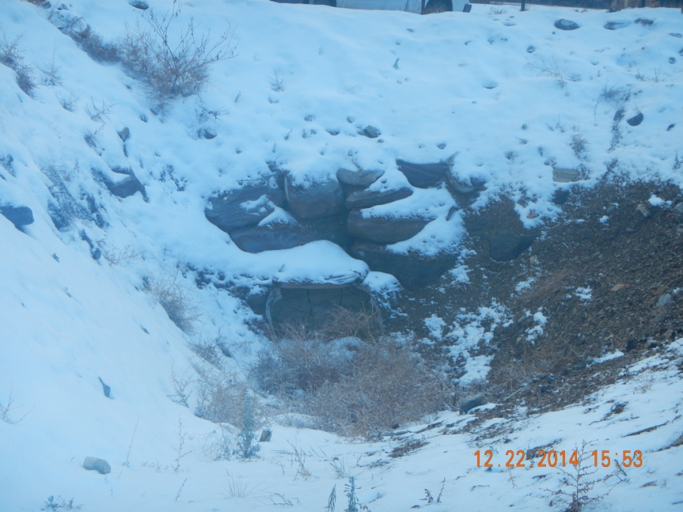
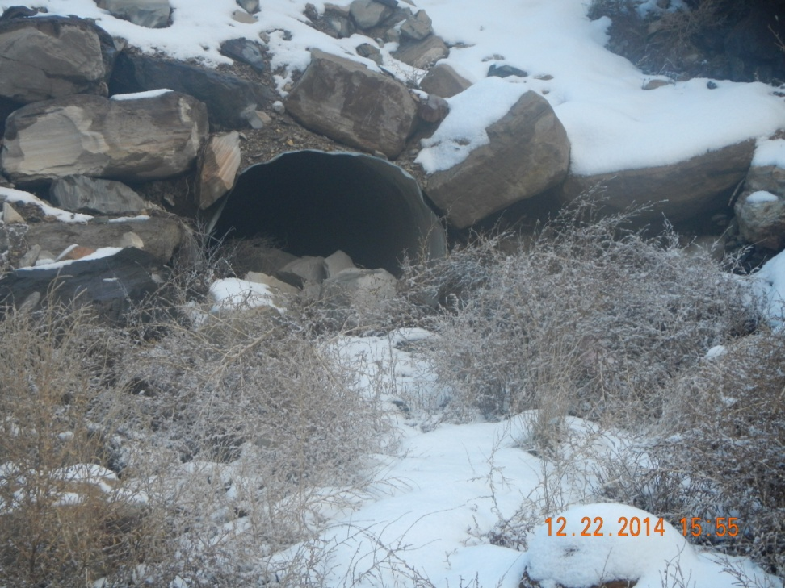
Inlet
Outlet

Slide 4
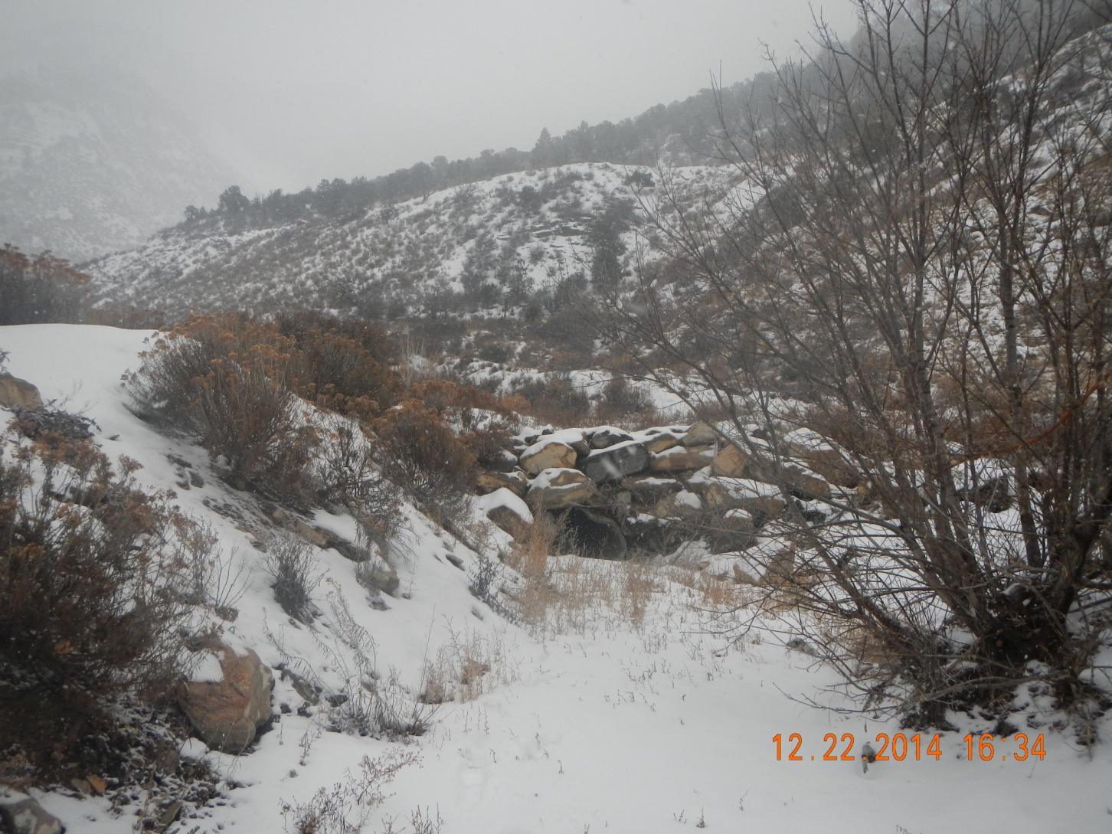
Culvert inlet – outlet not found

Slide 5
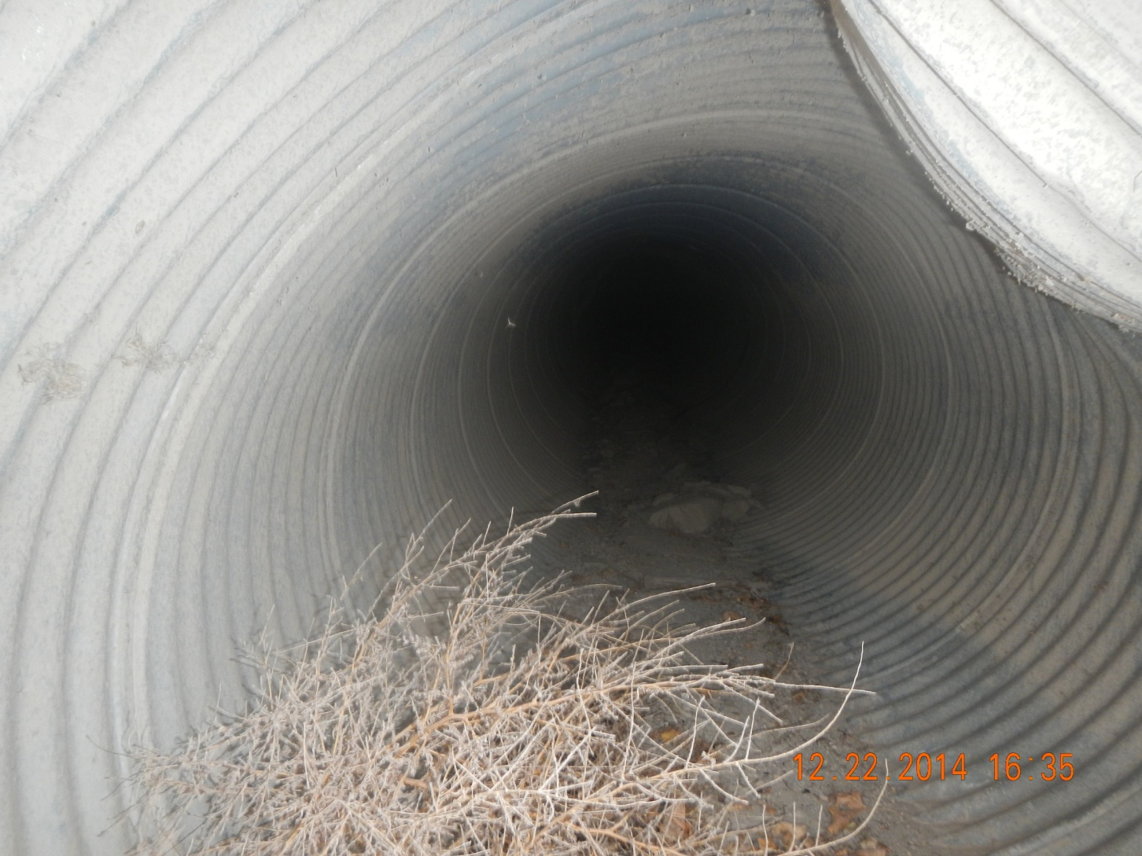
Inlet of culvert no daylight

Slide 6
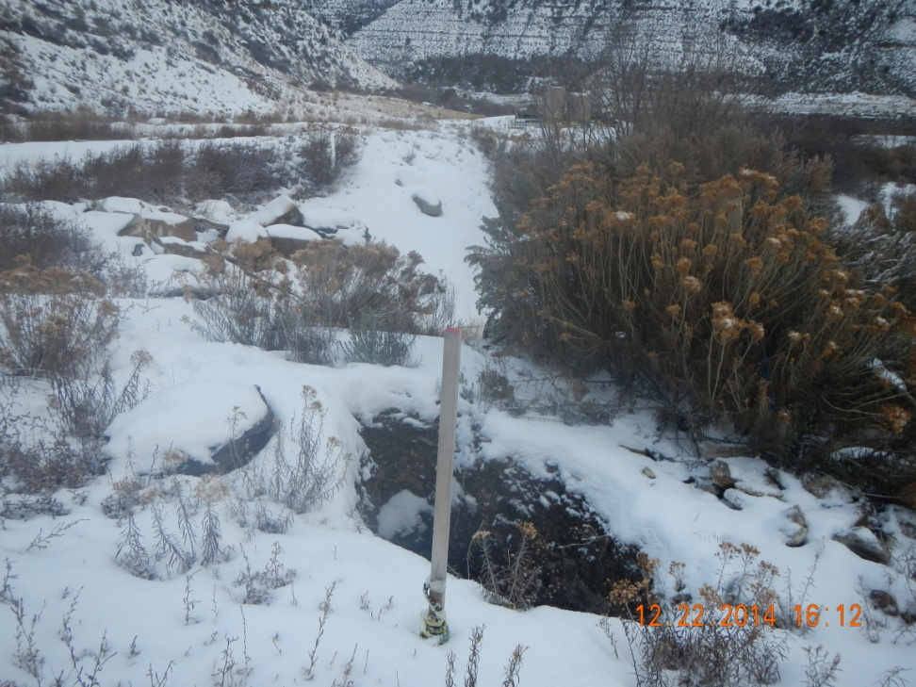
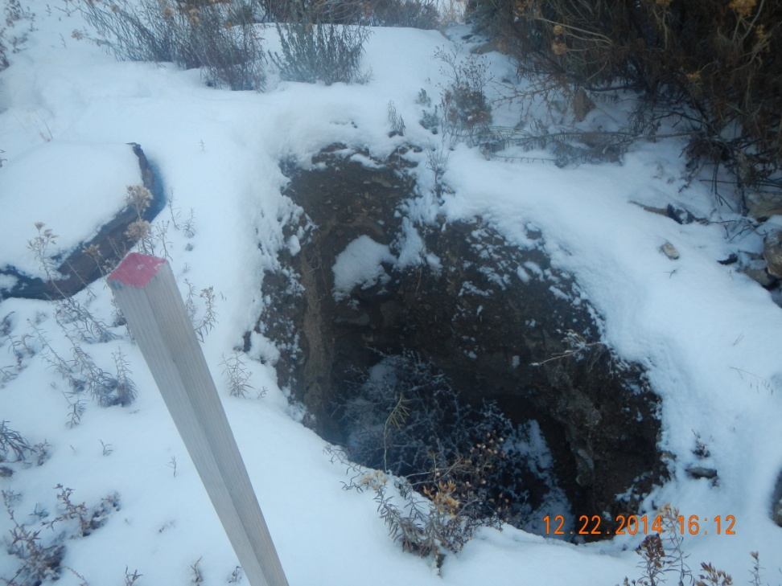
Open hole at culvert

