Slide 1
EnCana Oil and Gas
Location # 335598

Slide 2
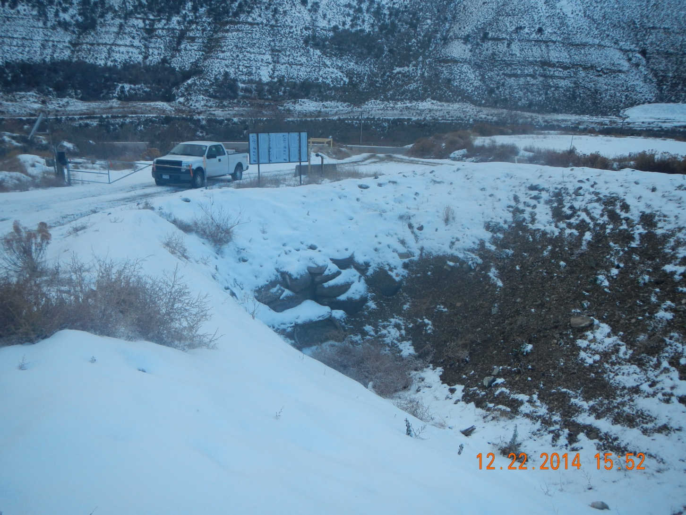
Plugged culvert

Slide 3
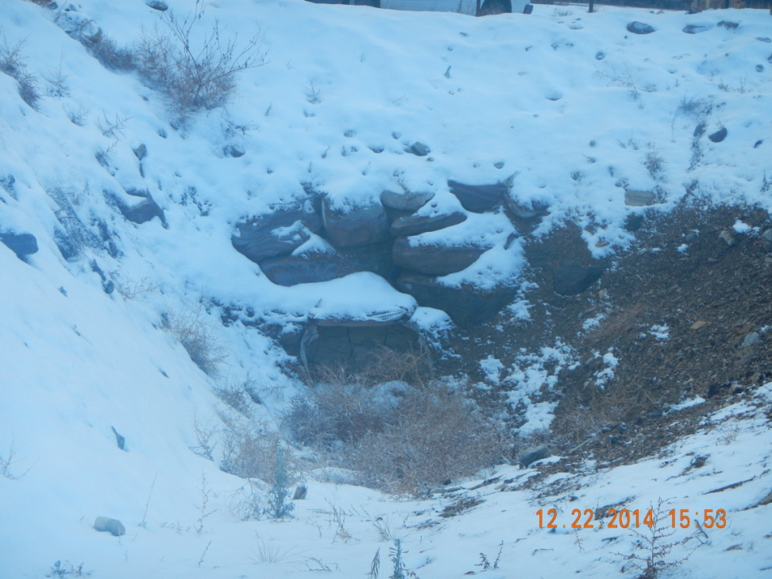
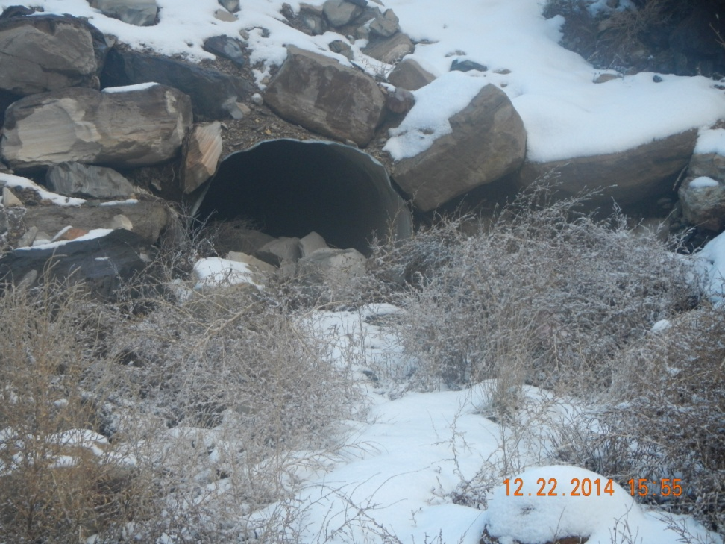
Inlet
Outlet

Slide 4
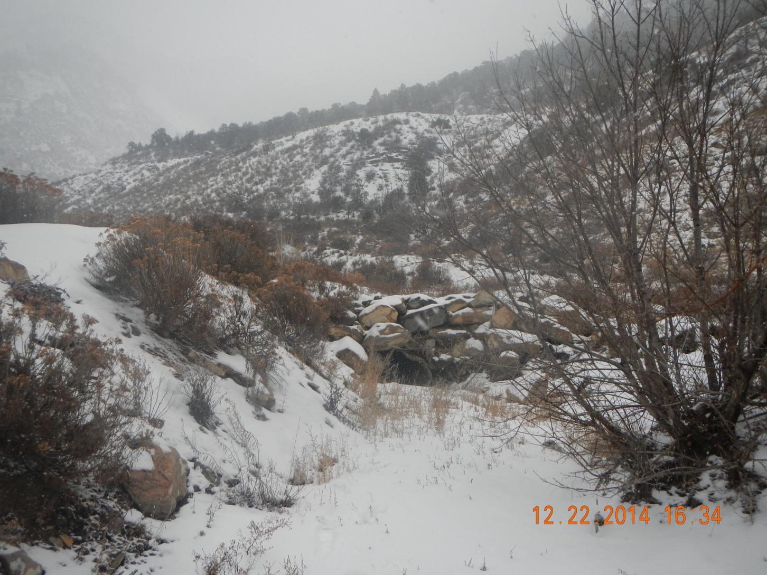
Culvert inlet – outlet not found

Slide 5
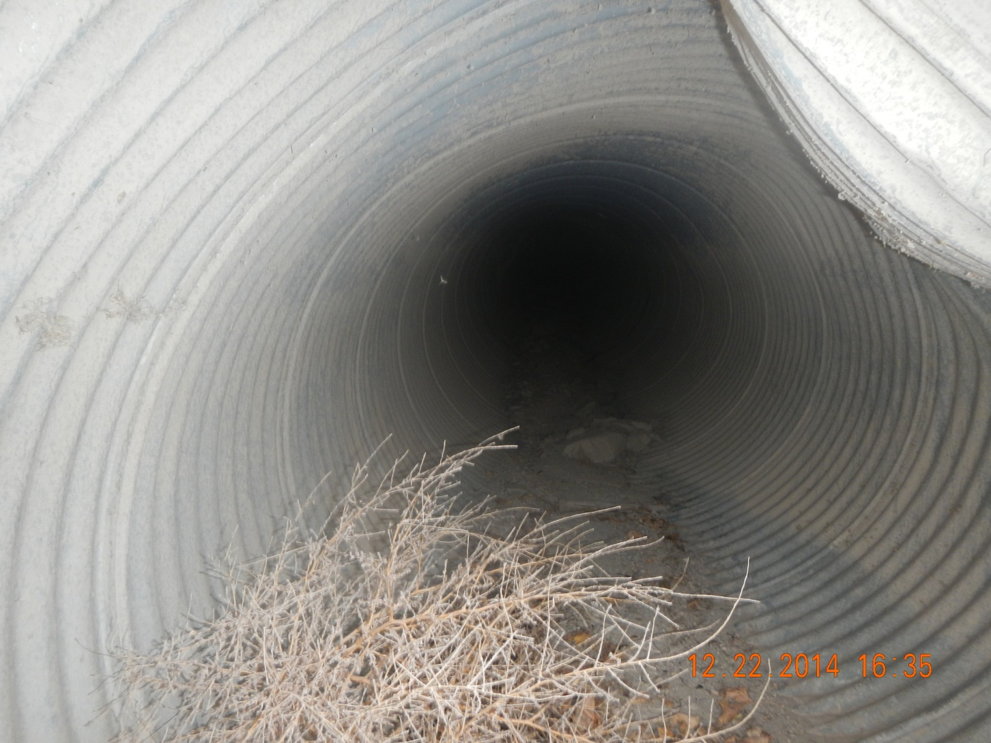
Inlet of culvert no daylight

Slide 6
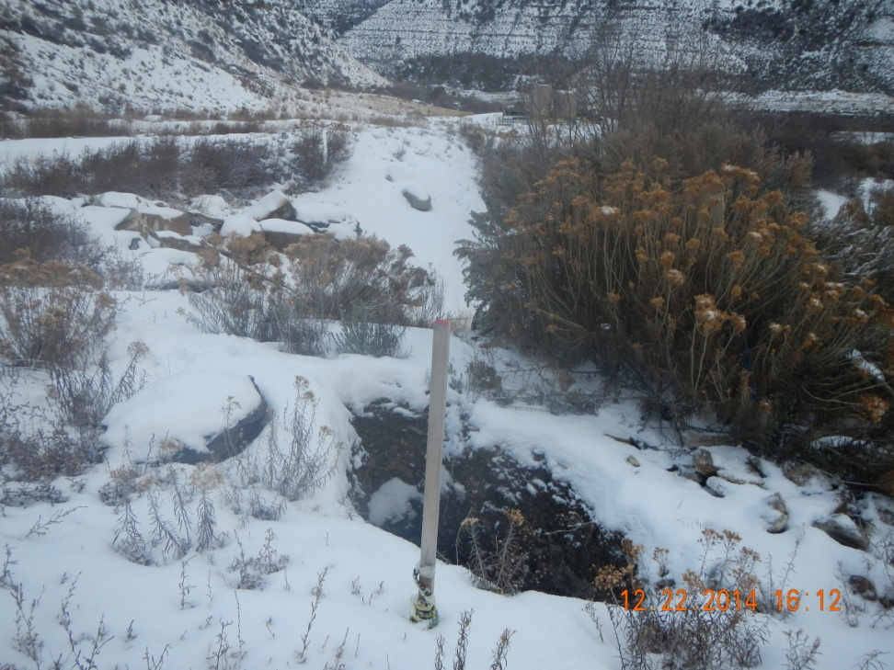
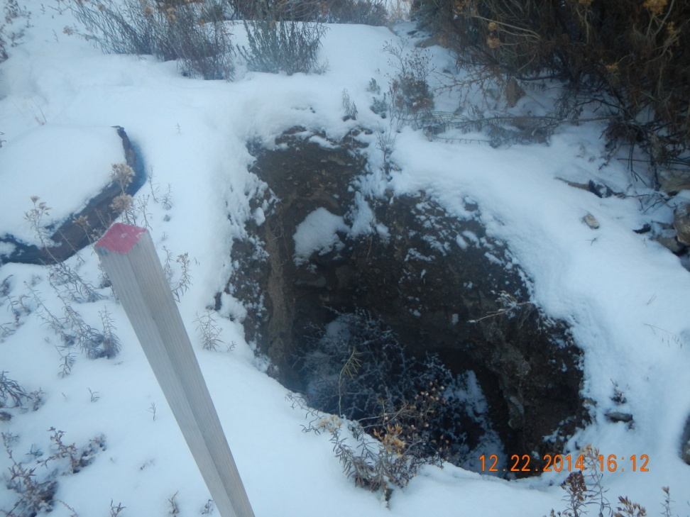
Open hole at culvert

