Slide 1
Caerus Piceance LLC
UNOCAL 24-4D
Location # 335778

Slide 2
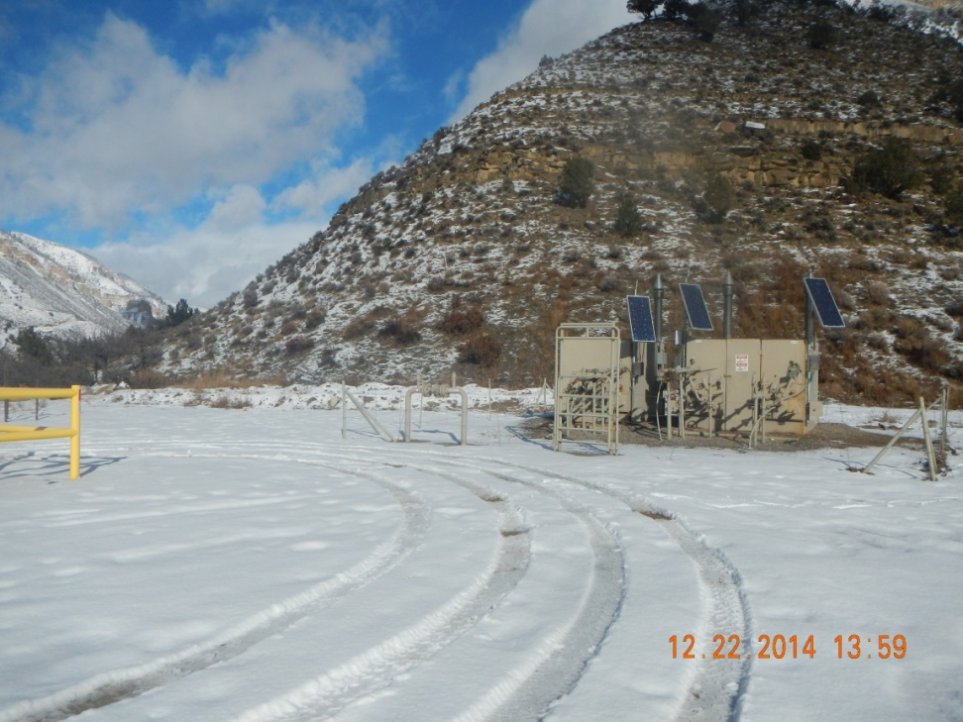
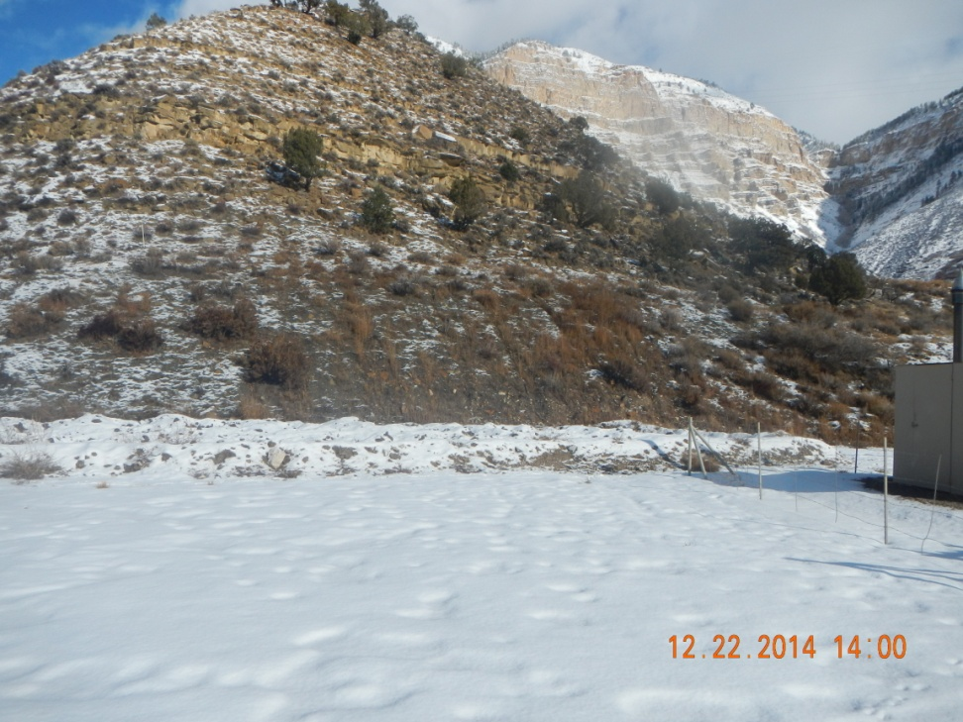
Landfarm on hillside

Slide 3
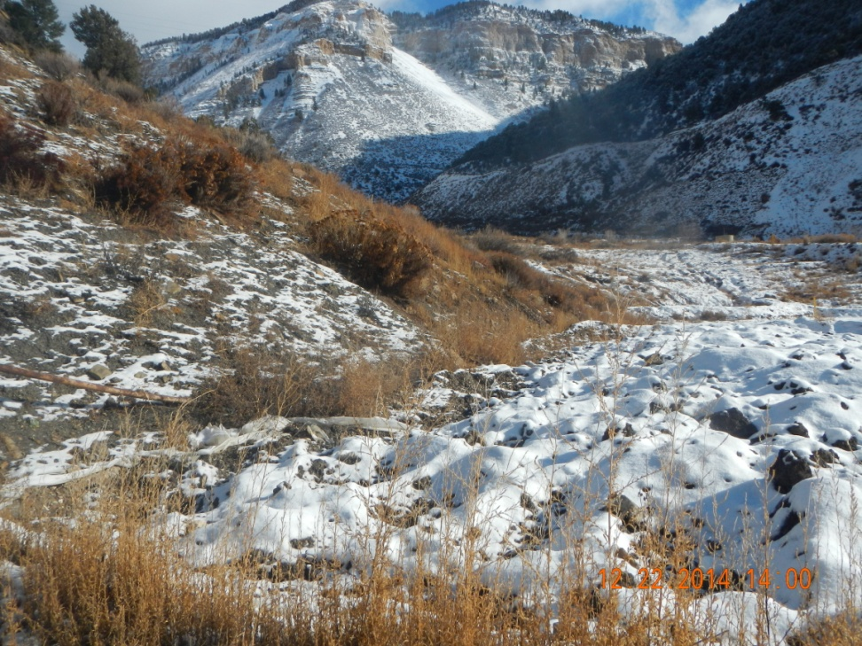
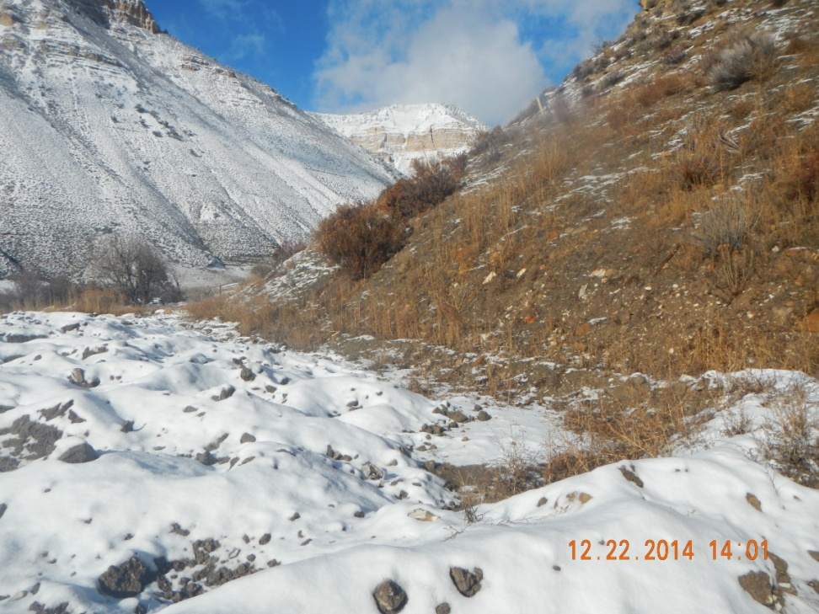
No run on BMPs

