Slide 1
CAERUS PICEANCE LLC
10456
UNOCAL-ENCANA
66S96W17NESE
Location # 335684

Slide 2
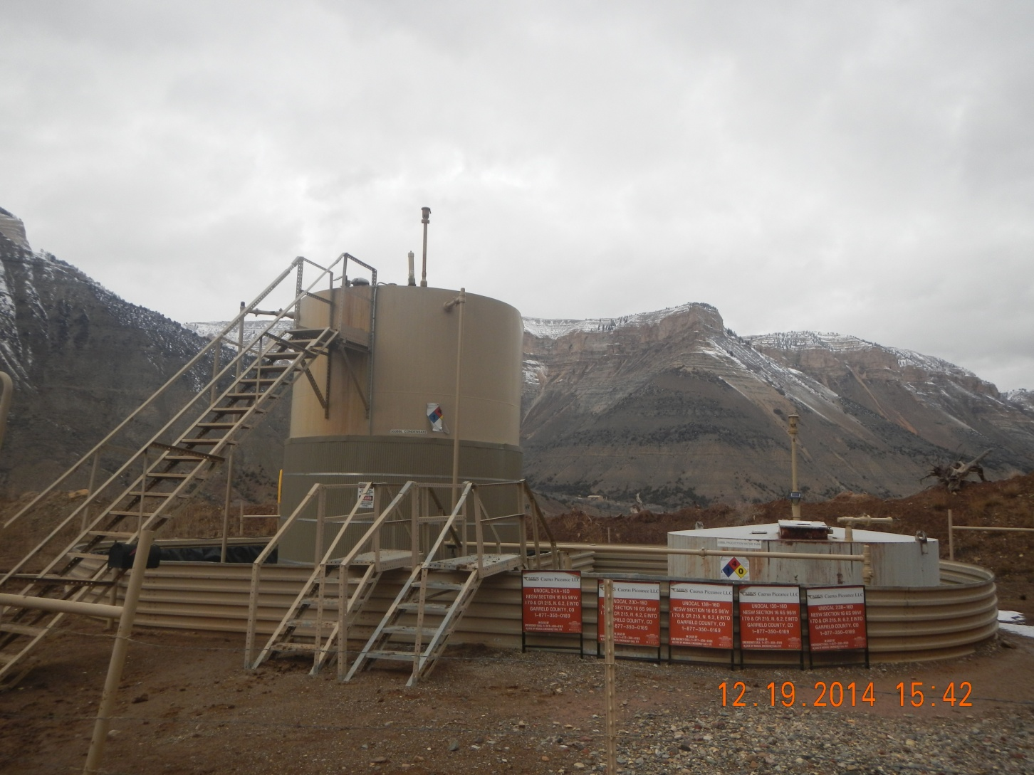
Peeling label

Slide 3
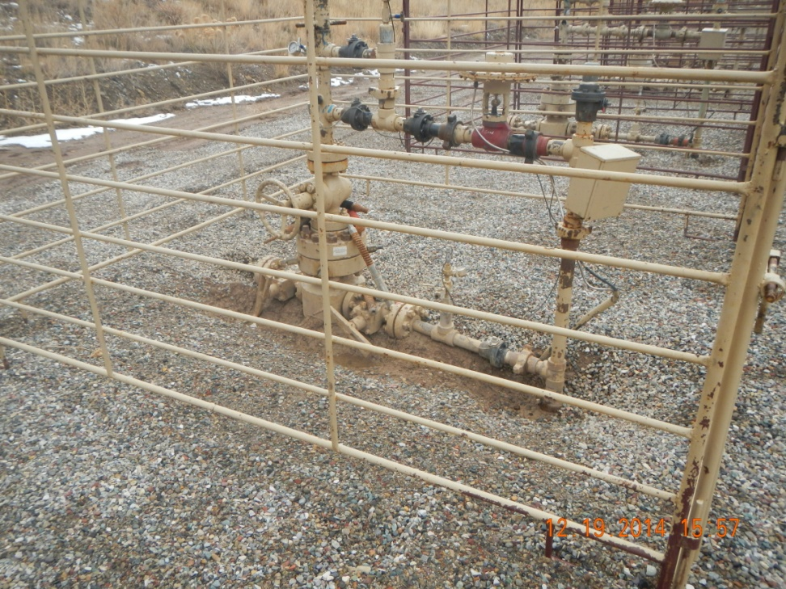
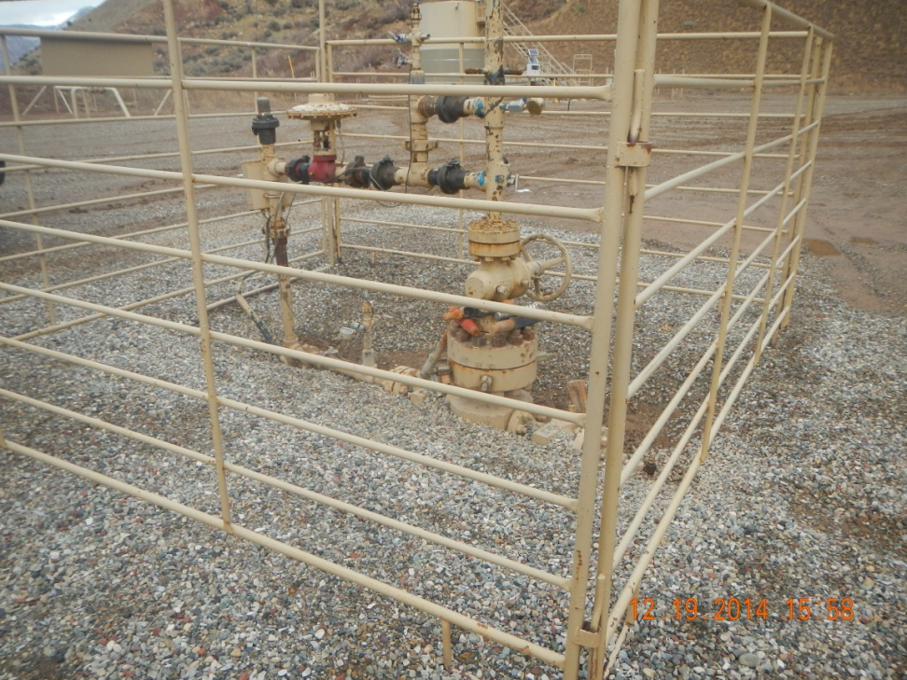
No visible Braden line

Slide 4
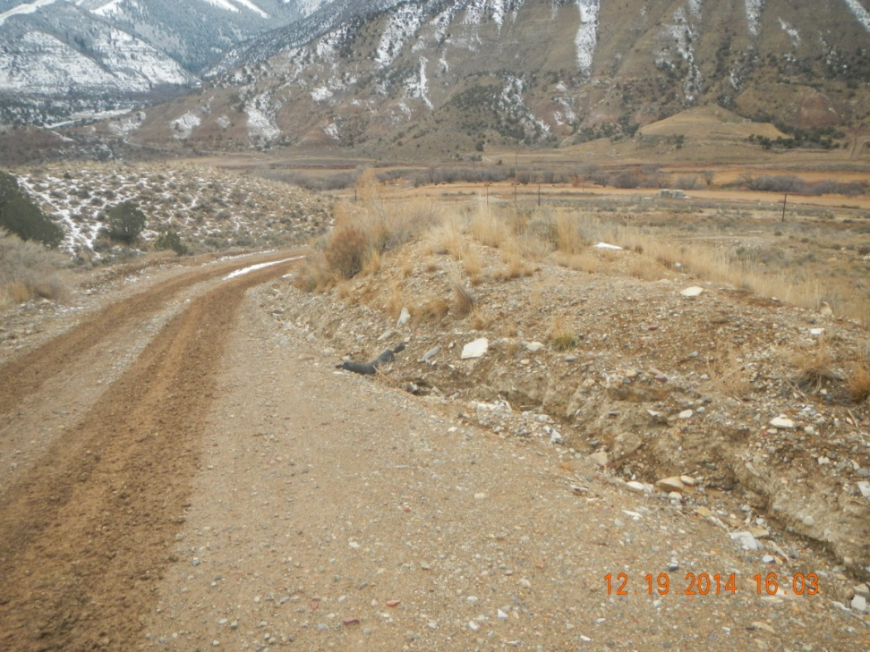
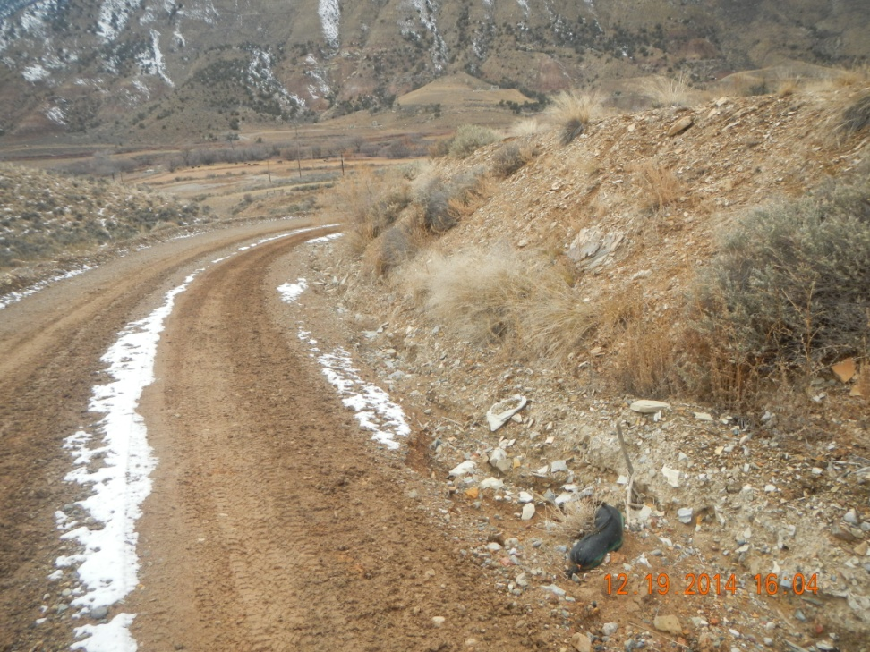
Eroding ditch

