Slide 1
WPX Energy
Location # 335116
AP 21-20-695

Slide 2
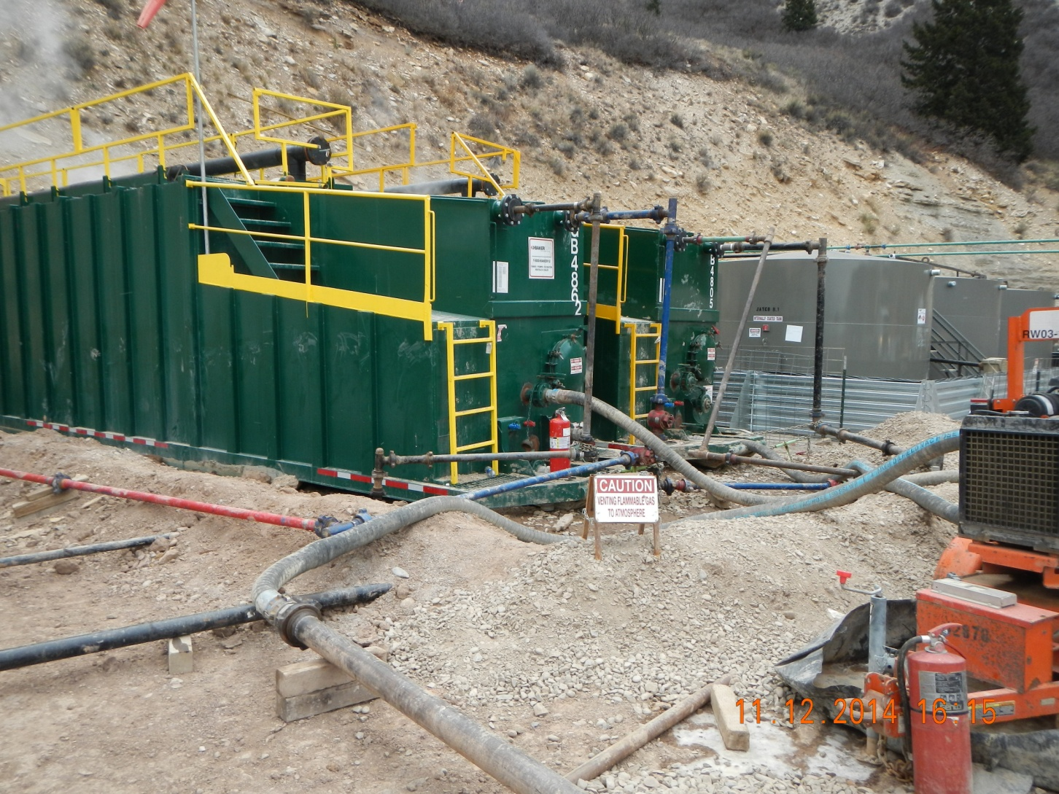
Flow Back Tanks

Slide 3
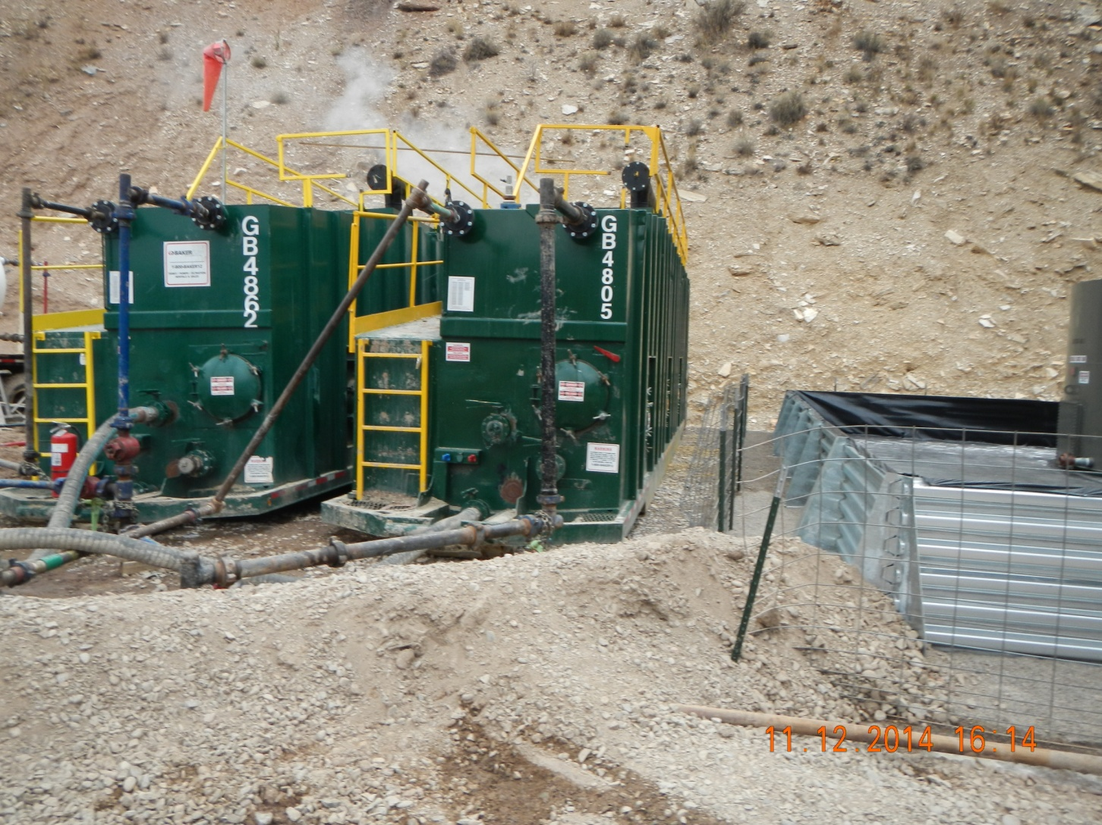
Dirt Berm to Metal Berm

Slide 4
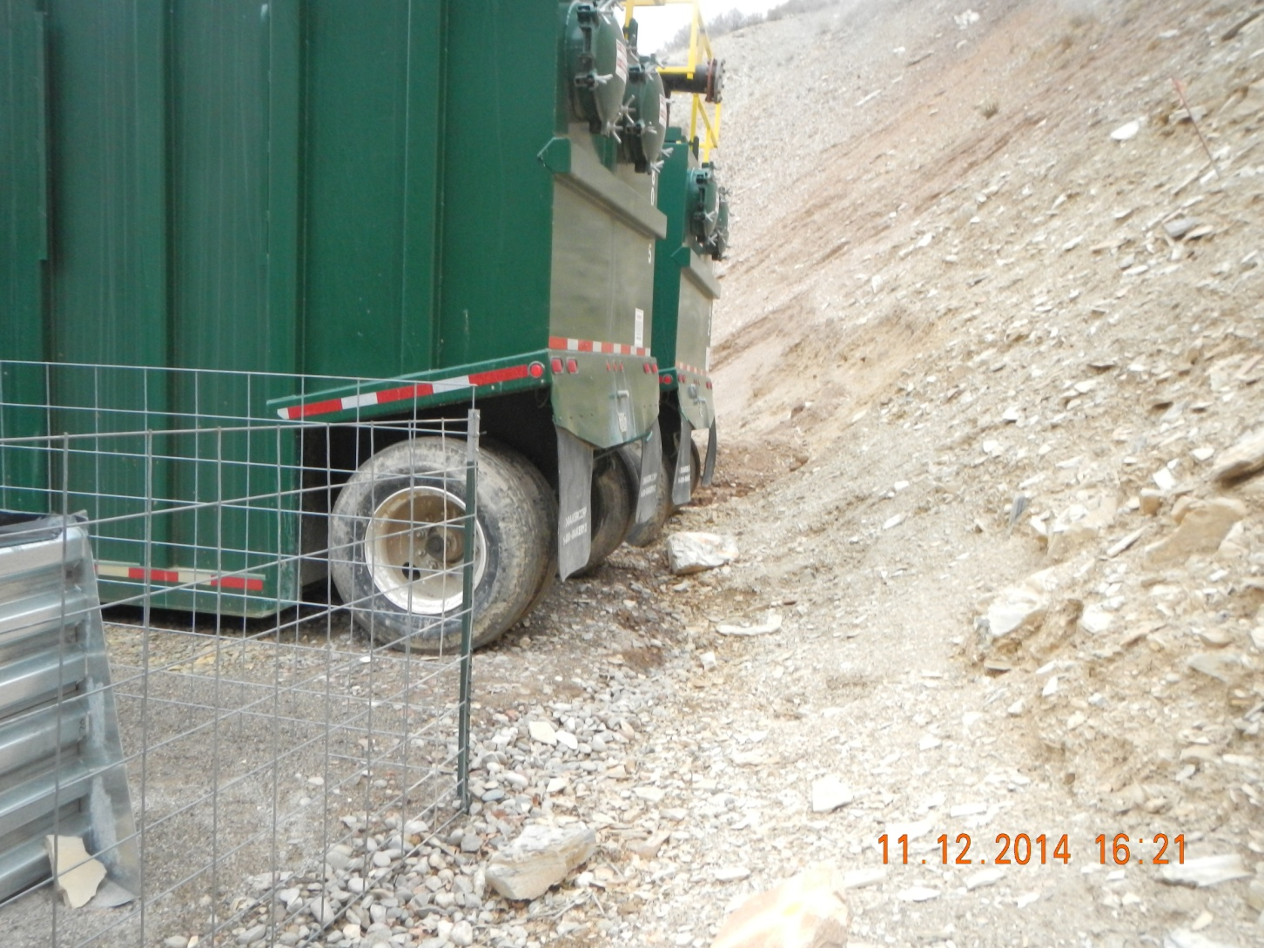
No Berm Wall after Metal Berm

