Slide 1
WPX Energy
Shell TR 41-6-697
Location# 324408
API. # 05-045-14092

Slide 2
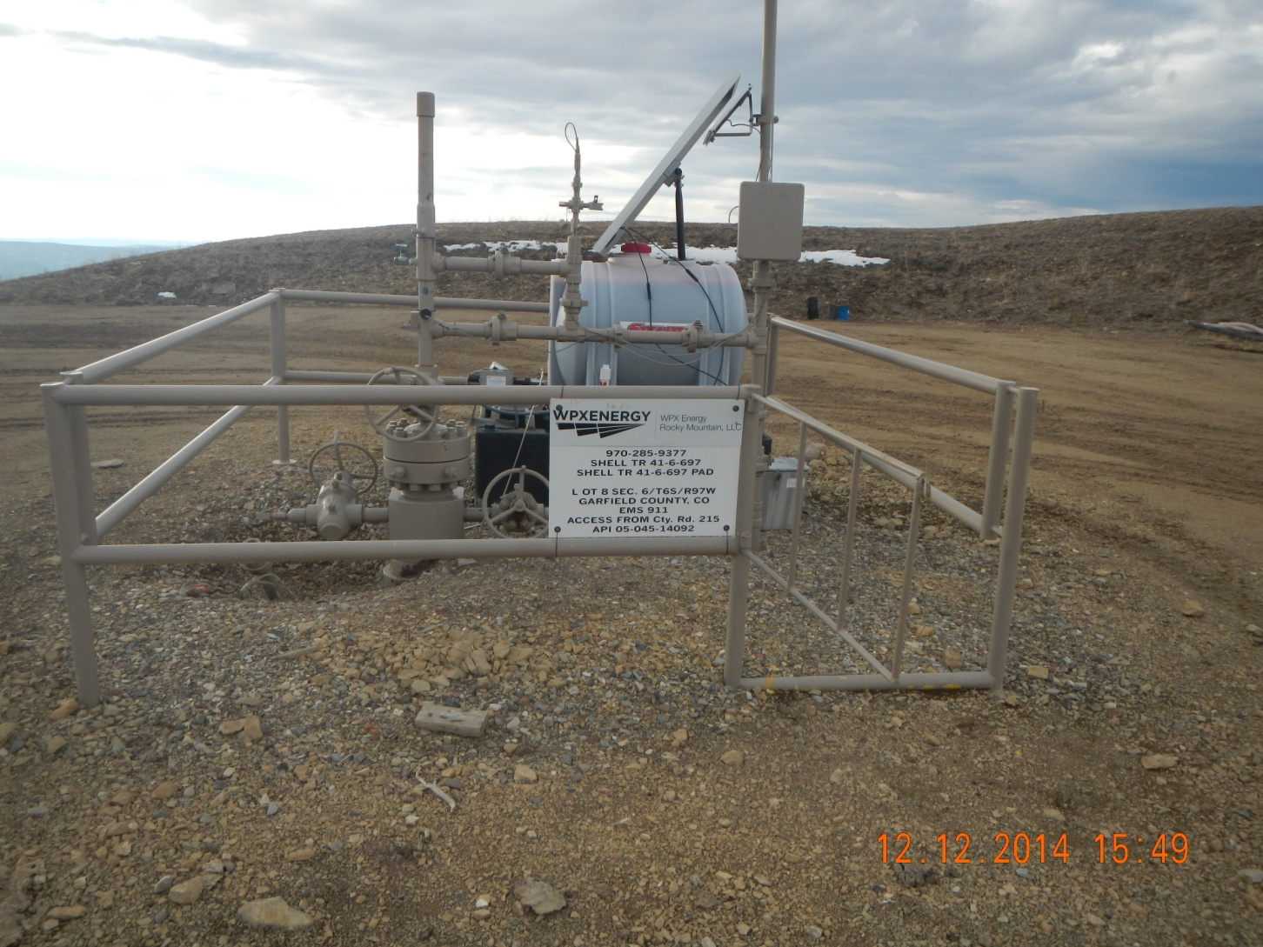
Well head

Slide 3
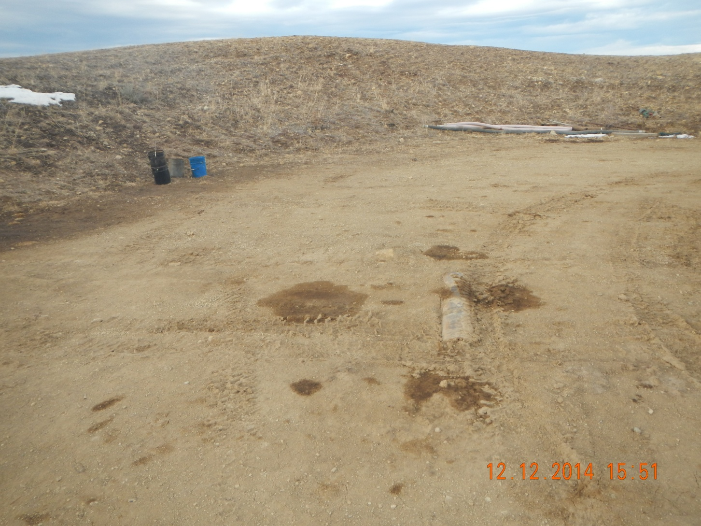
Stains on location Oily buckets and junk on edge of location

Slide 4
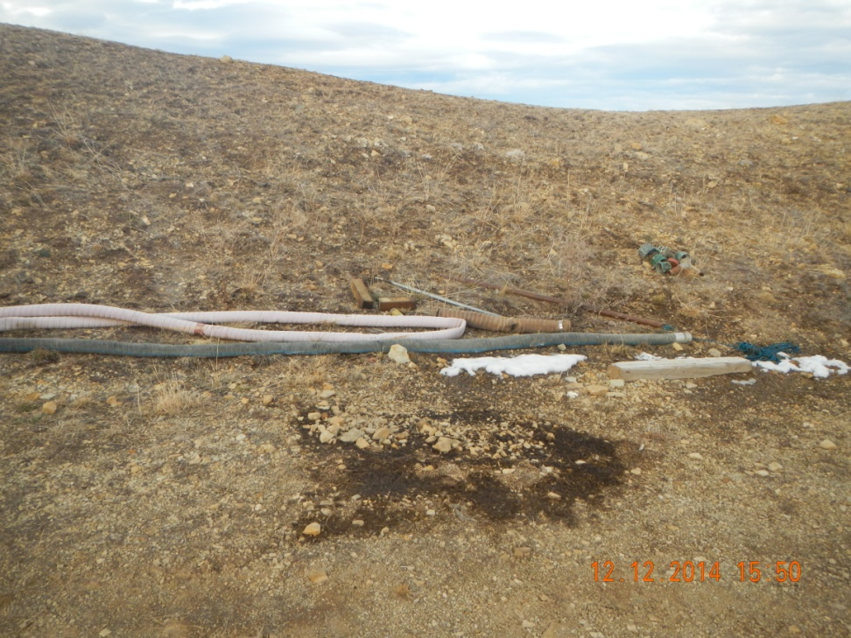
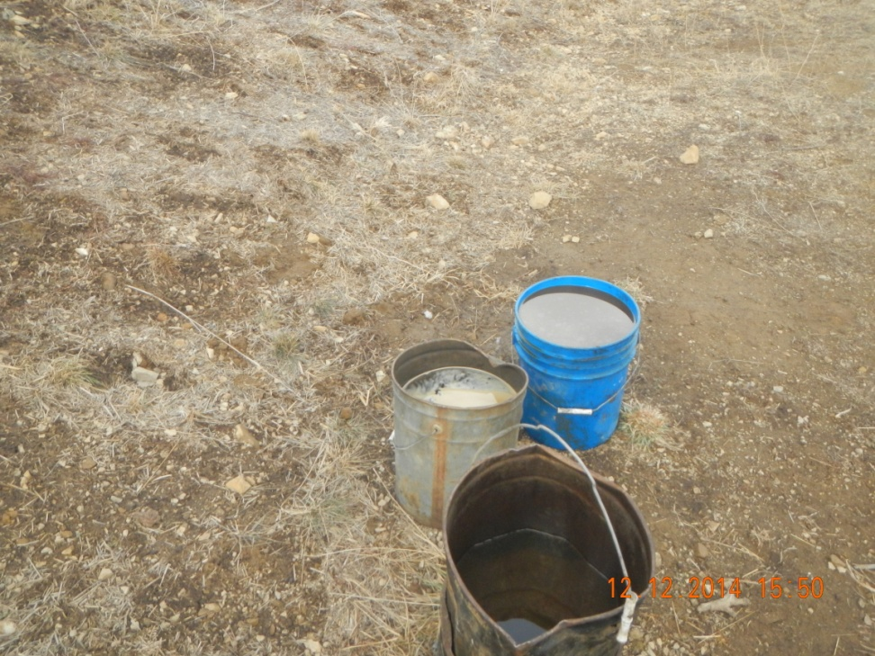
Junk and Uncontained and open oily water buckets

